Slide 1
Healthier Together NENC Pre-School Age Group Alex Battersby Healthier Together Clinical Lead

Slide 2
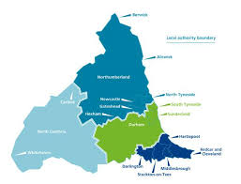
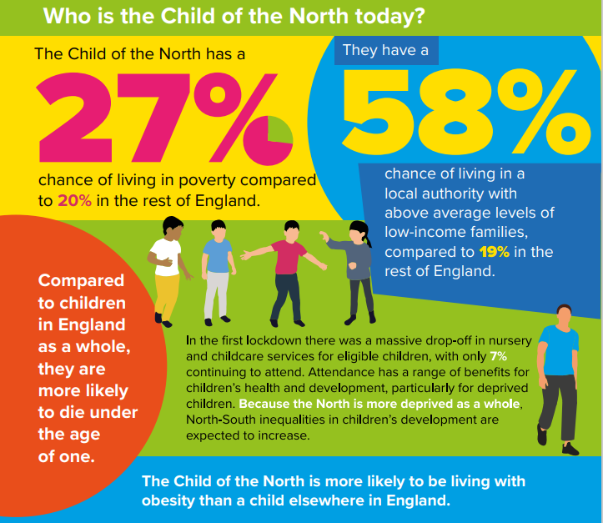
NENC Context
Children are c. 20% of our population (100% future)
Highest levels of child poverty in England
Reduced resource and capacity across healthcare workforce
Highest rates of childhood obesity in England
Highest rates of A&E attendances for 0–4-year-olds in England 22/23
Highest rates of asthma admission
Impact of pandemic
Equality Act - legal duty for programmes and organisations to make explicit consideration to age
Overcoming Challenges
Collaborative approaches with VCSE and Education to ensure reach into our most under-served communities
Effectively using data to target high prevalence areas to maximise resources effectively
System wide engagement to establish strong mutually beneficial relationships
Upskilling front line workforce

Slide 3
Network foundations and principles
Our shared vision
In the North East and North Cumbria we believe all children and young people should be given the opportunity to flourish and reach their potential, and be advantaged by organisations working together
What did the system want us to do
“Share good practice, drive work forward and connect us into experts and groups”

Slide 4
Network delivery and reach
Reach and partnership
Youth Board and Network groups to promote youth voice
3 Apprentices worked within our team
Network of advisors to support breadth of system
Over 30 huddles and Lunch & Learn sessions to share good practice
Attracted new funding into NENC – ARC, ACE,NHSCT
Membership of over 1900, weekly Child Health Tuesday
Twitter followers of over 2000 and Facebook more than 400 followers
Twitter reach of over 100,000 impressions in 2023
New innovations from new partnerships –iterative development to promote sustainability:
4th iteration of Poverty Proofing
3rd iteration of STAR
2nd iteration of YMHFA and Chris Drinkwater Awards

Slide 5
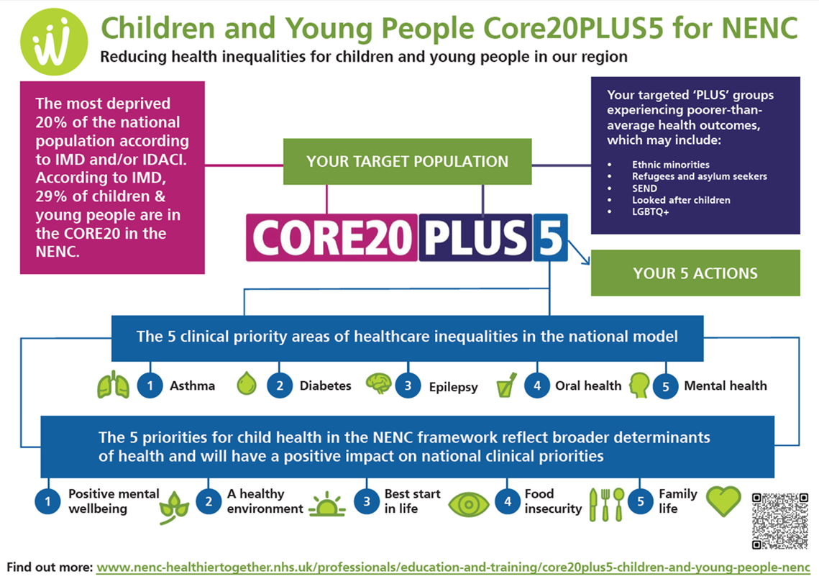
Network delivery and reach
Delivery Areas
CYP Transformation programme, Integration and CEW pilots (NHSE)
Asthma, Epilepsy, Transition and Diabetes focus & Mental Health Champions and
Paediatric Early Warning (PEW)
2 Clinics for Excessive Weight pilots established
integration Centre 3-year pilot – supportive environment to test and learn
Delivered the Tackling Inequalities in Children Programme (NHS Charities Together)
Youth MH First Aid, Poverty Proofing, South Tees ARts (STAR), Digital Apprenticeship
- NENC specific CYP Core20 Toolkit developed and launched (NHSE H&F)
Work with Healthier and Fairer delivering the national framework oversight
Asylum seeking health work focus
Developed a Sustainability Resource on Child Health
Delivered an Interactive film on Mental Health and Young Parents
Notes:
Deliver the CYP Transformation & Integration programme (NHSE)
Asthma, Epilepsy, Transition and Diabetes focus
Mental Health Champions and Paediatric Early Warning (PEW)
2 CEW Clinic pilots established
13 schools accredited as Beat Asthma Friendly
Healthier Together - over 7,000 children registered
VCSE partnership model to embed initiatives into our most underserved communities – over 43 organisations involved (and 58 Education settings)
Asthma - Primary Care to Secondary Care and Secondary Care to Tertiary Care pathway downloaded 2918 times & L1 and L2 Elearning for Health Asthma Training accessed by 1261 people
NENC specific CYP Core20 Toolkit developed and launched (NHSE H&F)
Work with Healthier and Fairer delivering the national framework oversight
Asylum seeking health work focus
Delivered the Tackling Inequalities in Children Programme (NHS Charities Together)
Over 500 trained in Youth MH First Aid
Over 1000 children been part of STAR initiative
Supported Poverty Proofing in 8 settings including dental and oral health
Delivered a Sustainability Resource on Child Health
Delivered an Interactive film on MH and Young Parents

Slide 6
Outline
Common conditions/presentations in pre-school children
Red flags for common presentations
When to refer on
How the Healthier Together website and mobile app can support professionals and parents with this

Slide 7
Conditions
Acute
Wheeze
Diarrhoea and Vomiting
Chronic
Cough and Wheeze
Lymphadenopathy
Abdominal Pain
Constipation
UTI
Sleep

Slide 8
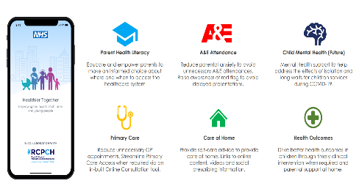
Healthier Together Website and Mobile App
Valued by both professionals and families alike as a platform to share information consistently across the whole healthcare system

Slide 9
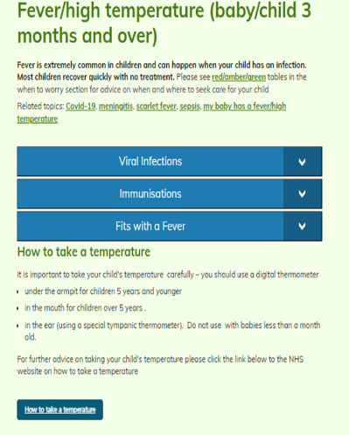
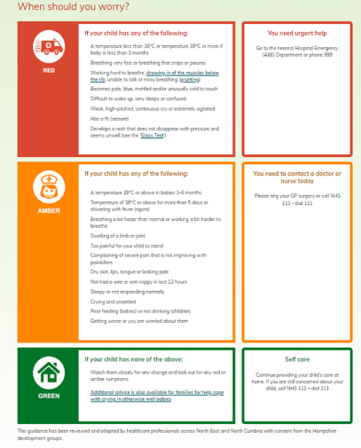
Traffic light system
Notes:
Reassure/empower parents
Reduce unnecessary PED attendance and encourage prompt attendance of sick children

Slide 10
Professional Resources
Professional resources
Community resources
Webinars
Referral Pathways

Slide 11
Viral Induced Wheeze
Very common in pre-school children
Single episode or recurrent
Some have features of atopy
Some develop interval symptoms

Slide 12
Acute Management
Trial salbutamol
Assess response in work of breathing
Always via a spacer
Assess technique
Steroids
Not indicated in the majority of patients
Consider in severe but should be presenting to hospital
Wheeze Management Plan
Available from beatasthma
Smoking Cessation in Parents

Slide 13
And then what?
Smoking Cessation advice!!
Red Flags
Recurrent admission for wheeze
Faltering Growth
Clubbing
Fixed Crepitations
Wet cough for 6 weeks or more persistently

Slide 14
Recurrent Episodes
Consider triggers
If there is Suspected Asthma:
Consider a trial of continuous ICS or Montelukast can be considered when there is poor cooperation with inhalers or poor compliance.
Trial of treatment: the duration of the trial will depend on the symptoms for which it was started.
Stop treatment.
Review and restart treatment only if symptoms recur and there was an initial benefit seen in step 1.
All children with suspected asthma should be seen annually to reinforce education
No response to treatment should be referred

Slide 15
Chronic Cough
Questions
Is this actually recurrent cough?
Is this post viral cough?
Is the cough wet?
Are there other pathologies involved?
Commonest Causes
Recurrent viral Infections
Up to 7-10 times per year often clustering in winter.
No further investigation or referral is required
Post viral cough
In infants can persist for up to a month
in school age children, cough associated with viral upper/lower respiratory tract infections mostly improve by 14 days (although it may sometimes take up to 8 weeks).
Notes:
infectionsThe commonest cause of chronic cough lasting over 8 weeks (in a child who is thriving/well/no systemic signs or symptoms) remains, so ask “has your child coughed every single day, or has their cough got better and worse again

Slide 16
Red Flags
persistent daily cough (>8 weeks duration) especially if worsening or wet
systemic features (such as weight loss; night sweats; persistent fever; clubbing);
poor weight gain
haemoptysis
neonatal onset
cough with feeding

Slide 17
Other pathologies
Early onset asthma (assess for triggers, atopic history, wheeze, shortness of breath)
Aspirated foreign body (suggestive history; persistent focal signs)
Post-nasal drip (history of atopy; nasal congestion)
Gastro-oesophageal reflux (suggestive history)
(rarely) serious pathology such as cystic fibrosis, tuberculosis or immune deficiency

Slide 18
Diarrhoea and Vomiting

Slide 19
Red Flags
Alternative diagnosis
Systemically unwell
Bilious vomiting
High Fever

Slide 20
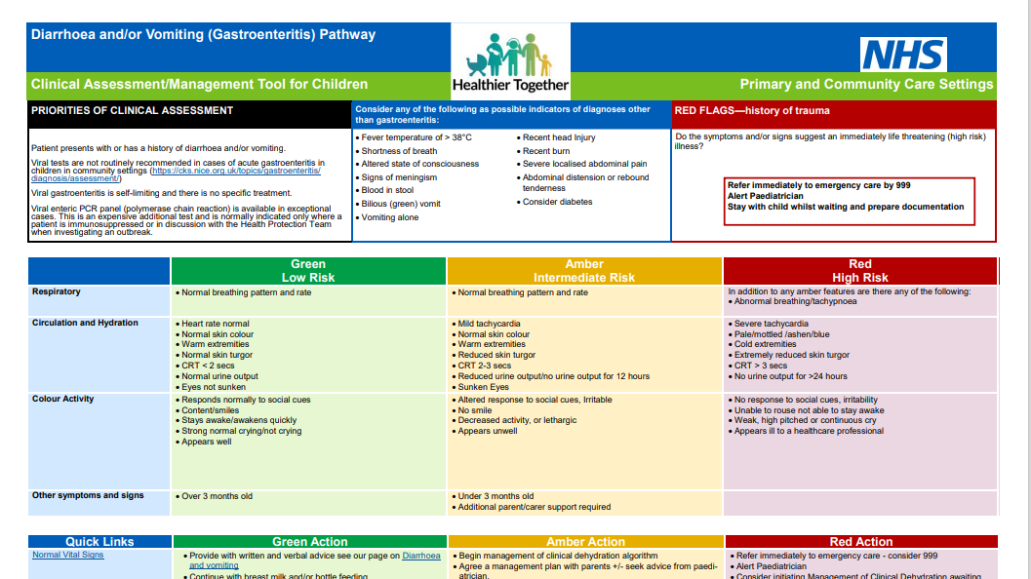

Slide 21
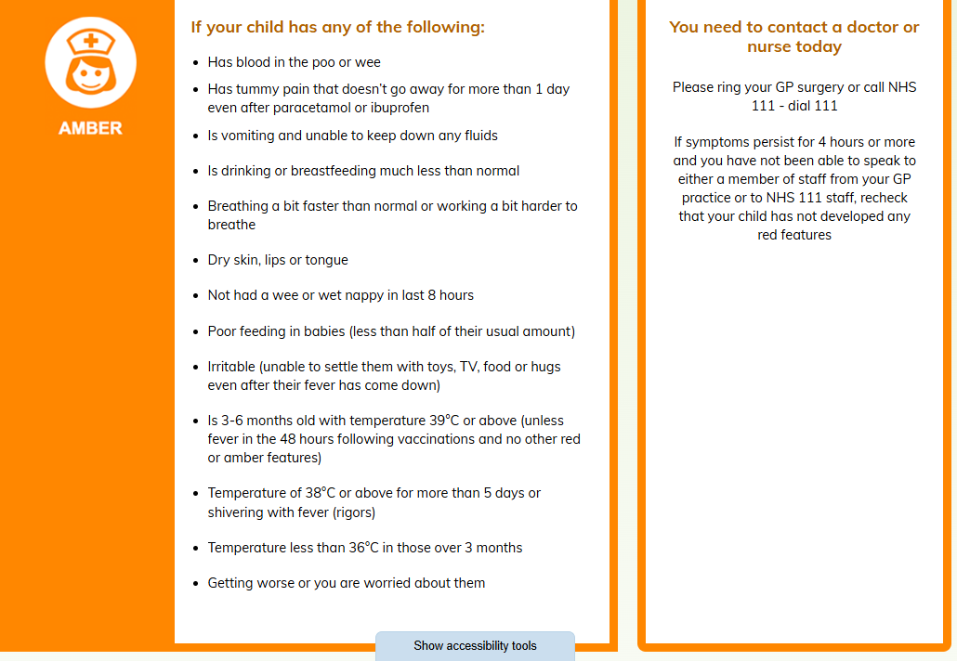

Slide 22
Lymphadenopathy
Common
More persistent
Reassuring Features
Soft, mobile
<2cm
Recent viral infection
Eczema

Slide 23
Lymphadenopathy
Red Flags
Larger than 2 cm and growing
Associated Symptoms
Weight Loss
Unusual Pain/Itch
Prolonged fever
Examination findings
HSM
Supraclavicular or Popliteal

Slide 24
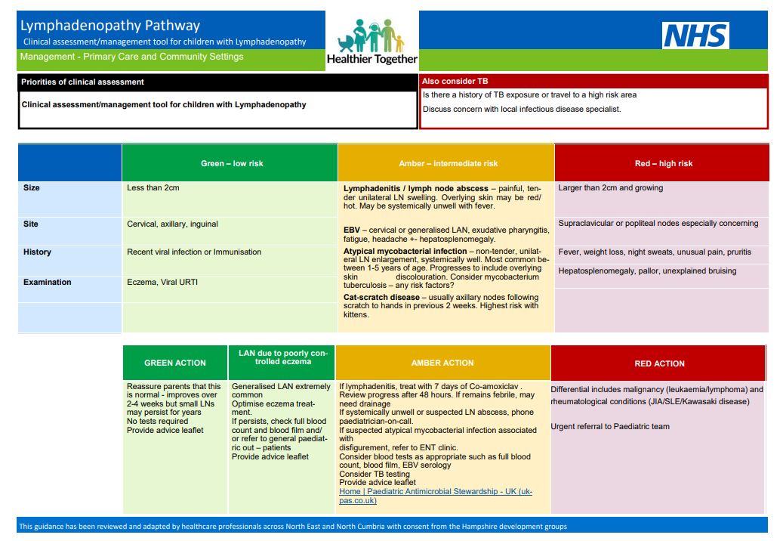

Slide 25
Tummy Ache

Slide 26
Acute Red Flags

Slide 28
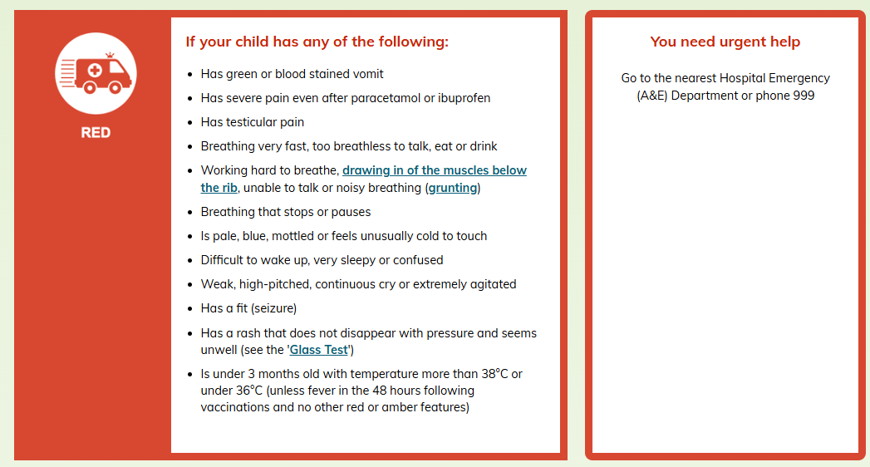
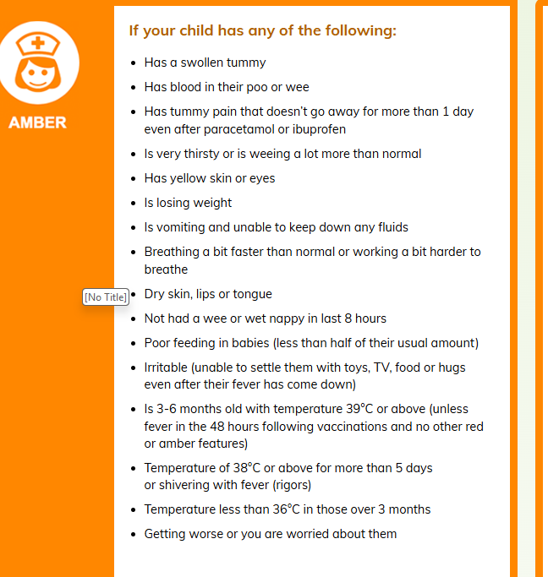
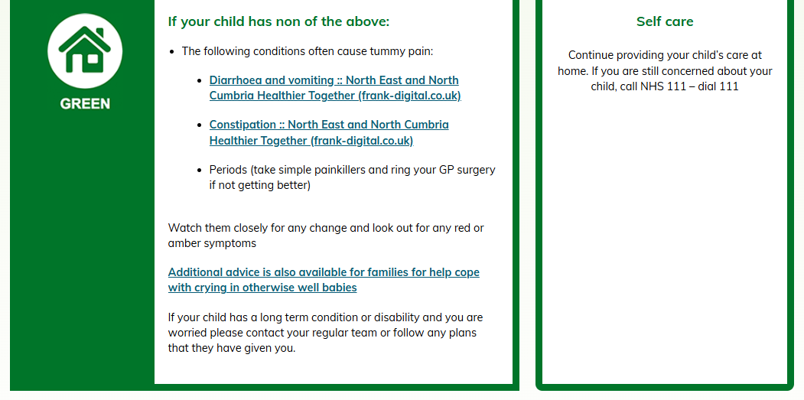

Slide 29
Chronic Tummy Pain

Slide 30
Non Specific Abdominal Pain
Functional Abdominal Pain

Slide 31
Features
Peri-umbilical or central
Child over 3 years
Thriving
Can interrupt activities
Recurrent and or persistent/intermittent

Slide 32
Red Flags
weight loss
melaena or fresh blood in stools;
persistent diarrhoea
child is being woken from sleep by pain and/or by the need to open their bowels.

Slide 33
Tests NOT to do
Faecal Calprotectin
Faecal calprotectins are naturally much higher in this age group
We do not recommend routine testing
Early onset inflammatory bowel disease in this age group presents with true colitis features
H Pylori
asymptomatic colonisation common without any issue and
we do not advise routine blanket testing or treatment in the absence of a significant history of gastritis symptoms/epigastric pain.

Slide 34
Management
Exclude Constipation
Consider Coeliac Disease
Reassurance

Slide 35
Constipation
If you look you will find it
Common presentations
Soiling
Recurrent UTI
Non Specific Abdominal Pain
Loose stool or diarrhoea

Slide 37
Common Pitfalls
Not treating for long enough
Not adding a stimulant
Not tolerated
Not using maintenance

Slide 38
Red Flags
constipation from birth/neonatal period;
failure/delay in passing meconium > 48hrs;
weakness in legs/locomotor delay;
abdominal distension + /-vomiting;
abnormal appearance of anus (do not do a PR);
abnormal examination of spine;
abnormal neuromuscular signs or reflexes; or
persistent constipation not responding to maximal doses of laxatives

Slide 39
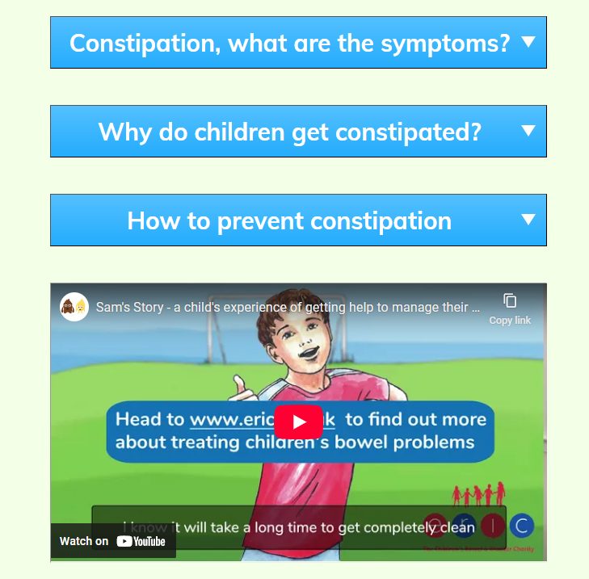

Slide 40
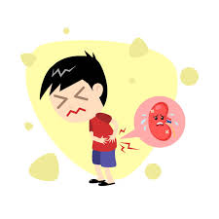
Urinary Tract Infection

Slide 41
Diagnosis
Sample Collection
Alternative Diagnosis
Clinical Symptoms

Slide 42
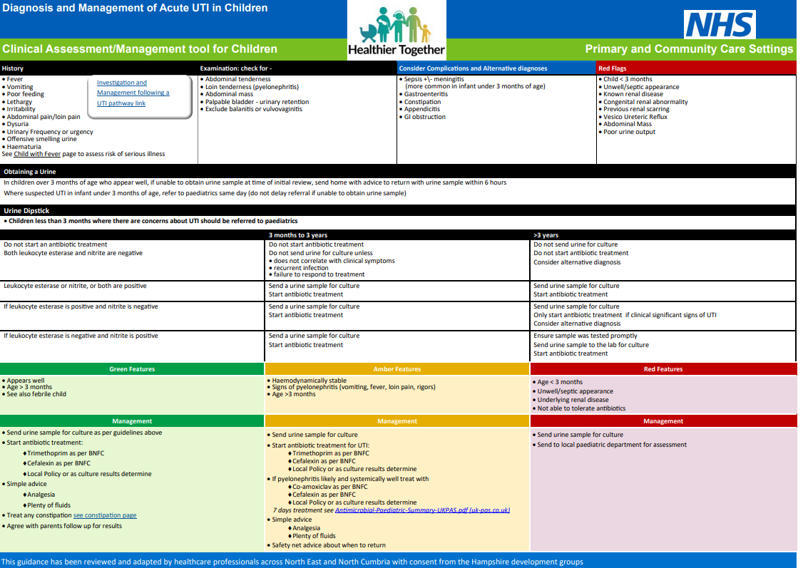
Management - Acute

Slide 43
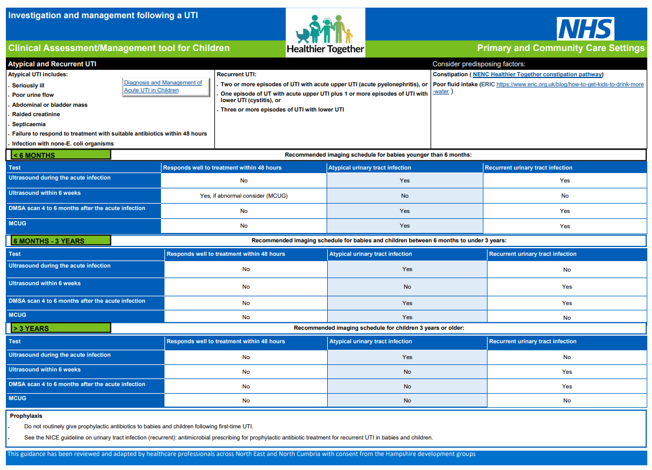
Following a UTI

Slide 44
Sleep

Slide 45
Common referral
Primary sleep not seen in outpatients
Impact
Resources

Slide 46
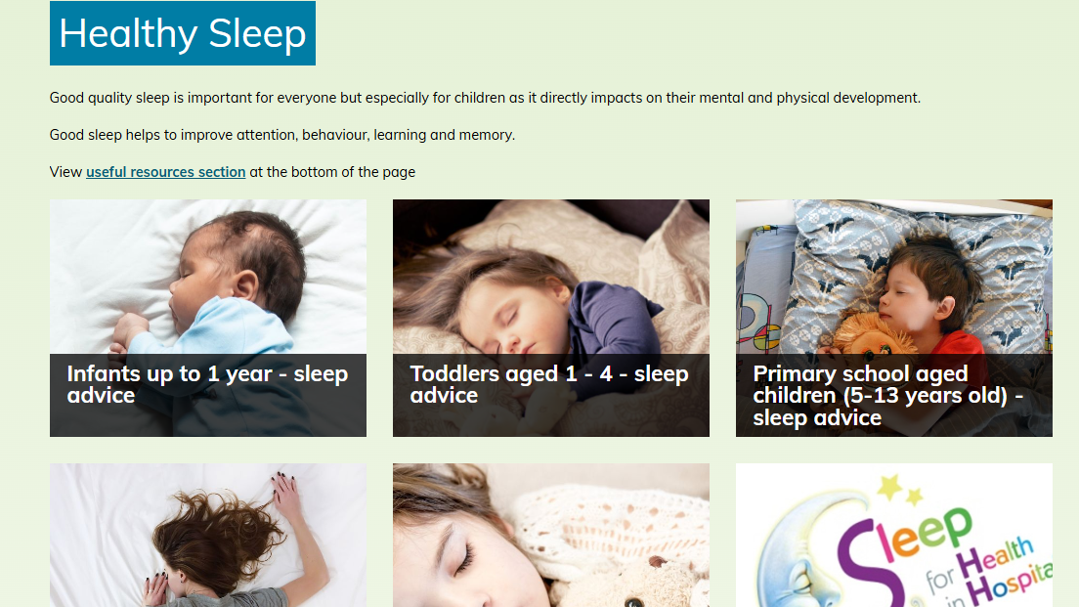

Slide 47
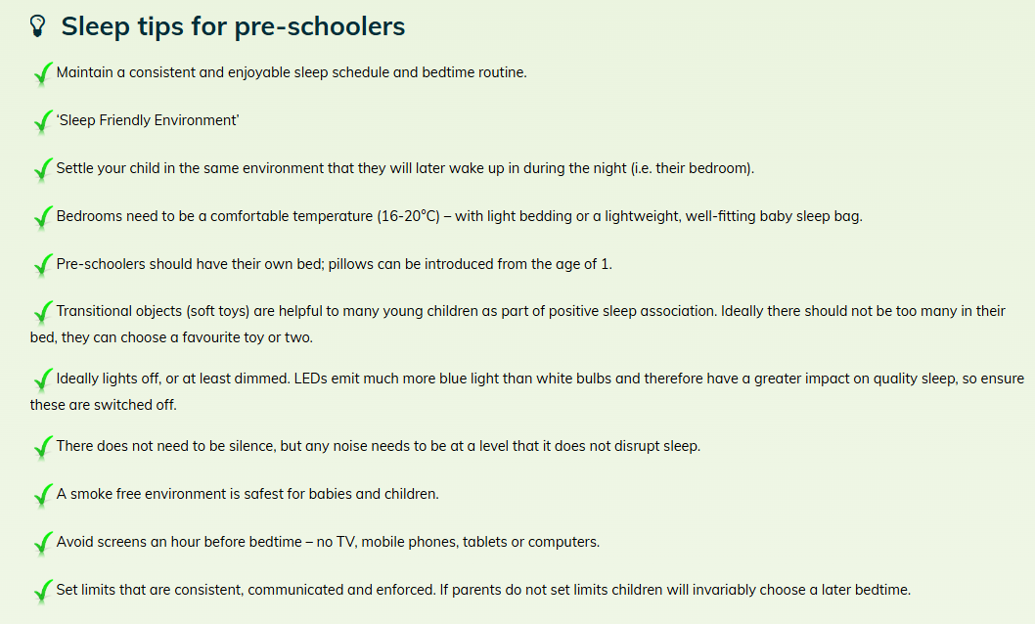

Slide 48
Any Questions?

