Slide 1
Child Health and Wellbeing Network
Primary Care: Epilepsy
Louise Dauncey
Network Delivery Manager - CYPT
Notes:
ADD LD NETWORK LOGO
Hello everybody
It gives me great pleasure to welcome you to our jointly developed Webinar about paediatric epilepsy for colleagues from Primary Care.
Thank you so much for joining us at this session. Im going to lead off straight away because we have got an exciting and full agenda.
Colleagues may continue to join us
Just to advise that this session will be recorded to enable us to make this available on healthier together following the event
A few points of housekeeping if I may:
Please can participants stay on mute throughout the session unless you are actively taking part in discussion, we are a sizeable group this evening and this will help with bandwidth
Can we ask that participants do not attempt to take control or move the slides along, speakers will move through the slides as they work through the content. We will of course share the slides and resources widely following the event and will collate the questions that have been asked and responses that have been given for wider sharing.
Please can we ask participants to introduce themselves in the chat and identify the Practice/PCN and geography that they represent so that we can get an understanding of reach for the session.
Do feel free to use the chat facility throughout or raise your hand during the opportunity for questions/discussion at the end of the session. Please note that we will be sharing this recording and details of the discussions so just a polite reminder to participants about confidentiality when discussing practical application
Expert colleagues will be responding to the chat facility throughout.
By way of introduction then, my name is Louise Dauncey and I am CHWN Network Delivery Manager and my main role and responsibility is to lead delivery of the CYP Transformation programme here in the North East and North Cumbria.
Im here on behalf of the Child Health and Wellbeing Network and the NENC ICS Epilepsy Leadership Group and I am delighted to be here alongside my colleague Emma Cheetham from the NENC Learning Disability Network, who will provide a brief introduction shortly.
NEXT Slide

Slide 2
Outline
Background and context
Child Health and Wellbeing Network overview
Learning Disabilities Network overview
NENC Paediatric Epilepsy Leadership Group
Epilepsy Action – available support
Education session
What is Epilepsy and aetiology
Seizures and Triggers
Medication and Contraception
Other treatments
Safety advice
SUDEP
Transition
Mental Health and the impact of Epilepsy
What can GPs do
Support available
Discussion / questions

Slide 3
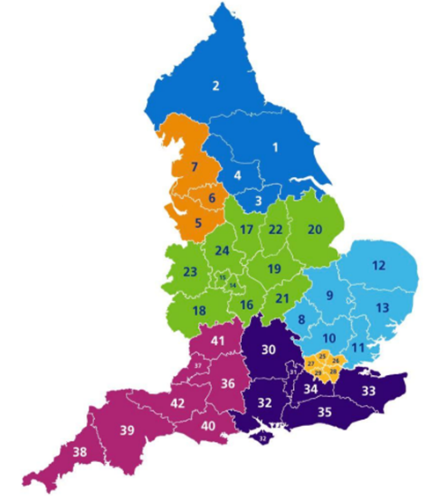
NENC ICS Footprint
 | Age 0-17 | Age 17+ | All Ages
North East and North Cumbria ICB (QHM) | 580,613 | 2,536,999 | 3,117,612
Northumberland (00L) | 50,848 | 239,831 | 290,679
North Tyneside (99C) | 42,697 | 181,113 | 223,810
North Cumbria (01H) | 52,098 | 241,203 | 293,301
Newcastle & Gateshead (13T) | 99,290 | 455,325 | 554,615
South Tyneside (00N) | 30,302 | 131,448 | 161,750
Sunderland (00P) | 55,263 | 242,314 | 297,577
County Durham (84H) | 103,024 | 469,530 | 572,554
Tees Valley (16C) | 147,091 | 576,235 | 723,326
Data Source – NECS BI Team 07.10.24
Notes:
I wont go into detail on this slide but this just provides some local context about our local population and also gives an indication of the size of our geography
The map on the right shows the 4 area ICPs and marks out the 13 local authority boundary areas that we operate across
This includes 13 LAs, 13 LEAs, 13 PH authorities, 8 acute trusts, 3 ambulance services and numerous PCNs
We operate across wide geography and diverse population with wide ranging socio-economic challenges
You will be aware of the Core 20 plus 5 framework and the recognition of epilepsy as a clinical area of additional vulnerability

Slide 4
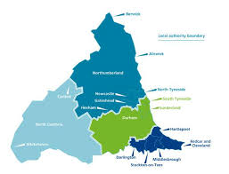
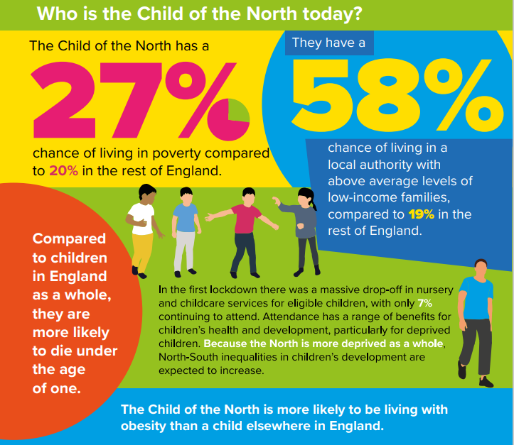
NENC Context
Children are c. 20% of our population (100% future)
Highest levels of child poverty in England
Reduced resource and capacity across healthcare workforce
Highest rates of childhood obesity in England
Highest rates of A&E attendances for 0–4-year-olds in England 22/23
Highest rates of asthma admission
Impact of pandemic
Equality Act - legal duty for programmes and organisations to make explicit consideration to age
Overcoming Challenges
Collaborative approaches with VCSE and Education to ensure reach into our most under-served communities
Effectively using data to target high prevalence areas to maximise resources effectively
System wide engagement to establish strong mutually beneficial relationships
Upskilling front line workforce
Notes:
I wont labour this slide but wanted to highlight the local levels of relative poverty and our challenges here in the NENC
As a professional working in this area I am sure you will be well aware of the socioeconomic challenges locally and the impact of this on health and other outcomes for our populations as a whole
Highlighted here are the highest levels of poverty in England and some of the suggested ways that we are seeking to overcome challenges including collaborative working across the system, targeting resource and upskilling frontline work force

Slide 5
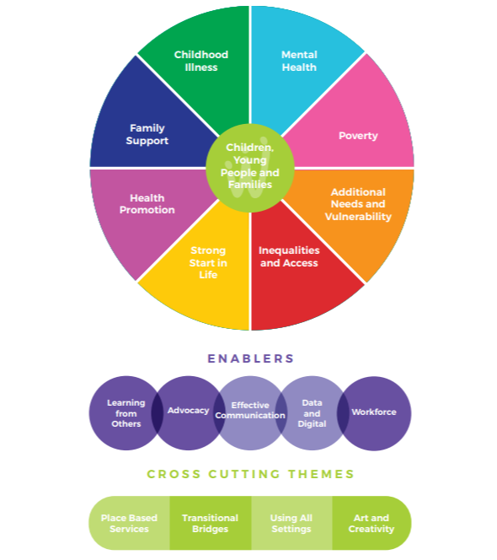
Child Health and Wellbeing Network
Our vision
In the North East and North Cumbria we believe all children and young people should be given the opportunity to flourish and reach their potential, and be advantaged by organisations working together
What do you want us to do
“Share good practice, drive work forward and connect us into experts and groups”
Join the Network
Notes:
The NENC CHWN has a series of priorities that have been determined by initial consultation which are portrayed here in the colourful wheel on the left hand side
These areas will not be a surprise to colleagues given what we know about the levels of deprivation in our area
Within these priorities the CHWN has a growing role in relation to the CYPT agenda – particularly in relation to additional needs, vulnerability and childhood illness
The CHWN has an overriding vision which holds CYP at the centre of all we do and the mission statement here outlines our belief that CYP should be given opportunities and that this should be enables by systemwide partners working cohesively. Our role within the Network is about sharing good practice and driving improvement and enabling platforms for connection. Our network is growing and has broad representation from across the childrens workforce, we currently stand at about 2000 members
Within the work of the network we have a broad range of programmes including Youth Voice, Healthcare Inequalities and Core 20, Communication and Engagement, CYPT Integration Centre and the local delivery of the CYP Transformation programme
I am going to hand now to Emma who will briefly introduce herself and the NENC LD Network – thanks Emma – over to you

Slide 6
The North East & Cumbria Learning Disability Network
Our vision: The North East & Cumbria will be the best place in England to live if you have a learning disability and or autism
Our mission: To tackle Health and Social Care inequalities faced by people with a learning disability & or autistic people
Our values: People with a learning disability and or autistic people and their families will be at the centre of our work.

Slide 7
The North East & Cumbria Learning Disability Network
Established 2010. Part of the North East North Cumbria Integrated Care Board
Multi stakeholder network working with leaders across health, social care & the community voluntary sector
Our work programme focuses on tackling health inequalities
Work collaboratively as a region. Local areas then adopt and adapt to suit local needs.
We are about innovation & creative thinking across the system to improve people’s lives

Slide 8
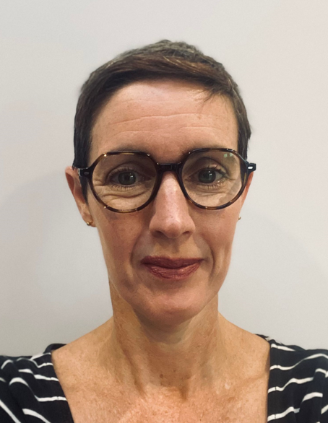
NENC – Paediatric Epilepsy Leadership Group
Dr Ramesh Kumar
Consultant Paediatrician
JCUH
NENC Epilepsy Clinical Lead
Dr Dina Jayachandran
Consultant Paediatrician CDDFT
PENNEC Chair
Louise Dauncey
Network Delivery Manager
CHWN
CYPT Delivery Lead
Sophie Gilmour-Ivens
Paediatric Epilepsy Nurse NHCT
Regional Strategic ESN Lead
Notes:
Thanks for that brief overview Emma
In relation to the NENC Paediatric Epilepsy Leadership Group
We are a small team who have worked together since 2021 and have delivered a whole programme of work associated with Paediatric Epilepsy, a few examples include
we have established a multi agency Alliance group to support with oversight and to operationalise service improvement
we have undertaken a series of quality improvement projects within paediatric epilepsy
We are continuing working with colleagues and services to increase clinical capacity.
We have also worked with the RCPCH to deliver an interactive Innovation Lab day, to involve young people in discussions about epilepsy care
More recently we have been working with colleagues from the NENC Learning Disabilities Network and have taken a collaborative approach to managing transition for epilepsy patients from paediatric healthcare services to adults services – In May we collaboratively delivered a face to face education and sharing session focussing on healthcare transition for epilepsy patients
The National Paediatric Epilepsy Bundle was released in October 23 and we are undertaking localised service improvement with the acute services in line with the bundle requirements.
Dr Kumar is our NENC Clinical Lead for Paediatric Epilepsy
Dr Jayachandran is the Chair for the PENNEC – Paed Epilepsy Network North East and North Cumbria
Sophie Gilmour Ivens – is our Regional Strategic Paediatric ESN Lead
Dr Kumar, Sophie, Emma and I are joined by Sarah Bennison AND DR AMANDA BOARDMAN for this session all of whom who will be available in the chat to support with responding to questions from participants during the session and as part of the questions session at the end. We are also lucky to be joined by Leah Norton from Epilepsy Action also who will say a few words about their available resources also be available as part of the chat.
I will hand now to Amanda Boardman to say a few words of introduction
Thanks, over to you Dr Boardman
NEXT Slide

Slide 9
Dr Mandy Boardman Clinical Lead in North Cumbria local delivery team for the ICB Amanda.boardman@nhs.net North East and North Cumbria ICB

Slide 10
WE SAY GO.

Slide 11
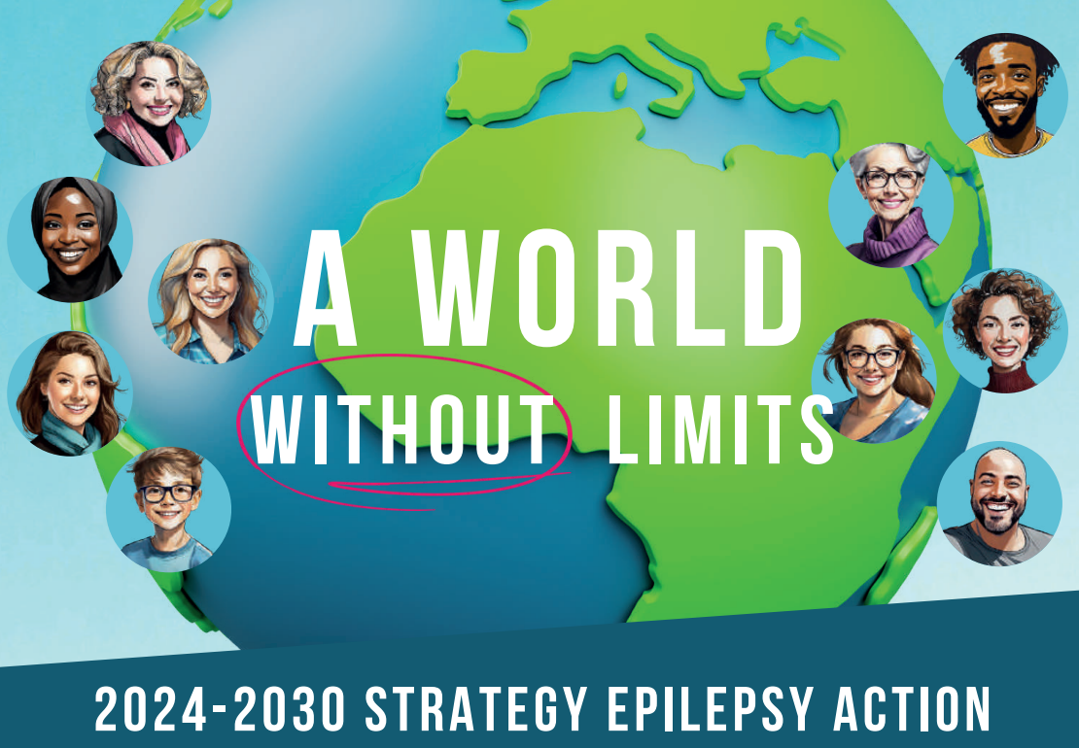
Who are Epilepsy Action?
UK-wide charity supporting the 630,000 people living with epilepsy in the UK
Ambitions:
Improve the lives of everyone with epilepsy
Raise public understanding of epilepsy
Be fully inclusive of everyone

Slide 12
Resources- for you
Free training module for primary care nurses
Template care plans and seizure diaries
Drugwatch- medicine shortages
Printable health information
Resources available to order
Advice for professionals available through our helpline

Slide 13
Resources- for your patients
Huge amount of information on our website
Helpline
Talk & Support groups- online and in person
Befriending
Free online training for people with epilepsy and carers
Children’s resources
Support for parents/carers

Slide 14
Epilepsy
Sophie Gilmour-Ivens | Sarah Bennison
Paediatric Epilepsy Specialist Nurse Strategic Lead | Paediatric Epilepsy Specialist Nurse Newcastle upon Tyne Hospitals NHS Foundation Trust

Slide 15
What is Epilepsy (The Epilepsies)?
Epilepsy is a condition defined by a person having at least two unprovoked seizures occurring >24 hours apart; the probability of further seizures occurring over the next 10 years and / or diagnosis of an epilepsy syndrome.
(ILAE, 2014)
In UK approximately one in every 200 children has a diagnosis of epilepsy.
(Young Epilepsy, 2023)
Notes:
When we think about the UK population as a whole, approximately 1 in 100 people has epilepsy; and 1 in 200 school-aged children have a diagnosis of epilepsy.
And I’ve put ‘The Epilepsies’ in brackets because of the diversity of types and causes, and the fact that we need to remember that it’s not a single condition.

Slide 16
Co-morbidities
Seizure types
Etiology
Focal
onset
Generalized onset
Unknown onset
Structural
Genetic
Epilepsy types
Infectious
Focal
Generalized
Combined
Generalized
& Focal
Unknown
Focal
Metabolic
Immune
Unknown
Epilepsy Syndromes
Notes:
This shows an overview of how we think about epilepsy: the causes, the different ways we classify seizures and the potential comorbidities that are associated with epilepsy; and I’m going to expand upon these in the next few slides.

Slide 17
Aetiology
Structural: Hippocampal sclerosis, brain tumours, malformations of cortical development, vascular malformations, glial scarring (including stroke and traumatic brain injury)
Genetic: Monogenic aetiology (SCN1A) or polygenic basis (GGEs)
Infectious: Bacteria, viruses, fungi and parasites
Metabolic: Genetic (inborn) or acquired
Some are treatable (GLUT1 transporter deficiency and pyridoxine-dependent seizures)
Immune: Some are treatable (NMDAR-antibody encephalitis)
Neurodegenerative: Down’s Syndrome and Alzheimer’s disease
Unknown
Notes:
Anything that alters the structure of the brain, whether it is developmental or acquired, can give rise to seizures.
We know that some epilepsy syndromes are caused by mutations in a single gene: Mutations in SCN1A and SCN1B cause Dravet Syndrome and Genetic Epilepsy with Febrile Seizures Plus; and mutations in PCDH19 are associated with epilepsy, predominantly in girls who can have multiple seizure types, there can be associated intellectual disability, psychiatric comorbidities and some of these girls will have ictal apnoea.
Whereas the Genetic generalised epilepsies like Childhood absence epilepsy, juvenile absence epilepsy, juvenile myoclonic epilepsy and epilepsy with generalised tonic clonic seizures alone, are thought to have a polygenic basis, and there is ongoing research that suggests that single genes could be implicated in some of the GGEs, such as SLC2A1, which causes GLUT1 transporter deficiency but may also have a role to play in Juvenile absence epilepsy.
Infection is probably the leading cause of epilepsy worldwide and is the most common cause in the developing world, where infections like malaria and TB are more common.
GLUT1 is an inborn error of metabolism which causes epilepsy and seizures are also caused by acquired metabolic issues such as hypo or hyperglycaemia.
Autoimmune epilepsy is caused by a change in the body’s immune function, and this can be due to Autoimmune encephalitis, or another autoimmune condition such as Lupus or Crohn’s disease.
There are neurodegenerative conditions like Batten Disease which is an umbrella term for several different genetic, life-limiting diseases that share similar features; and Alpers-Huttenlocher Syndrome which is caused by mutations in the POLG gene, which have epilepsy as part of them; and epilepsies where no cause can be found, fall into the ‘Unknown’ category.

Slide 18
What is an Epileptic seizure?
A Seizure is a transient occurrence of signs or symptoms due to abnormal excessive or synchronous neuronal activity in the brain.
(Fisher et al, 2017)
Seizures can manifest as a disturbance of consciousness, behaviour, cognition, emotion, motor function, or sensation.
(Krishnamurthy, 2016; Fisher et al, 2017)
Notes:
I like these definitions as they capture the entirety of the breadth of seizure presentations, and there are 60 different types of seizures.

Slide 19
Notes:
Epileptic seizures are categorised by where in the brain they start, and can be described as ‘focal’, ‘generalised’ or, for seizures with inadequate information or an inability to place elsewhere, ‘unknown’

Slide 20
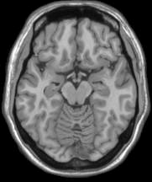
Focal seizures
Originate within networks limited to one hemisphere
May be discretely localized or more widely distributed.…
Notes:
Focal seizures are seizure that start in one lobe of the brain.
Because each part of the brain is responsible for a different function, how the seizure presents will depend upon which part of the brain it starts in.
For example, the occipital lobe at the back of the brain, is responsible for vision therefore if you have a focal seizure in that area, you may see flashing lights, colours or simple patterns, and you could have temporary loss of vision
Motor features are prominent with frontal lobe seizures, so you may see a Fencing posture, Pelvic thrusting, kicking, pedalling, Head and eye deviation, but there can also be Screaming, swearing, or laughing
Parietal lobe seizures involve sensation: and this could be Paraesthesia or numbness, and less commonly, Pain and thermal perception change.
And temporal lobe seizures, which are the most commonly-seen focal seizures, can involve symptoms like déjà vu, auditory or olfactory hallucinations, a churning or rising feeling in the stomach, or repeated swallowing or chewing.
We try to ‘say what we see’ with seizures therefore focal seizures are either described as ‘Focal aware’ seizures, where there is no change in the person’s awareness; or ‘Focal impaired awareness’ seizures where, as the name suggests, there is a change in the person’s level of awareness. They might be able to hear you, but not fully understand what you say or they may not be able to respond to you. They may not react as they would normally.
We also describe focal seizures as motor or non-motor seizures:
Motor seizures, as the name suggests, are seizures involving movements such as jerking or repeated movements, like lip-smacking, swallowing or picking movements.
Focal non-motor seizures are when the main symptoms don’t involve muscles. They can include things like changes in emotions, thinking and sensations; and examples of this would be:
Experiencing deja vu or jamais vu (which is when the person having the seizure doesn’t recognise something or someone that should be familiar to them).
a sudden intense feeling of panic, fear or joy
a feeling of numbness or tingling
And as I said before, what happens will depend upon which area of which lobe of the brain the seizure has occurred in.
20

Slide 21
Focal to bilateral tonic clonic seizure
When a focal seizure spreads to involve wider brain networks, this is known as a ‘focal to bilateral tonic-clonic seizure’ and the resulting seizure will have tonic (stiff) and clonic (rhythmical jerking) features
Notes:
When someone has a focal seizure, and the seizure activity does not remain confined to the lobe in which it starts but spreads to bilateral cerebral networks, this is known as a focal to bilateral tonic clonic seizure.
Sometimes the spread in brain networks may be so rapid that no preceding focal seizure type is identified, and the child can be admitted with what is thought to be a generalised seizure but has actually been a seizure with focal onset, and this requires careful history-taking as the type of epilepsy may influence which medications are used and which should be avoided, as some antiseizure medications can exacerbate some types of seizures.

Slide 22
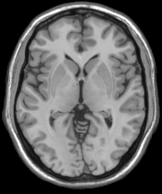
Generalised seizures
Originate at some point within and rapidly engage bilaterally distributed networks
Can include cortical and subcortical structures but not necessarily the entire cortex
Notes:
Generalised seizures affect both cerebral hemispheres and consciousness is always lost, albeit briefly for some seizures.
The generalised seizures are tonic, atonic, myoclonic, tonic clonic and absence seizures and again, we try to ‘say what we see’ so:
Atonic seizures are seizures without tone, and someone falls limply to the ground like a puppet with the strings cut.
Tonic seizures are stiff seizures
Tonic clonic seizures are seizures where there is stiffness followed by jerking.
Myoclonic seizures: ‘myo’ means muscle and ‘clonic’ means jerking so these are seizures involving muscle jerks. They can affect a single hand or foot, or the head, or one half of the body, or sometimes they affect the whole body and the CYP will fall.
Absence seizures are the most common seizure that you see in primary age children, and this is when the child has behavioural arrest and looks like they are blank for a short period of time and although their eyes are open, they are not conscious or aware of what is happening around them.
There are typical absence seizures: the child suddenly stops and stares into space, They won’t respond to people around them, their Eyelids may flutter, there could be Slight jerking movements of body and / or limbs, you may see Automatisms (repetitive, purposeless movements), they Last 5-20 seconds and Can occur in clusters.
In an Atypical absence: they Last longer (20-30 seconds), Start and end more slowly, Can involve change of tone, and the young person may be able to respond during the event, but not ‘normal’ response
We also classify generalised seizures as being either ‘motor’ and non-motor seizures, and all generalised seizures are motor seizures except for absence seizures.
22

Slide 23
Seizure Triggers
Not taking antiseizure medication as prescribed
Change of ASM brand
Tiredness / Lethargy
Lack of sleep / disrupted sleep pattern
Illness
Anxiety
Stress
Constipation
Teething
Menstruation
Hormonal Changes
Excess Alcohol
Drug / Substance misuse
Going for long periods without eating
Flashing Lights / photosensitivity (3% of people with epilepsy affected)
References: Epilepsy Action 2022 and ILAE 2022
Notes:
This is not an exhaustive list of triggers or provoking factors but are some of the more common ones.
The ones I see most commonly in my practice are illness, with or without a temperature, and lack of sleep or disrupted sleep.
In females, menstruation can be a trigger so even if their seizure control is good for the rest of the month, the hormonal changes associated with their period can trigger seizures; usually in the 2 or 3 days before it starts or the first 2 or 3 days of menstruation itself. And sometimes girls and women can have seizures around the time of ovulation. We sometimes use short courses of clobazam each month to try and manage catamenial epilepsy.
If people aren’t taking their medication properly, this can cause seizures. Most antiseizure medications are given twice a day, every day, as close to 12 hours apart as possible. Missed doses or when there is no routine for taking medication increases the likelihood of seizures.
I’ve put ‘flashing lights / photosensitivity’ on the list as there is a common misconception that everyone with epilepsy is photosensitive however it is around 3-4% of people with epilepsy; and it’s not just lights that affect those people who are photosensitive. Seizures can also be triggered by high contrasting patterns such as stripes or bars with contrasts of light and dark, and these patterns are more likely to trigger a seizure if they are changin direction or flashing, rather than if they are still, or moving slowly in one direction.
Things that have been reported as being triggers are sunlight through slatted blinds; or through the trees when you’re driving down a tree-lined street; or sunlight reflecting off the waves at the beach, or light through a moving ceiling fan.
Similarly, an animated background on a Zoom or Teams call, or a moving escalator can trigger a seizure; and it could be any type of seizure, but tonic clonic seizures are the most common.

Slide 24
Antiseizure Medications?
Most ASMs are prescribed as mg/kg/day in children.
Titration: start low and go slow, to minimise side effects.
Side effects: usually settle within 14 days.
Medicinal forms:
‘sprinkles’ can be useful in CYP who refuse liquid.
Neurodivergent CYP often hate the texture of ‘sprinkles’.
Be careful when prescribing Lamotrigine – doses vary according to concomitant ASMs
Sodium valproate / Topiramate: MHRA guidance / ARAFs
Notes:
Most antiseizure medications are prescribed in milligrams per kilogram per day, in children, and each medication will have a range of mg/kg doses that are thought to be effective.
As a general rule, starting low and increasing the dose slowly is the best way to avoid adverse effects but this isn’t always possible if you have a patient with regular seizures and you want them to get to a therapeutic dose as soon as possible however, you can always slow down the titration regimen so that you’re increasing doses less regularly than recommended in the BNF, and sometimes you need to do this if the young person is struggling with side effects.
In my experience, my patients do report side effects, but the majority of them settle after 10-14 days on a steady dose, so even when we’re increasing the dose every 2 weeks, and they experience side effects repeatedly during this period, once they reach the dose we’re aiming for, things settle down. Obviously if they have intolerable side effects such as self-injurious behaviour or suicidality, then we have to stop the antiseizure medication and try something different; for example, if we see intolerable mood or behaviour effects from levetiracetam, we usually switch them to brivaracetam which is an analogue of levetiracetam, with fewer mood and behaviour effects.
Most of the antiseizure medications come in a variety of forms: liquids, tablets, dispersible tablets, and sprinkles; and some of the medications come in more than one brand of liquid, so if I have a patient who can’t swallow tablets but they won’t take the Tegretol brand of Carbamazepine liquid, because they don’t like the caramel flavour, I’ll probably switch them to SUN Carbamazepine as it’s orange flavour. As Carbamazepine is a category 1 antiseizure medication, you’re supposed to ensure the parient is maintained on a specific manufacturer's product however, if they won’t take Tegretol at all, that poses more risk than switching them to another product that we will take, and then maintain them on the new product.
Another option for people who won’t take liquid but can’t swallow tablets are the sprinkles. Sodium valproate, topiramate and levetiracetam come as sprinkles, which can be given on one spoonful of a cold, soft food like yoghurt or Nutella; but in my experience, some neurodivergent young people don’t like the texture of the sprinkles so will refuse or spit them. It’s also worth knowing for people who wear pads that the shell of the sprinkles can appear in their stool, once the active ingredient has been absorbed, but I’ve had a few concerned parents ring me as they’ve been worried that the medication has gone straight through their child.
If you are going to prescribe lamotrigine, you need to think about whether the patient is on any other antiseizure medications as the prescribing advice in BNF depends upon whether it is monotherapy, is being prescribed with sodium valproate, or with an enzyme-inducer, or with another antiseizure medication which isn’t sodium valproate or an enzyme inducer.
I want to talk about sodium valproate and topiramate because they are the 2 antiseizure medications that are currently known to be more teratogenic than most of the others and they are subject to specific advice from the MHRA:
Sodium valproate: 1 in 9 babies born to females taking VPA will have a congenital malformation such as a neural tube defect, malformations of limbs, heart, kidney, urinary tract and genitalia; and 3-4 babies will have a developmental disorder like Autism, ADHD, speech and language issues or lower IQ.
Sodium valproate is thought to cause infertility in some males, and this may be reversible once valproate is stopped. One study that is currently being re-reviewed by the MHRA said that 5 out of 100 Babies conceived when males are taking sodium valproate, or within 3 months of stopping sodium valproate, are at risk of neurodevelopmental disorders; therefore there is a pregnancy prevention programme for females of childbearing potential and forms for both males and females up to the age of 55 that must be completed when valproate is started, and yearly for all females.
It’s a similar picture for females on topiramate but this guidance is newer. The risks again are congenital malformations, neurodevelopmental disorders like autism and ADHD, and there’s also a risk of babies being small for gestational age and lower birth weight. The risk of congenital malformations with topiramate appears to be dose-dependent, however, a threshold dose below which no risk exists, has not been established. Again, there’s a pregnancy prevention programme and a risk acknowledgment for to complete annually with females.

Slide 25
Antiseizure Medication
Lamotrigine and Phenytoin plasma concentration can fall during pregnancy and worsen seizure control
Erthyromycin / Grapefruit / Grapefruit juice ↑ concentration of Carbamazepine
Antihistamines: use Loratidine / Desloratidine
Osteoporosis: Carbamazepine, Phenobarbital, Phenytoin, Primidone, Sodium valproate
Consider prescribing calcium / vitamin supplement
Notes:
Some other things to remember about the antiseizure medications are that during pregnancy, the plasma concentration of lamotrigine and phenytoin can fall, and this could increase the possibility of seizures; Erythromycin and grapefruit products increase the concentration of carbamazepine so the patient may experience symptoms of carbamazepine toxicity like dizziness, somnolence, and falls; and the grapefruit interaction is also an issue with diazepam and midazolam.
If you have a patient on an antihistamine like Chlorpheniramine or cetirizine or they are buying over the counter, and they are diagnosed with epilepsy, the advice is to switch their antihistamine to loratadine or desloratadine as they are non-sedating and don’t have ‘epilepsy’ as a caution. There’s some Korean research published in The Journal of American Medical Association in June 2024 that found an association between first generation H1 antihistamines including chlorpheniramine, and an increased risk of seizures in children, of which the risk was highest in the 6 to 24-month age group.
Carbamazepine, Phenobarbital, Phenytoin, Primidone and Sodium valproate are all know to carry the risk of osteoporosis, and the Royal Osteoporosis society says that there is only limited and conflicting research data from studies of newer non-enzyme inducing antiseizure medications like gabapentin, lamotrigine, topiramate and levetiracetam regarding their effects on bone, but these studies do suggest that most antiseizure medications are associated with an increased risk of fractures.
The current UK guidance suggests considering vitamin D supplementation in people who are taking sodium valproate or any of the enzyme inducing anti-epileptic drugs on a long-term basis and who are felt to be at ‘higher risk’; so this might be non-ambulant wheelchair users, people whose diets are deficient in calcium or who have insufficient exposure to sunlight to maintain adequate vitamin D levels.

Slide 26
Contraception
The efficacy of the combined oral contraceptive pill, progestogen-only pill, contraceptive implant, contraceptive patch, vaginal ring and emergency contraceptive pill are all affected by:
Carbamazepine Cenobamate Eslicarbazepine Oxcarbazepine Perampanel Phenobarbital Lamotrigine Phenytoin Primidone Rufinamide Topiramate
The copper IUD, Levonorgestrel IUD and contraceptive injection are NOT affected by these medications.
The combined contraceptive pill, contraceptive patch and vaginal ring ↓ blood level of Lamotrigine
The Progesterone-only pill ↑ blood level of Lamotrigine – possible toxicity
Notes:
I get a lot of questions from my patients and from other health professionals about contraception and antiseizure medications, because it isn’t straightforward.
If you are a female who is on sodium valproate, the MHRA recommends using at least one effective method of contraception, preferably a highly effective user-independent form such as an Intrauterine device or an implant; or two complementary forms of contraception, including a barrier method should be used.
The enzyme inducing antiseizure medications, and lamotrigine affect the efficacy of medication, the hormonal contraceptive pills, the implant, the patch, the vaginal ring and emergency contraception, but IUDs and the contraceptive injection can be used.
Lamotrigine is not an enzyme inducing antiseizure medication, but it affects the efficacy of all the contraceptive choices that the enzyme inducers do; and in addition to this, the combined pill can reduce the level of lamotrigine, making it more likely that the patient could have a seizure, and the progesterone only pill, increases the level of lamotrigine in the blood and could lead to toxicity. So if you are on lamotrigine, your contraceptive options are an intrauterine device, the contraceptive injection and barrier methods. Or sterilisation, but I never suggest this as I work in paeds.
I’M NOW GOING TO HAND YOU OVER TO MY COLLEAGUE SARAH WHO WILL DISCUSS NON-MEDICINE TREATMENTS FOR EPILEPSY, SAFETY, SUDEP AND TRANSITION

Slide 27
Other treatments for Epilepsy
Ketogenic diet
A high fat, adequate protein, low carbohydrate diet
First described in the medical literature in 1921 as a treatment for epilepsy in children, following reports of the beneficial effects of fasting on seizure control
Designed to mimic the metabolic changes that occur in the body during starvation, i.e. adaption to spare muscle protein breakdown and draw on energy reserves of body fat.
Charities: The Daisy Garland / Matthew’s Friends
Notes:
Ketogenic diet was first described in the medical literature in 1921 as a treatment for epilepsy in children, following reports of the beneficial effects of fasting on seizure control. A medically managed ketogenic diet is designed to mimic the metabolic changes that occur in the body during starvation, i.e. adaption to spare muscle protein breakdown and draw on energy reserves of body fat.
There are several types of ketogenic diet:
The Classical diet is based on a ratio of fat to carbohydrate and protein. A ratio of at least 3:1(87% fat) is usually needed for maintenance of a good state of ketosis and optimal seizure control.
The MCT diet was developed in the 1970s as an alternative to the classical diet because MCT is absorbed and transported more efficiently in the body,
less total fat is needed, allowing more protein and carbohydrate to be included; and the modified Atkins diet and low glycaemic index diet are Modified ketogenic diets which follow similar principles to the classical and MCT diets in that they are very low in carbohydrate and high in fat, but allow more flexibility of meal choice due to the main focus being around carbohydrate counting, alongside portion guidance to ensure adequate calories from fats.
There is a paediatric ketogenic diet service based at RVI, which is run by consultant Anita Devlin, neurology nurse specialist Lucy Bellis and dietitian Ruth Ord, and they currently have capacity to take referrals into the service; and can provide advice for children and young people already on a ketogenic diet, as they may require specific forms of medication to comply with the restrictions of their diet. They has a pre-assessment clinic for families who are considering the diet, and this level of pre-assessment ensures that the drop-out rate is lower than any of the other services in the country.
The Daisy Garland and Matthew’s Friends websites are the best sites to signpost patients and families to, and they have a wealth of information for both patients and professionals, including a section of recipes that families can try if they are considering the diet.

Slide 28
Other treatments for Epilepsy
Vagus nerve stimulation (VNS)
3 modes: normal mode, magnet mode and autostimulation mode
Notes:
A VNS is an implantable device that sits in the left side of the chest and has leads connected to it which are attached to the left vagus nerve.
The ‘normal’ mode has a programmed duty cycle of on and off times which sends electrical pulses to the vagus nerve at regular intervals, all day, every day. These pulses are then carried by the vagus nerve to the brain and although a precise mechanism of action is still inconclusive, VNS is known to cause a decrease in frequency of chronic seizures.
There is a magnet mode which can be activated by a special VNS magnet, during a seizure, and this initiates an extra dose of stimulation, that is usually longer and at a higher output current than the normal mode stimulation, to try and terminate the seizure.
The autostimulation mode which is a feature of VNS models since 2015, works by monitoring baseline heart rate, and in response to a pre-programmed percentage rise in heart rate within 2 seconds, which is usually associated with the start of a seizure, the device gives additional stimulation, like a magnet stimulation, to try and terminate the seizure.

Slide 29
Safety advice for CYP with epilepsy
Heat: Hot radiators, fires, kettles, ovens, hobs, hair straighteners
Height: No heights unharnessed
Traffic: No cycling on roads / go-karting / quad-biking / driving until seizure-free for 1 year
Water: Shower in preference to bath
No swimming / water sports in open water until seizure- free for 1 year
Pool swimming with appropriate supervision

Slide 30
SUDEP
Proposed mechanisms: Cardiac arrhythmia, respiratory dysfunction, dysregulation of systemic or cerebral circulation, and seizure-induced hormonal and metabolic changes during and after seizures.
Incidence: one death per 1,000 people with epilepsy per year.
Risk factors: GTCS, especially at night / when asleep; Medication changes / not taking medication as prescribed; Alcohol or substance abuse; Depression / mental health condition; Pregnancy; Intellectual disability; infrequent epilepsy reviews / engagement with an epilepsy clinician

Slide 31
Reducing Risk of SUDEP
Take ASMs as prescribed
Vomiting: Repeat dose if vomit within 20 minutes of dose
Take each ASM separately – 30 minutes apart
Avoid missing doses of ASMs
Avoid common seizure triggers: lack of sleep, stress, too much
alcohol, recreational drug use
Consider hormonal management of menstrual periods
Use safety equipment

Slide 32
Safety Equipment
Seizure monitors: wearable monitors; bed monitors; seizure alarms with video monitoring
Other monitors: Baby audio; baby audio and video monitor
Charities that provide monitors: Dravet Syndrome UK; The Daisy Garland (Emfit bed monitor / Pulmolink SATs monitor); Jon Shaw Foundation
Monitors are exempt from VAT
Sleepsafe antisuffocation pillows: highly porous / open cell structure; breathable air ducts
Charities providing pillows: Hope for epilepsy (<19 years)

Slide 33
Transition
Most areas offer an annual transition appointment from school year 9, with transition completed at age 18/19
Discuss: - Career choice - Drugs / alcohol - Driving - Expectations of adult services - Making / changing appointments - Medication management (ordering prescriptions / reminder apps / dosette boxes) - Mental health - Reproductive health (contraception / pregnancy) - SUDEP
Some time spent in clinic without parent / carer
Annual GP LD health check from age 14

Slide 34
Transition Resources
Healthier Together NENC transition documents – 10 stage Transition journey to Adult services: www.nenc-healthiertogether.nhs.uk/professionals/transition-information-professionals
Together for Short Lives transition documents: www.togetherforshortlives.org.uk/resource/transition-adult-services-pathway/
Hull transition documents – ready 2025
Notes:
These are the transition documents and 10 stage transition journey from North East North Cumbria Healthier Together website, and from Together for Short Lives, which is the UK registered charity for children's palliative care. The ‘Stepping up’ transition pathway is written for professionals who work with young people with life-limiting conditions, and there’s also a transition checklist for young people.
Nicola Heenan who is the paediatric epilepsy nurse specialist in Hull and the Paediatric lead for ESNA (the epilepsy specialist nurses association) has produced some transition documents, including easy read versions, that are going to be adopted by NHS England. The final document has needed to be amended therefore these will be available in 2025.

Slide 35
Mental Health / Social impact of Epilepsy
Behaviour: Epilepsy and / or medication can cause hyperactivity, aggression and challenging behaviour.
Learning: CYPwE may have problems with memory, attention, concentration and processing information.
Mental Health: Approximately 40% of CYPwE have a co- existing mental health disorder
School attendance: Time off for appointments / days off after seizures / days off with medication side effects.
Sleep: Seizures and / or medication can disrupt sleep or make CYP sleepy.
Stigma / bullying: Due to misunderstanding about the condition

Slide 36
Support Services
Epilepsy Action:
- 8-week online / phone counselling offer (Age 18+)
- Living well with epilepsy: 4-week group programmes
Adults with epilepsy
Women-only / Men-only
Young people with epilepsy (Age 18-30)
Parents / carers of children with epilepsy
Family members of people with epilepsy
- Befriending service: matches the person with epilepsy with a volunteer for regular phone/online chats
Young Epilepsy:
Online Youth clubs: 10-12 years / 13+ years
Youth support services: 1-2-1 sessions; Group work; virtual / in-person

Slide 37
Epilepsy Specialist Nurses
Advice to other professionals
Family support – phone / email / text / WhatsApp
Medication – prescribing / deprescribing / switching form
Nurse-led clinics – new patients / review patients / transition
Request investigations
Safeguarding
Training – safety / first aid / emergency medication
Don’t forget the ESNs - We usually know the answer!

Slide 38
Trust | PESN | Contact Number | ESNs | Contact Details
County Durham and Darlington | Amanda Barr Kate Howe Sue Lewis | 0191 3876368 | Bev Barnett Elaine Lincoln Natalee Howe | 0191 3876531
Gateshead | Hazel MacEwan | 0191 4453075
Newcastle | Sarah Bennison | 0191 2821156 07902 370371 | Gemma Clarke Jo Glenton Lisa Sparke Louise Dimmick | 0191 2823995
North Cumbria | Vicki Walsh | 07867 102379 | Michelle Wood | 01786 244576
North Tees and Hartlepool | Katie Bailey Pauline King | 01429 522717
Northumbria | Andrea Irlam Sophie Gilmour-Ivens | 07755 025947 07814 652086
South Tees | Helen Garfitt Helen Gilpin Samantha Boddy | 01642 854489 | Fiona Adams Claire Madden Emma March Claire Wilson | 01642 854169
South Tyneside and Sunderland | Lisa Emmerson Angela Richardson | 0191 5699808 0191 4028177 | Kat Boulton | Kat.boulton@nhs.net

Slide 39
What can GPs do?
Seizures:
Keep a seizure diary (Epilepsy Action / Epilepsy Society / Brain Trust)
Description of events: what was happening before the event? Side of body affected / colour change?
Time events with a watch / clock
Ask families to video events
Attend ED for seizures >5 minutes / concerns about breathing / injury
Information:
First aid and safety advice Epilepsy Action Epilepsy Society Healthier Together NE NHS Young Epilepsy

Slide 40
Resources
Epilepsy Action: www.epilepsy.org.uk
Epilepsy Society: www.epilepsysociety.org.uk
FND Action: www.fndaction.org.uk
Healthier together: www.nenc-healthiertogether.nhs.uk
The International League Against Epilepsy: www.ilae.org
Medicines for children: www.medicinesforchildren.org.uk
SUDC: www.sudc.org.uk
SUDEP Action: www.sudep.org
Young Epilepsy: www.youngepilepsy.org.uk

Slide 41
Questions?

