Slide 1
Child Health and Wellbeing Network CYP Transformation
Louise Dauncey
Network Delivery Manager - CYPT

Slide 2
Outline for the Session
Welcome and Introductions
CHWN Introduction
CYPT Overview
Epilepsy Programme NENC
Relevance to Education colleagues
What is Epilepsy and the causes
What is a seizure and potential triggers
Different Types of Seizure and how to manage them
Impact of epilepsy on CYP
General advice about supporting CYP with epilepsy
Available support and resources
Questions/Discussion

Slide 3
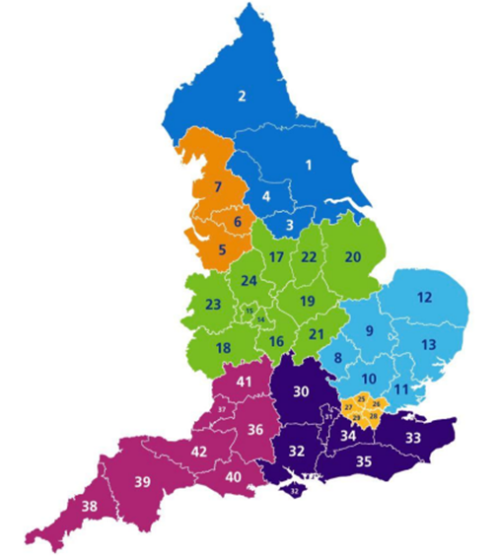
NENC ICS Footprint
Data Source – https://www.ons.gov.uk/

Slide 4
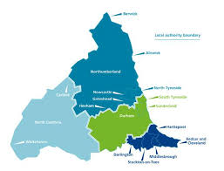
NENC Context
Children are c. 20% of our population (100% future)
Highest levels of child poverty in England
Reduced resource and capacity across healthcare workforce
Highest rates of childhood obesity in England
Highest rates of A&E attendances for 0–4-year-olds in England 22/23
Highest rates of asthma admission
Impact of pandemic
Equality Act - legal duty for programmes and organisations to make explicit consideration to age
Overcoming Challenges
Collaborative approaches with VCSE and Education to ensure reach into our most under-served communities
Effectively using data to target high prevalence areas to maximise resources effectively
System wide engagement to establish strong mutually beneficial relationships
Upskilling front line workforce

Slide 5
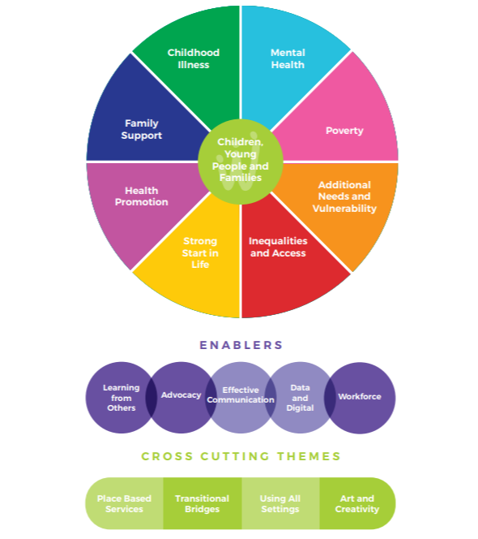
Child Health and Wellbeing Network
Our vision
In the North East and North Cumbria we believe all children and young people should be given the opportunity to flourish and reach their potential, and be advantaged by organisations working together
What do you want us to do
“Share good practice, drive work forward and connect us into experts and groups”
Join the Network

Slide 6
CHWN Work Programmes
Youth Voice
Inequalities focus – Core 20
Comms and Engagement
CYPT Integration Centre
CYPT Programme

Slide 7
CYP Transformation Programme 10 Key Priority Workstreams
The CYPT programme will lead change to integrate and improve the delivery of inclusive services.
Ten key areas of work for CYP Transformation Programme:
Integration of Services within Health and Care, led by local systems
Identifying and protecting the most vulnerable children and young people
Evaluating paediatricians working in 111 providers
Developing data and capacity to monitor and understand the state of child health
Spotting the deteriorating child
Developing a joint approach to transition and 0-25 model of care
Delivering obesity pilot to develop evidence base relating to obesity related complications
Implement national bundle to improve asthma outcomes
Improvements in epilepsy, diabetes and other long-term conditions
Keeping children well and focus on holistic and therapeutic needs

Slide 8
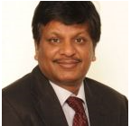
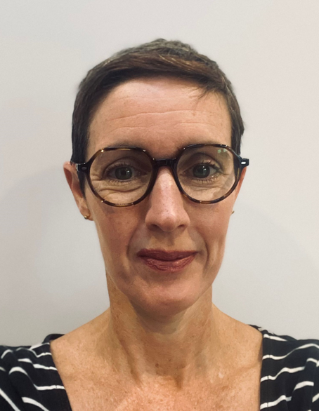
NENC – Epilepsy Leadership Group
Dr Ramesh Kumar
Consultant Paediatrician
JCUH
NENC Epilepsy Clinical Lead
Dr Dina Jayachandran
Consultant Paediatrician CDDFT
PENNEC Chair
Louise Dauncey
Network Delivery Manager
CHWN
CYPT Delivery Lead
Sophie Gilmour-Ivens
Paediatric Epilepsy Nurse NHCT
Regional Strategic ESN Lead

Slide 9
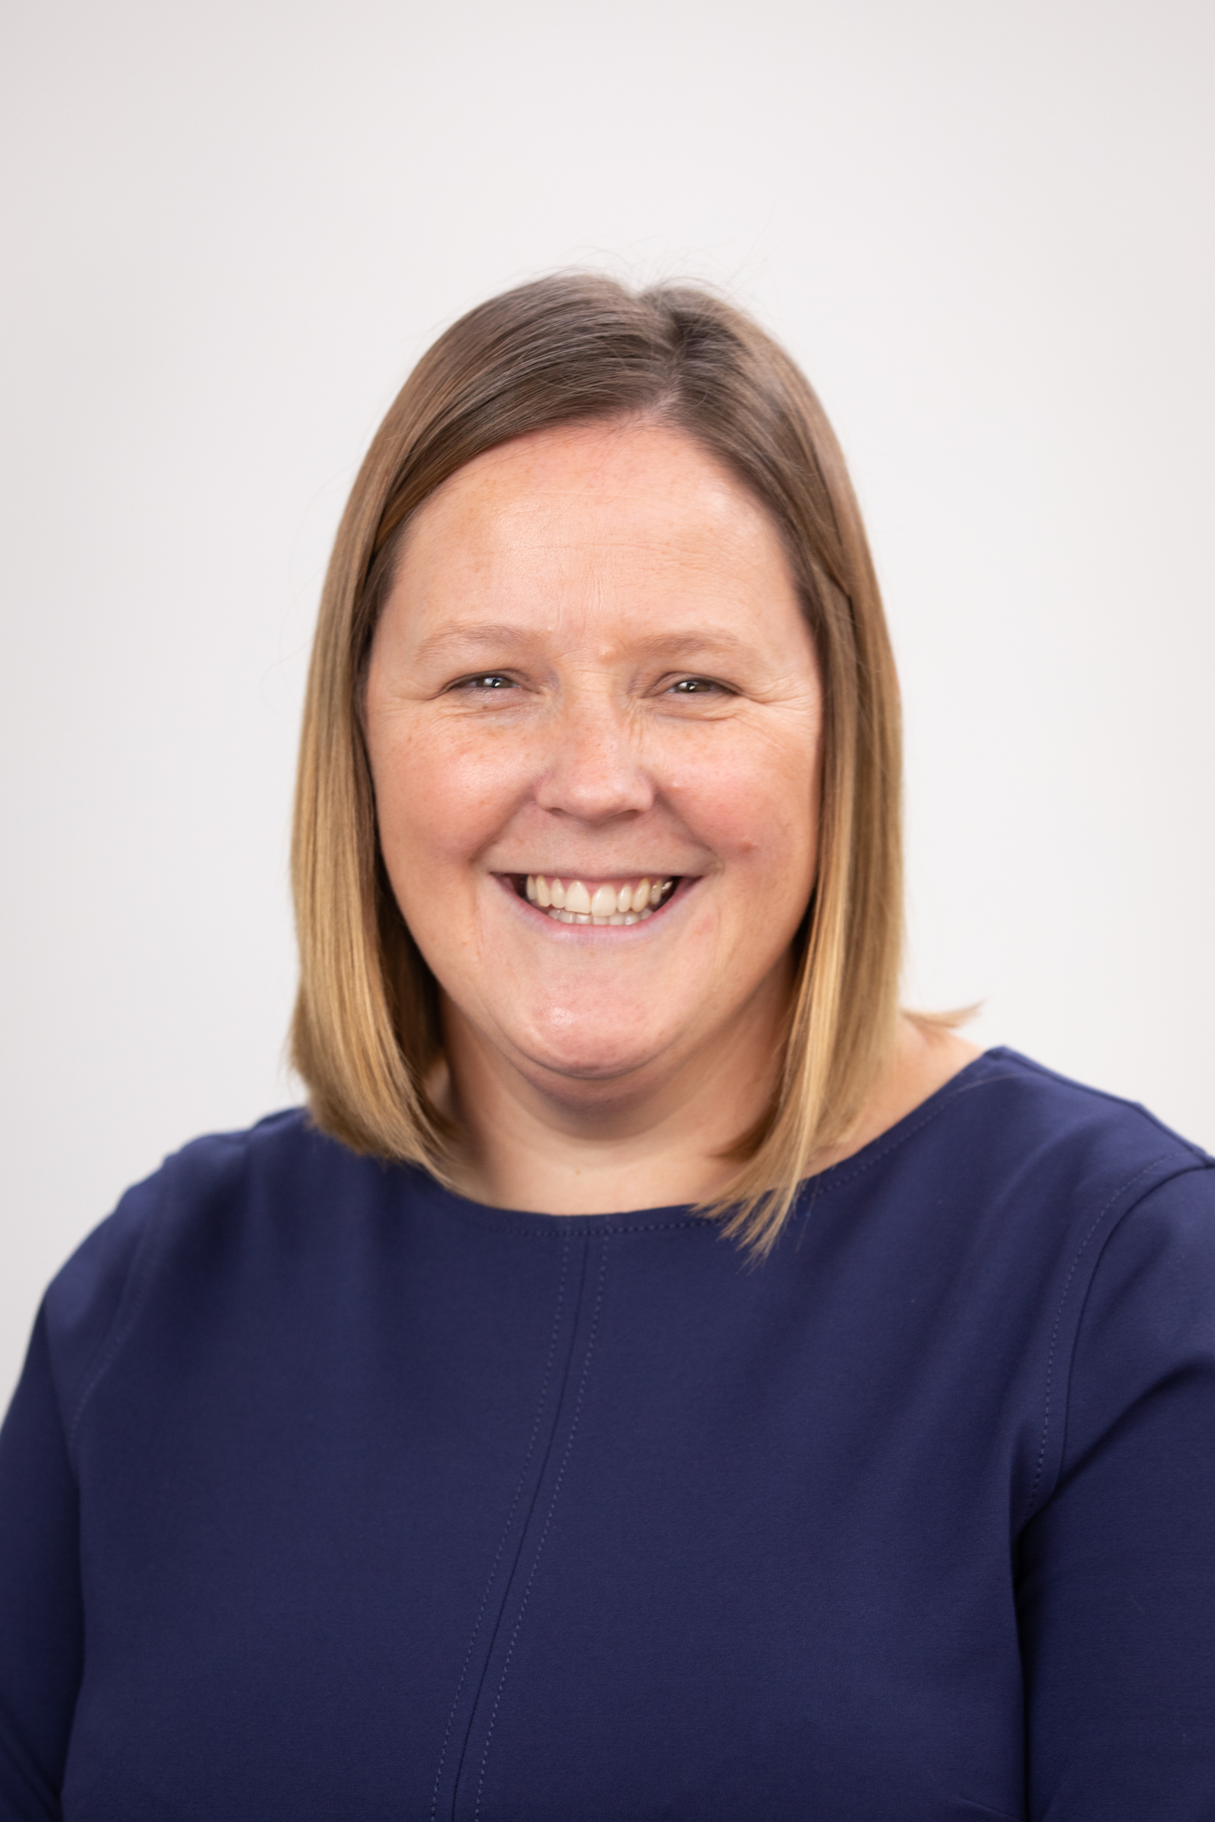
Adele Pearson – System Leader in Education (Executive Headteacher – Ascent Academies Trust, statutory Head of Academy for Hope Wood Academy and Barbara Priestman Academy)
"I am absolutely thrilled to be invited to be a system leader for the network, I hope to support bringing colleagues together from different sectors, I truly believe in working together for our young people across the region, as a collective we can achieve so much more when we talk, discuss and take action together. Today's young people are tomorrow's adults, I am passionate about improving opportunities and engagement for young people and their families and I have special interest in the area of SEND and impact of deprivation"
Availability- Monday PM, Tuesday, Wednesday, Thursday PM, Friday PM

Slide 10
Epilepsy
Sophie Gilmour-Ivens
Paediatric Epilepsy Specialist Nurse Strategic Lead
Lisa Emmerson
Paediatric Epilepsy Specialist Nurse

Slide 11
What is Epilepsy (The Epilepsies)?
Epilepsy is a tendency to have recurrent epileptic seizures, more than 24 hours apart
Epilepsy is a variable condition that affects different people in different ways.
Approximately 1 in 100 people in UK, has epilepsy.
1 in 200 children and young people in UK, have epilepsy.
70-80% of CYPwE are fully controlled on medication.

Slide 12
Causes of Epilepsy
Structural: Brain tumours Brain malformations that occur in utero Malformations of the blood vessels in the brain Stroke Traumatic brain injury.
Genetic: Known / presumed
Single gene / multiple genes
Infectious: Bacteria, viruses, fungi and parasites
Neurodegenerative: Down’s Syndrome and Batten Disease
Unknown

Slide 13
Epilepsy and co-existing conditions
Approximately 40% of CYPwE have a Mental Health condition (anxiety / depression)
Approximately 6% of CYPwE have Autism Spectrum Disorder, and approximately 12% of CYP with Autism have epilepsy
30-40% of CYPwE have ADHD
Approximately 50% of CYPwE have a learning disability
8-24% of CYPwE have migraine

Slide 14
What is a seizure?
A seizure is a sudden and temporary increase of electrical activity within the brain cells (neurons).
Seizures can affect part of the brain (focal seizures) or the whole of the brain (generalised seizures)
What a seizure looks like depends on what area of the brain is involved
There are over 60 different types of seizure.

Slide 16
Seizure Triggers
Not taking antiseizure medication as prescribed
Change of ASM brand
Tiredness / Lethargy
Lack of sleep / disrupted sleep pattern
Illness
Anxiety
Stress
Constipation
Teething
Menstruation
Hormonal Changes
Excess Alcohol
Drug / Substance misuse
Going for long periods without eating
Flashing Lights / photosensitivity (3% of people with epilepsy affected)
References: Epilepsy Action 2022 and ILAE 2022

Slide 17
Photosensitivity
Seizures are triggered by flashing or flickering lights, or high contrasting patterns:
Sunlight through slatted blinds / through trees from a moving vehicle / off moving water
Christmas tree lights, strobe lights
Animated backgrounds on Zoom / Microsoft Teams
Moving escalator
Light through a moving ceiling fan
Any type of seizure could be triggered, but tonic clonic seizures are the most common.
How to minimise risk of seizures:
If indoors, try to make sure the room is well lit.
Place an anti-glare filter over the screen or use a downloadable screen filter
Cover one eye with the palm of your hand straight away
Turn away from the possible trigger
Don’t close your eyes (as this could cause a flicker effect)

Slide 18
Conditions that mimic epileptic seizures
Daydreaming / Inattention
Diabetes: seizures caused by low blood sugar
Dissociative seizures (episodes of uncontrolled movements, sensations or behaviour that are not caused by abnormal electrical activity in the brain)
Febrile seizures (seizures with sudden rise in temperature in children <6 years)
Migraines
Movement disorders
Narcolepsy (sudden attacks of sleep)
Panic attacks
Parasomnias (unusual behaviours that disrupt sleep)
Syncope (fainting)
Tourette's syndrome (repetitive involuntary movements or tics)

Slide 19
Absence Seizures
Approximately 10% of CYPwE have absence seizures
Typical absence:
CYP suddenly stops and stares into space
They won’t respond to people around them
Eyelids may flutter
Slight jerking movements of body and / or limbs
Automatisms (repetitive, purposeless movements)
Last 5-20 seconds
Can occur in clusters
Atypical absence:
Last longer (20-30 seconds)
Start and end more slowly
Can involve change of tone
May be able to respond during the event, but not ‘normal’ response

Slide 20
Absence Seizure Video
Epilepsy in schools: what can an absence seizure look like? (youtube.com)

Slide 21
Epilepsy Syndromes
Childhood Absence Epilepsy (CAE)
1 in 5 primary school-age children with epilepsy have CAE
Starts age 4-10 years
Typical and atypical absence seizures
Seizures more likely when sitting quietly, tired, or unwell
Associated with attention, memory and language problems
6/10 children outgrow CAE by teens
CAE can evolve into other epilepsy syndromes:
Juvenile Absence Epilepsy (JAE)
Juvenile Myoclonic Epilepsy (JME)

Slide 22
Juvenile Absence Epilepsy (JAE)
2-3 / 100 CYPwE have JAE
Usually starts ages 9-13 years. May start later
Absence seizures happen less frequently than CAE but each seizure last longer (up to 30 seconds)
1 in 5 CYP with JAE have absence status epilepticus (seizures > 30 minutes)
9 / 10 CYP have GTCSs
Some CYP are photosensitive
8/10 CYP are seizure-free on medication
Lifelong diagnosis

Slide 23
Juvenile Myoclonic Epilepsy (JME)
1/10 of people with epilepsy have JME
Usually starts ages 12-18, but can be younger / older
1/3 of CYP with JME have a family member with epilepsy
Myoclonic, Absence and Generalised Tonic Clonic Seizures
9/10 people with JME have GTCSs
1/3 have Absence seizures
1/3 are photosensitive
Lifelong diagnosis, but seizures may get better as people get older

Slide 24
Self-Limited epilepsy with Centrotemporal Spikes (SeLECTS)
1/5 CYPwE have SeLECTS
Starts 4-10 years
Focal seizures: Tingling / fizzy / buzzing feeling in 1 side of mouth Difficulty speaking Twitching or stiffness in 1 side of mouth / face Drooling
Can have focal to bilateral Tonic Clonic Seizures
Nearly all CYP outgrow SeLECTS by their 16th birthday.
2/100 people develop epilepsy as an adult

Slide 25
Focal seizure video
Epilepsy in schools: what does a focal seizure look like? (youtube.com)

Slide 26
First aid for Focal Seizures
Guide them away from danger (such as roads, stairs, or open water)
Be calm and reassuring
Avoid doing anything that might frighten them, like sudden movements, shaking them or shouting
Stay with them until they are fully recovered
Explain anything that they may have missed
If a CYP is conscious, they do not need to be placed in the recovery position

Slide 27
Generalised Tonic Clonic Seizure video
Epilepsy in schools: how to deal with a tonic clonic seizure (youtube.com)

Slide 28
First aid for Generalised Tonic Clonic Seizures
Try and stay calm
Ask for assistance from another adult / first aid staff
Note the time the seizure starts (need to know when to give emergency medication / when to call ambulance)
Cushion the child’s head
Protect them from injury (remove harmful objects from nearby)
Once the jerking has stopped, help their breathing by placing them in the recovery position
Remember Privacy and Dignity
Don’t put anything in the child’s mouth (except emergency medication)

Slide 29
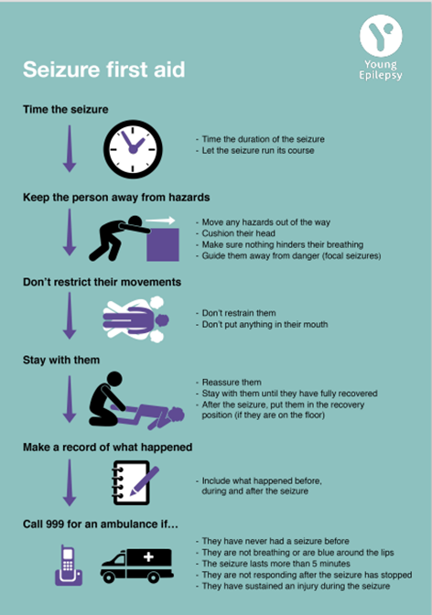
First aid (Young Epilepsy)

Slide 30
Safety advice for CYP with epilepsy
Heat: Hot radiators, fires, kettles, ovens, hobs, Bunsen burners
Height: No heights unharnessed
Traffic: No cycling on roads / go-karting / quad-biking / driving until seizure-free for 1 year
Water: Shower in preference to bath
No swimming / water sports in open water until seizure- free for 1 year
Pool swimming with appropriate supervision

Slide 31
Impact of Epilepsy on CYP
Attendance: Time off for appointments / days off after seizures / days off with medication side effects.
Behaviour: Epilepsy and / or medication can cause hyperactivity, aggression and challenging behaviour.
Learning: CYPwE may have problems with memory, attention, concentration and processing information
Mental Health: Approximately 40% of CYPwE have a co-existing mental health disorder
Sleep: Seizures and / or medication can disrupt sleep or make CYP sleepy.
Stigma / bullying: Due to misunderstanding about the condition

Slide 32
Impact of Epilepsy on CYP
Young Epilepsy ABLE Tool
Assessment-of-Behaviour-and-Learning-in-Epilepsy-ABLE_2015.pdf (youngepilepsy.org.uk)

Slide 33
What can you do?
Epilepsy education / training (Online / PESNs)
Basic epilepsy for schools | Epilepsy Action Learning
Advanced epilepsy for schools | Epilepsy Action Learning
Training courses | Young Epilepsy
Record seizures (video / written account / seizure diary)
Reasonable adjustments - safety
Remember co-existing conditions:

Slide 34
PESNs
Trust | PESNs | Contact number
County Durham and Darlington | Amanda Barr Kate Howe Sue Lewis | 0191 3876368
Gateshead | Hazel Macewan | 0191 4453075
Newcastle | Sarah Bennison | 0191 2821156 07902 370371
North Cumbria | Vicki Wash | 07876102379
North Tees and Hartlepool | Katie Bailey Pauline King | 01429 522717
Northumbria | Andrea Irlam Sophie Gilmour-Ivens | 07775025947 07814652086
South Tees | Helen Garfitt Helen Gilpin Samantha Boddy | 01642 854489
South Tyneside and Sunderland | Lisa Emmerson Angela Richardson | 0191 5699808 0191 4028177

Slide 35
Resources
Epilepsy Action: www.epilepsy.org.uk
Epilepsy Society: www.epilepsysociety.org.uk
FND Action: www.fndaction.org.uk
Healthier together: www.nenc-healthiertogether.nhs.uk
Medicines for children: www.medicinesforchildren.org.uk
Young Epilepsy: www.youngepilepsy.org.uk

Slide 36
Questions?

