Slide 1



Healthier Together Champions
Lunch and Learn
Focus on Oral Health
Notes:
Give insights into the network's work and governance structures
Consider the important refresh of some partnerships post Review 2.0 and the networks TuPE process and the approach to building CYP structures within the ICB

Slide 2
Session Overview
Introduction to the Child Health and Wellbeing Network
Oral Health focus session
Oral Health Q&A
Healthier Together sharing good practice
Healthier Together what’s new
Healthier Together discussion

Slide 3
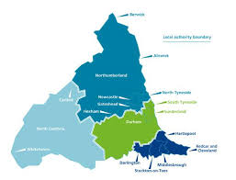
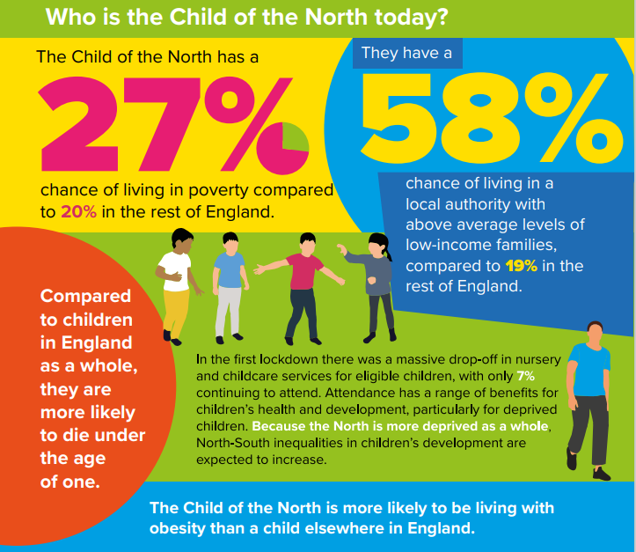
NENC Context
Children are c. 20% of our population (100% future)
Highest levels of child poverty in England
Reduced resource and capacity across healthcare workforce
Highest rates of childhood obesity in England
Highest rates of A&E attendances for 0–4-year-olds in England 22/23
Highest rates of asthma admission
Impact of pandemic
Equality Act - legal duty for programmes and organisations to make explicit consideration to age
  Overcoming Challenges
  Collaborative approaches with VCSE and Education to ensure reach into our most under-served communities
  Effectively using data to target high prevalence areas to maximise resources effectively
  System wide engagement to establish strong mutually beneficial relationships
  Upskilling front line workforce

Slide 4
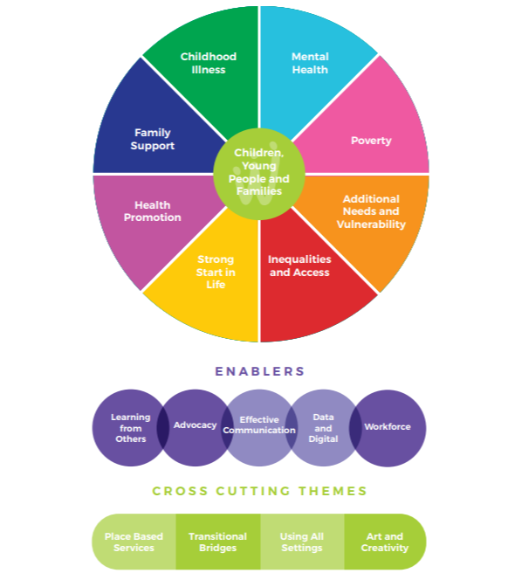
Network foundations and principles
Our shared vision
In the North East and North Cumbria we believe all children and young people should be given the opportunity to flourish and reach their potential, and be advantaged by organisations working together
What did the system want us to do
“Share good practice, drive work forward and connect us into experts and groups”

Slide 5
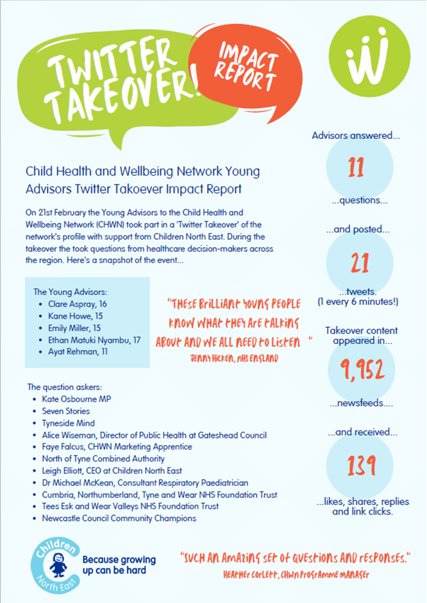
Network delivery and reach
Reach and partnership
  Youth Board and Network groups to promote youth voice
  3 Apprentices worked within our team
  Network of advisors to support breadth of system
  Over 30 huddles and Lunch & Learn sessions to share good practice
  Attracted new funding into NENC – ARC, ACE,NHSCT
  Membership of over 1900, weekly Child Health Tuesday
  Twitter followers of over 2000 and Facebook more than 400 followers
  Twitter reach of over 100,000 impressions in 2023
  New innovations from new partnerships –iterative development to promote sustainability:
    4th iteration of Poverty Proofing
    3rd iteration of STAR
    2nd iteration of YMHFA and Chris Drinkwater Awards

Slide 6
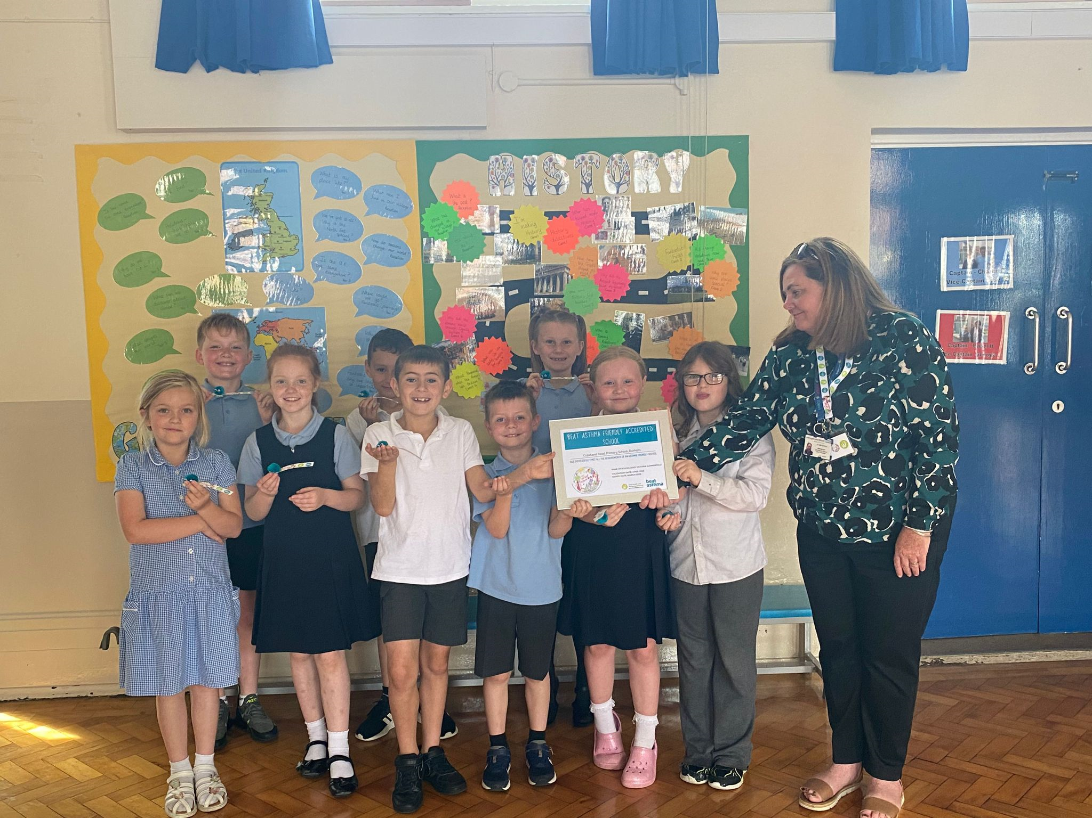
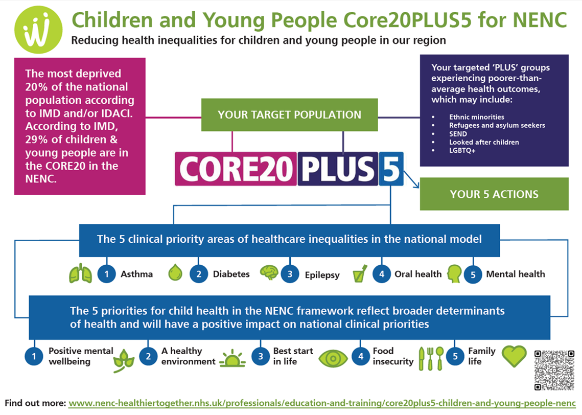
Network delivery and reach
Delivery Areas
- CYP Transformation programme, Integration and CEW pilots (NHSE)
  - Asthma, Epilepsy, Transition and Diabetes focus & Mental Health Champions and
  Paediatric Early Warning (PEW)
  - 2 Clinics for Excessive Weight pilots established
  - Integration Centre 3-year pilot – supportive environment to test and learn
- Delivered the Tackling Inequalities in Children Programme (NHS Charities Together)
  - Youth MH First Aid, Poverty Proofing, South Tees ARts (STAR), Digital Apprenticeship
- NENC specific CYP Core20 Toolkit developed and launched (NHSE H&F)
  - Work with Healthier and Fairer delivering the national framework oversight
  - Asylum seeking health work focus
- Developed a Sustainability Resource on Child Health
- Delivered an Interactive film on Mental Health and Young Parents
Notes:
Deliver the CYP Transformation & Integration programme (NHSE)
Asthma, Epilepsy, Transition and Diabetes focus
Mental Health Champions and Paediatric Early Warning (PEW)
2 CEW Clinic pilots established
13 schools accredited as Beat Asthma Friendly
Healthier Together - over 7,000 children registered
VCSE partnership model to embed initiatives into our most underserved communities – over 43 organisations involved (and 58 Education settings)
Asthma - Primary Care to Secondary Care and Secondary Care to Tertiary Care pathway downloaded 2918 times & L1 and L2 Elearning for Health Asthma Training accessed by 1261 people
NENC specific CYP Core20 Toolkit developed and launched (NHSE H&F)
Work with Healthier and Fairer delivering the national framework oversight
Asylum seeking health work focus
Delivered the Tackling Inequalities in Children Programme (NHS Charities Together)
Over 500 trained in Youth MH First Aid
Over 1000 children been part of STAR initiative
Supported Poverty Proofing in 8 settings including dental and oral health
Delivered a Sustainability Resource on Child Health
Delivered an Interactive film on MH and Young Parents

Slide 7
Healthier Together: Oral Health
Dr Greig Taylor, NIHR Clinical Lecturer & specialist in Paediatric dentistry
Mr Oliver Sumner, Consultant in Paediatric Dentistry

Slide 8
Why do teeth matter?

Slide 9
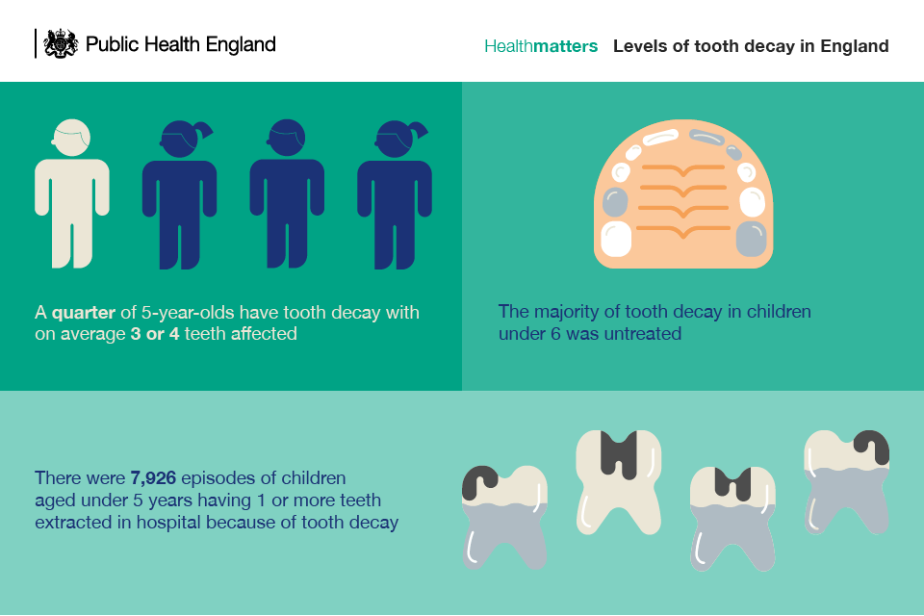
Notes:
In 19/20 cost of hospital admissions for extractions = £54.6 million
%20 of teenagers decay untreated – in under 5s this is 50% or more
Most common reason for hospital admission in age 5-9 group

Slide 10
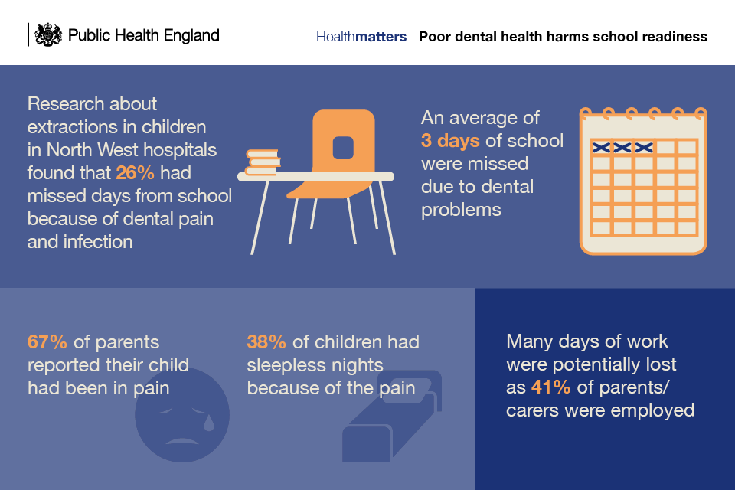
Notes:
60,000 school days missed per annum

Slide 11
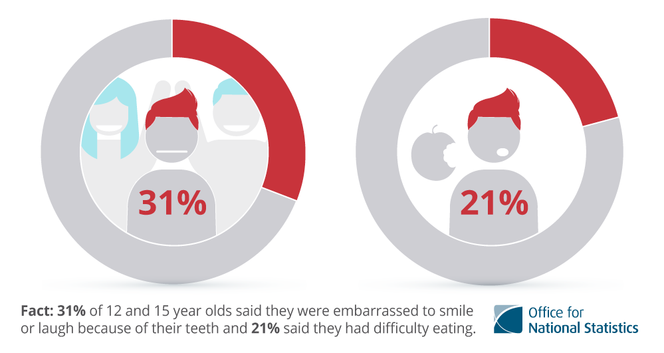
Notes:
Child dental health survey 2013

Slide 12
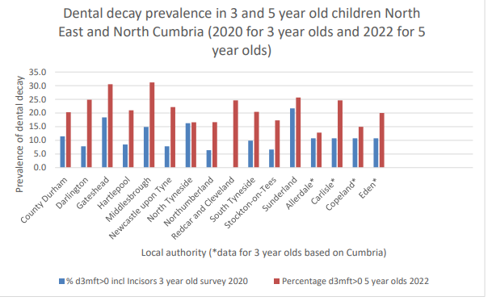

Slide 13
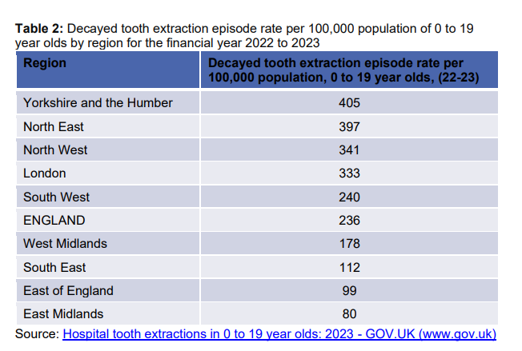

Slide 14
Dental Services in NENC

Slide 15
General Dental Practice
Majority of dentistry is carried out in primary care settings, by a general dentist – “high street”
Access is currently a challenge

Slide 16
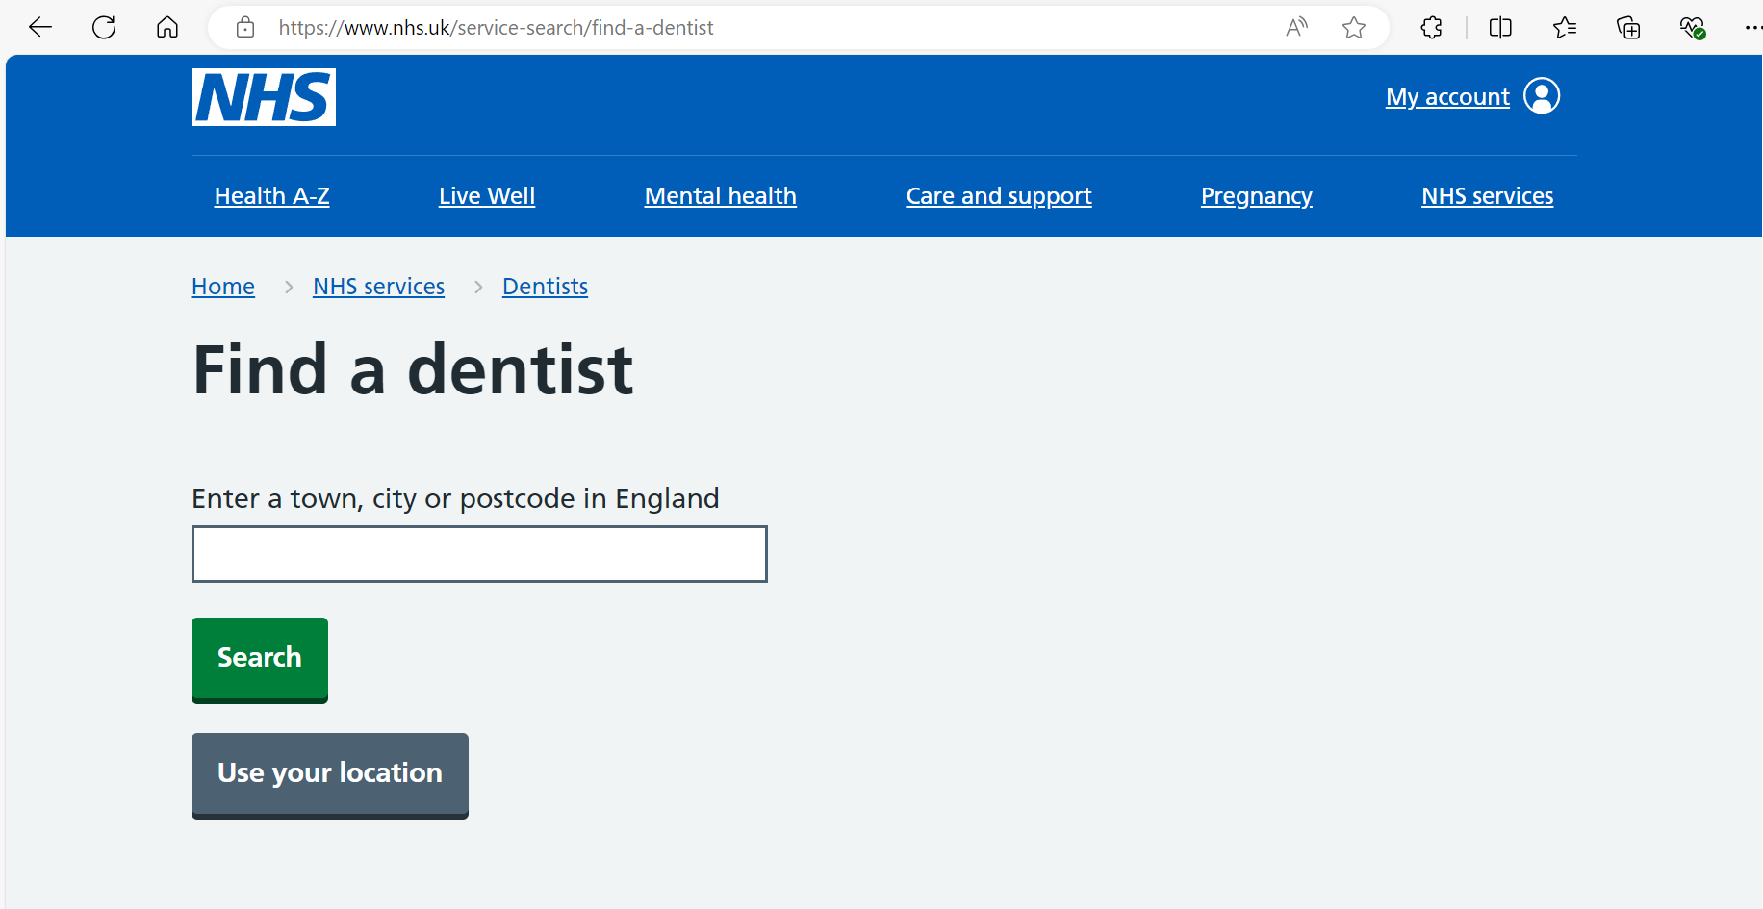

Slide 17
General Dental Practice
May not be accepting new patients
May have to ring and go on a waiting list
Private care

Slide 18
Secondary/ Tertiary care
Anxious / Phobic
Behavioural
Neurodevelopmental Disorders
Unable to accept treatment in primary care
Require sedation/general anaesthesia for treatment
Significant dental needs
Medically complex
Absent/missing teeth
Abnormal tooth form/shape or structure
Severe dental trauma
Children in care
Safeguarding
Asylum seekers
Notes:
Medically complex – immunocompromised, pre/post organ transplant, cardiac conditions, clotting disorders

Slide 19
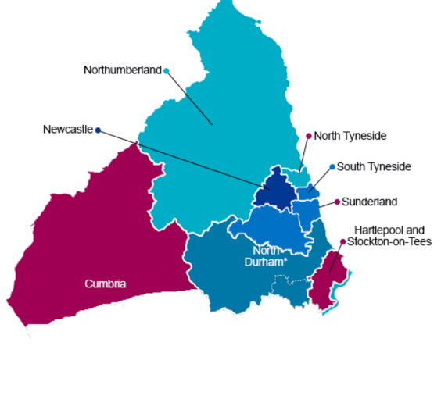
Secondary / Tertiary Care provided by Community Dental Services + Hospital Dental Service
5 WTE Consultants
5 specialists (3 in further training)
9 StRs/academic trainees
Notes:
Regional care
Freeman
Cleft
Paediatric Services at GNCH
Pop under 16 approx. half a million?

Slide 20
Local CDS
CDDFT – Dr Sola Adeboye (Consultant Paediatric Dentistry & Clinical Lead), Community Dental Service, Bishop Auckland Hospital
Northumbria – Dr Kathryn Jorgenson (Specialist Paediatric Dentistry & Clinical Lead), Wansbeck General Hospital
SoTW: Clarendon House, Hebburn
NCIC: Carlisle Dental Centre
Tees: Dr Oliver Sumner (Consultant Paediatric Dentistry), Guisborough Hospital
Newcastle: Arthur’s Hill Clinic
Newcastle Dental Hospital

Slide 21
After referral
Triaged
Full dental assessment
Treatment if needed – Sedation/GA
Assess long term needs
“Routine care”
General Dentist
Community Dental
One day – regional referral system?

Slide 22
Urgent Care
Via 111
Advice if appropriate
Signpost to primary care dental services
Link to primary care access appointments – same/next day
Link to Out Of Hours care (evening/weekends)
Refer on to secondary care triage (Dental Hospital)

Slide 23
Clinically…

Slide 24
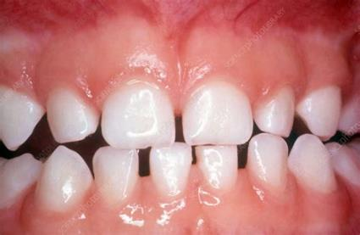
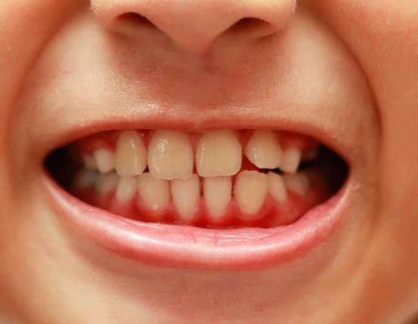
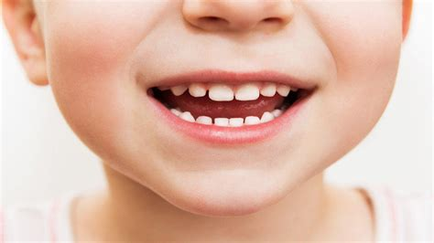
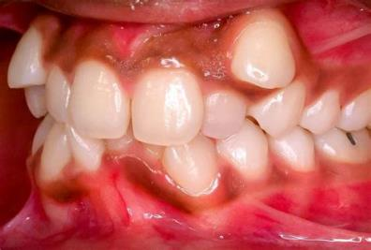

Slide 25
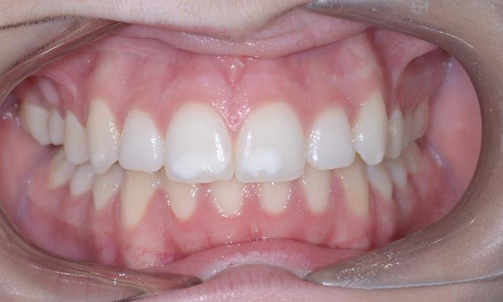
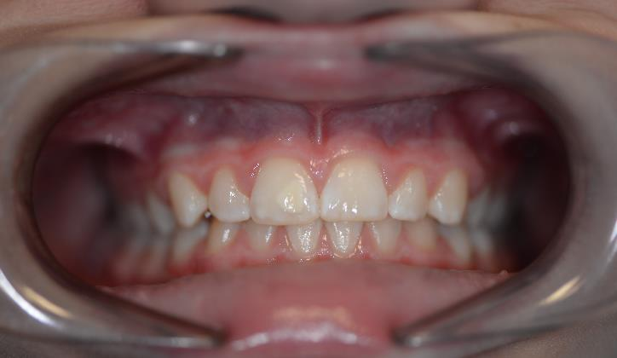

Slide 26
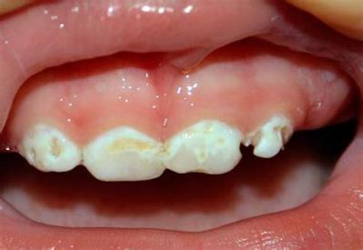
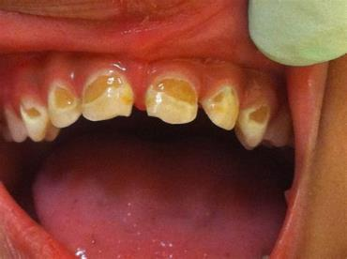
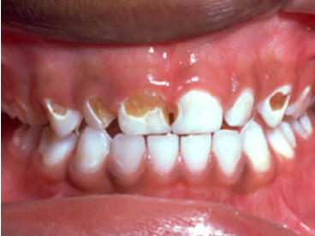
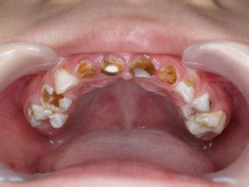
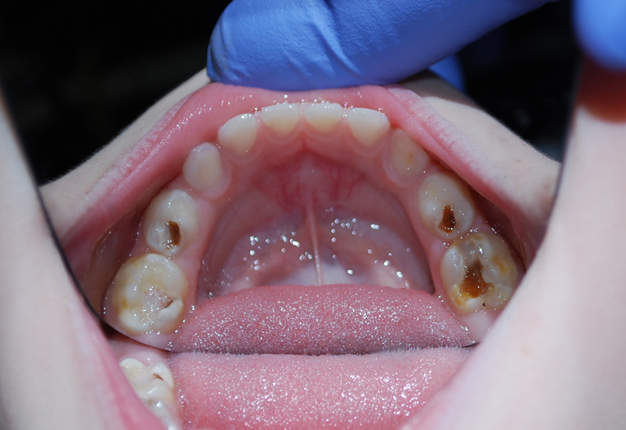
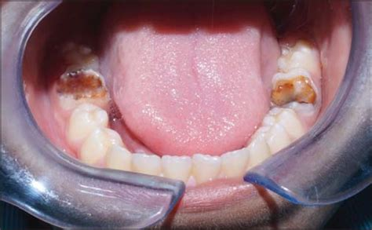
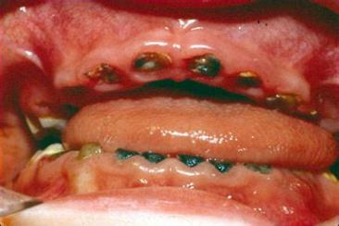

Slide 27
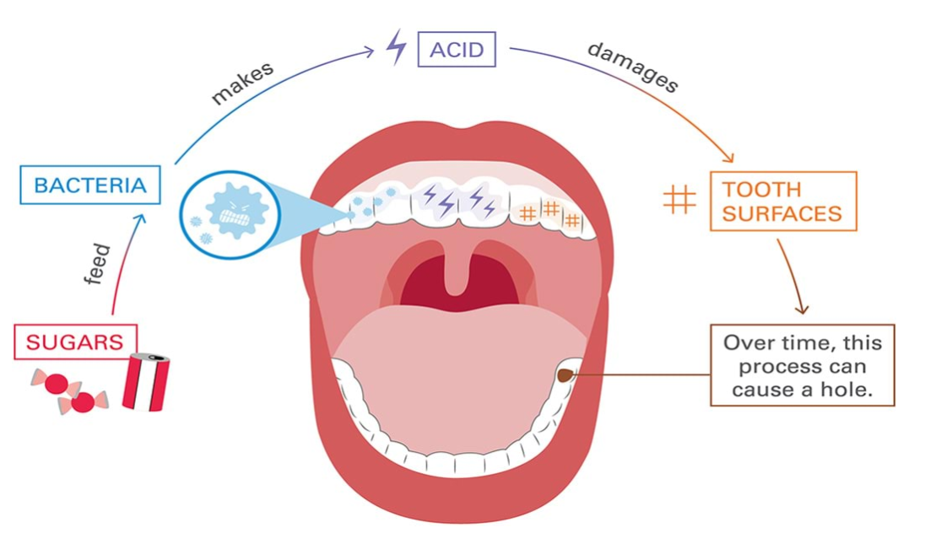
Dental Caries

Slide 28
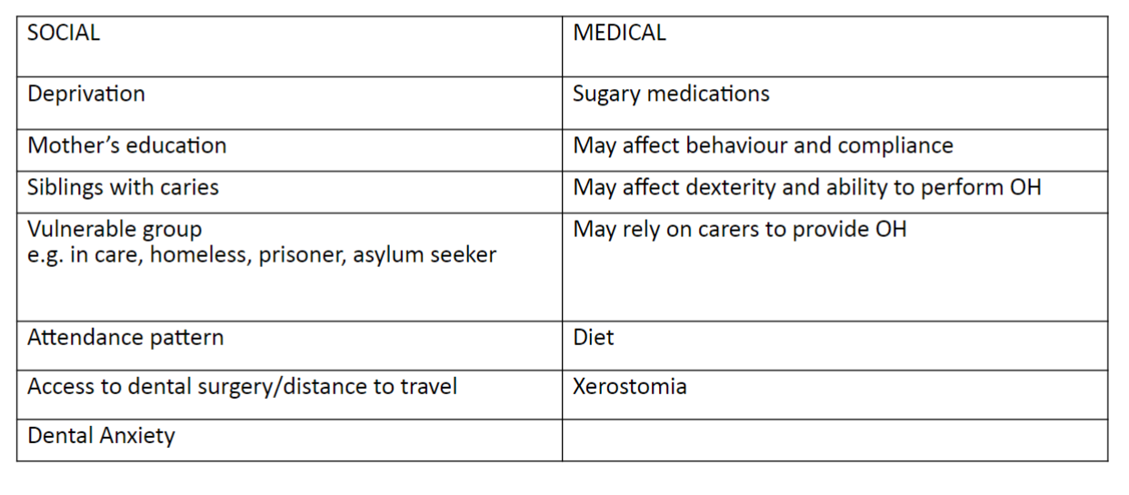
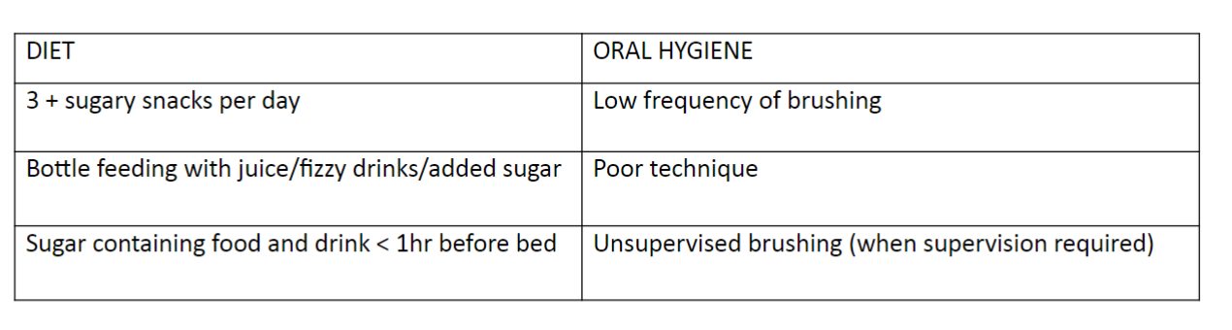
Dental Caries
Risk Factors

Slide 29
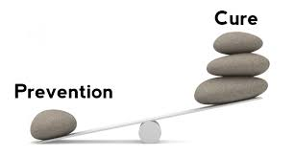
Dental Caries

Slide 30
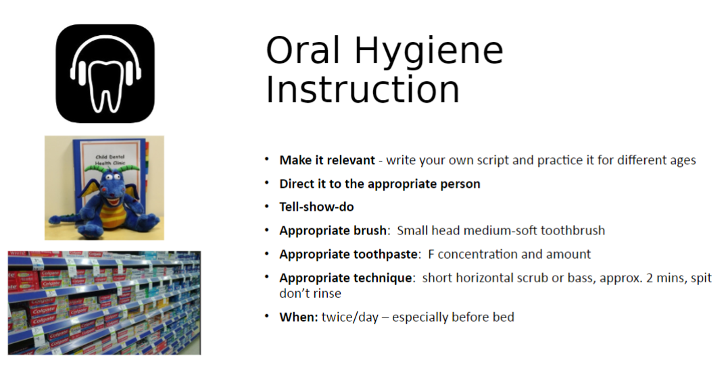
Dental Caries

Slide 31
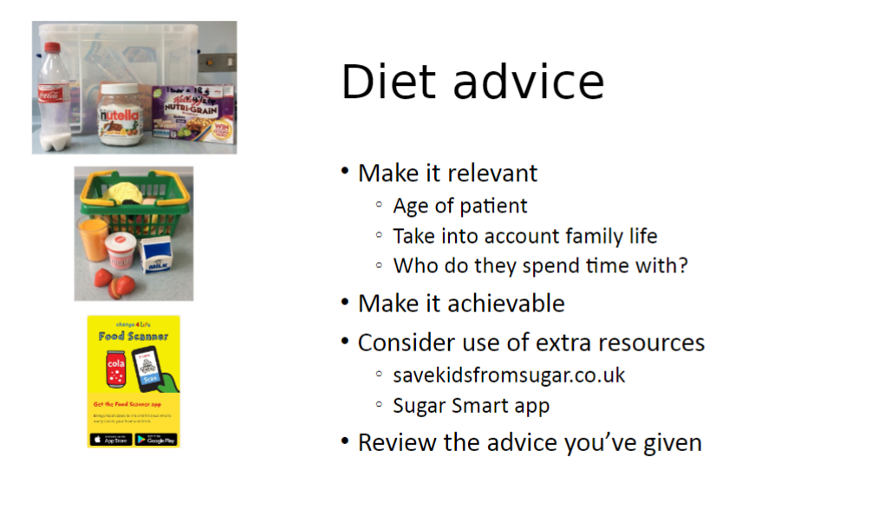
Dental Caries

Slide 32
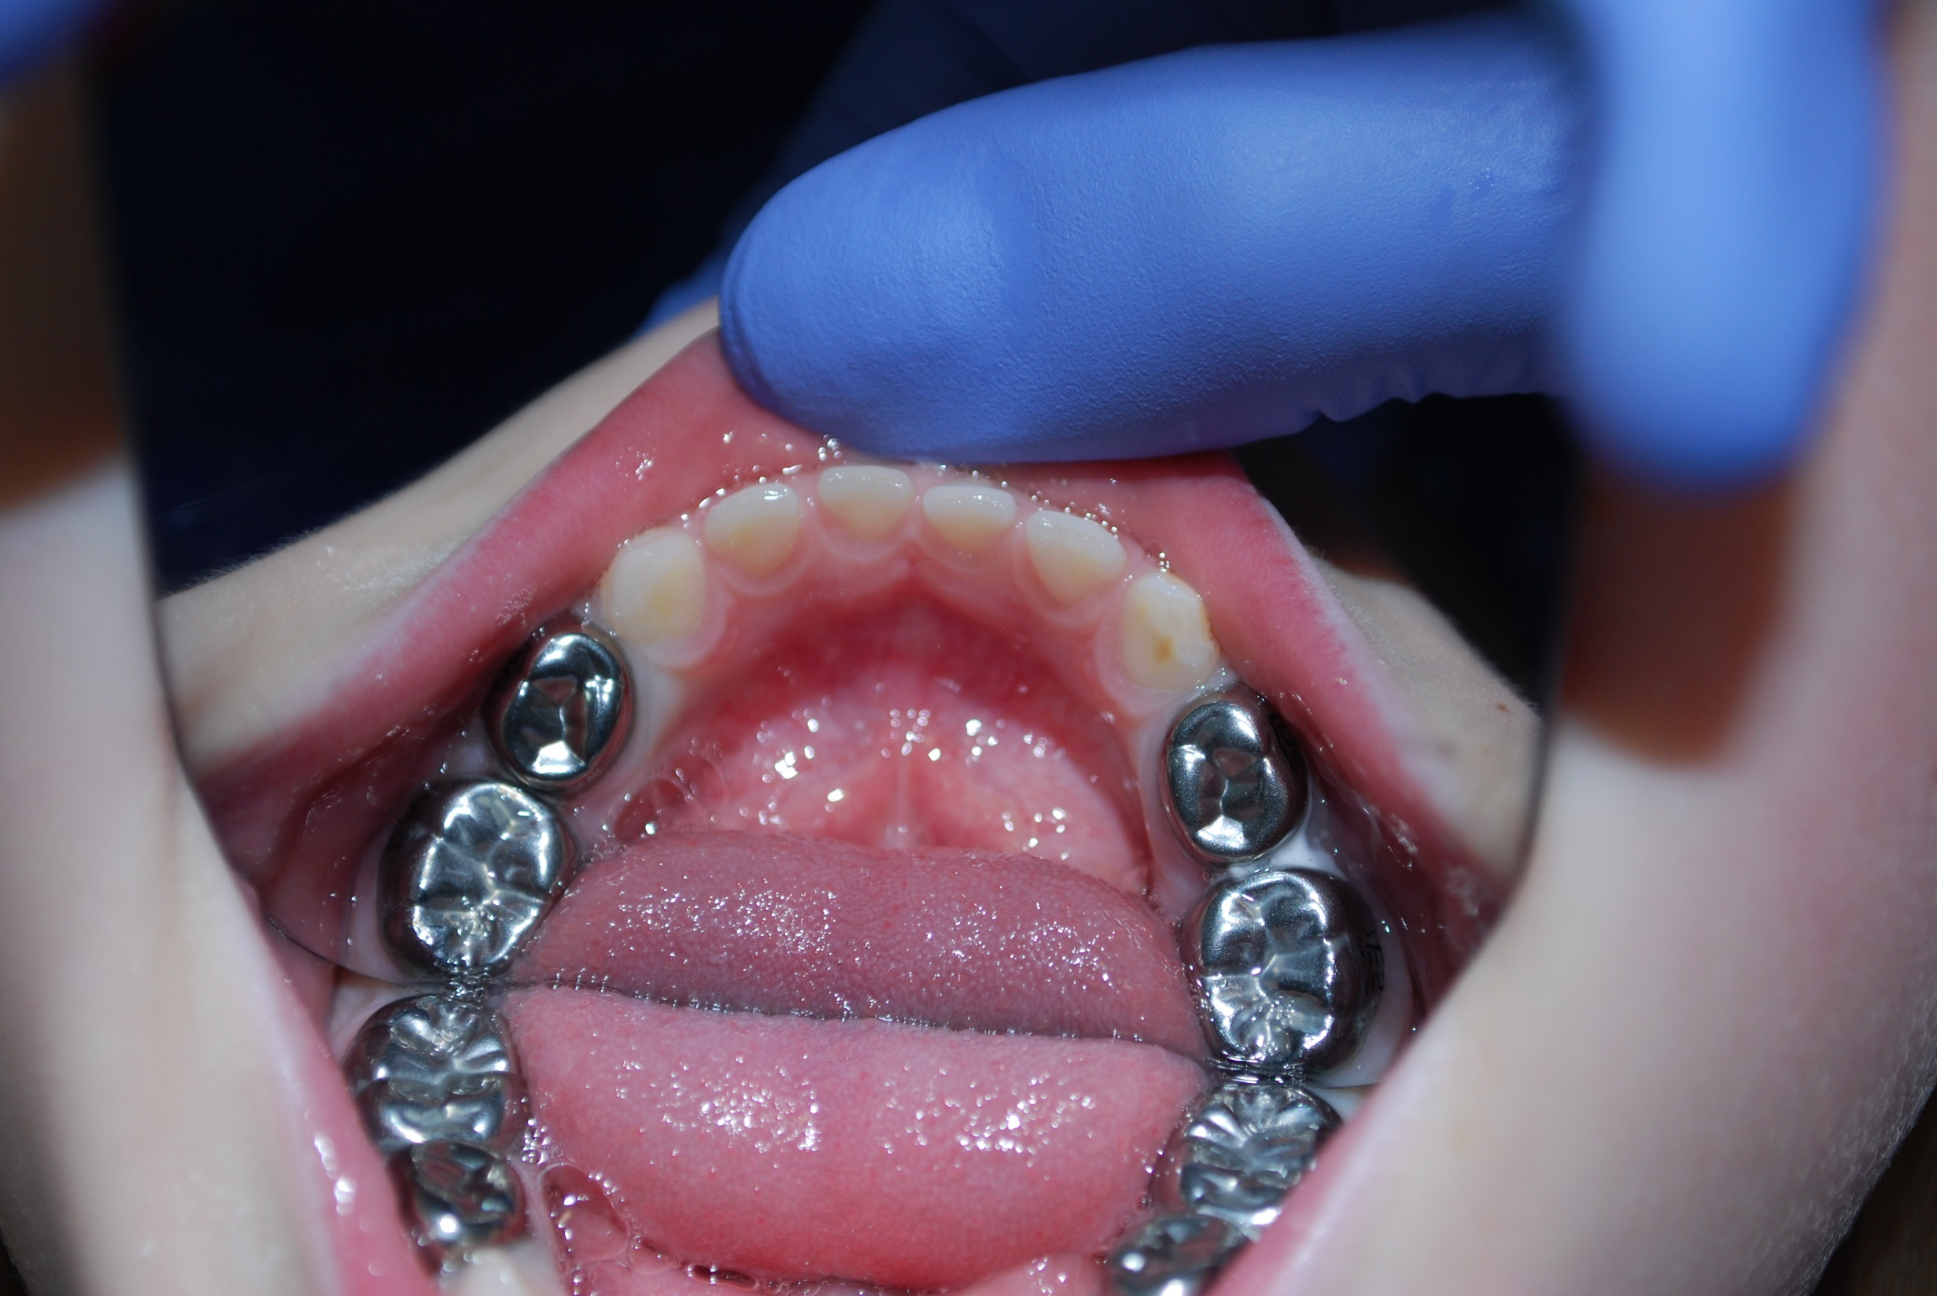

Slide 33
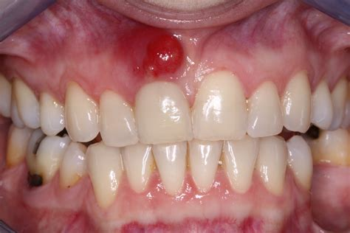
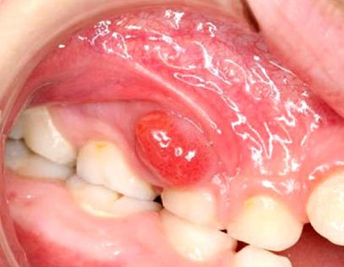
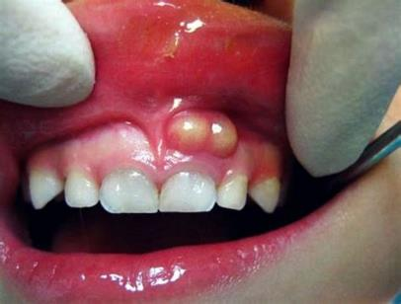

Slide 34
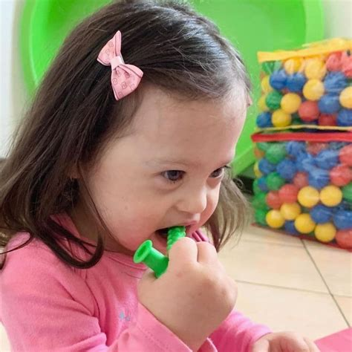
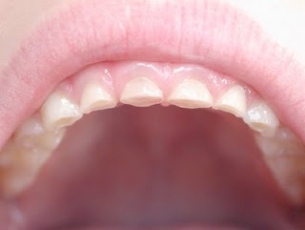
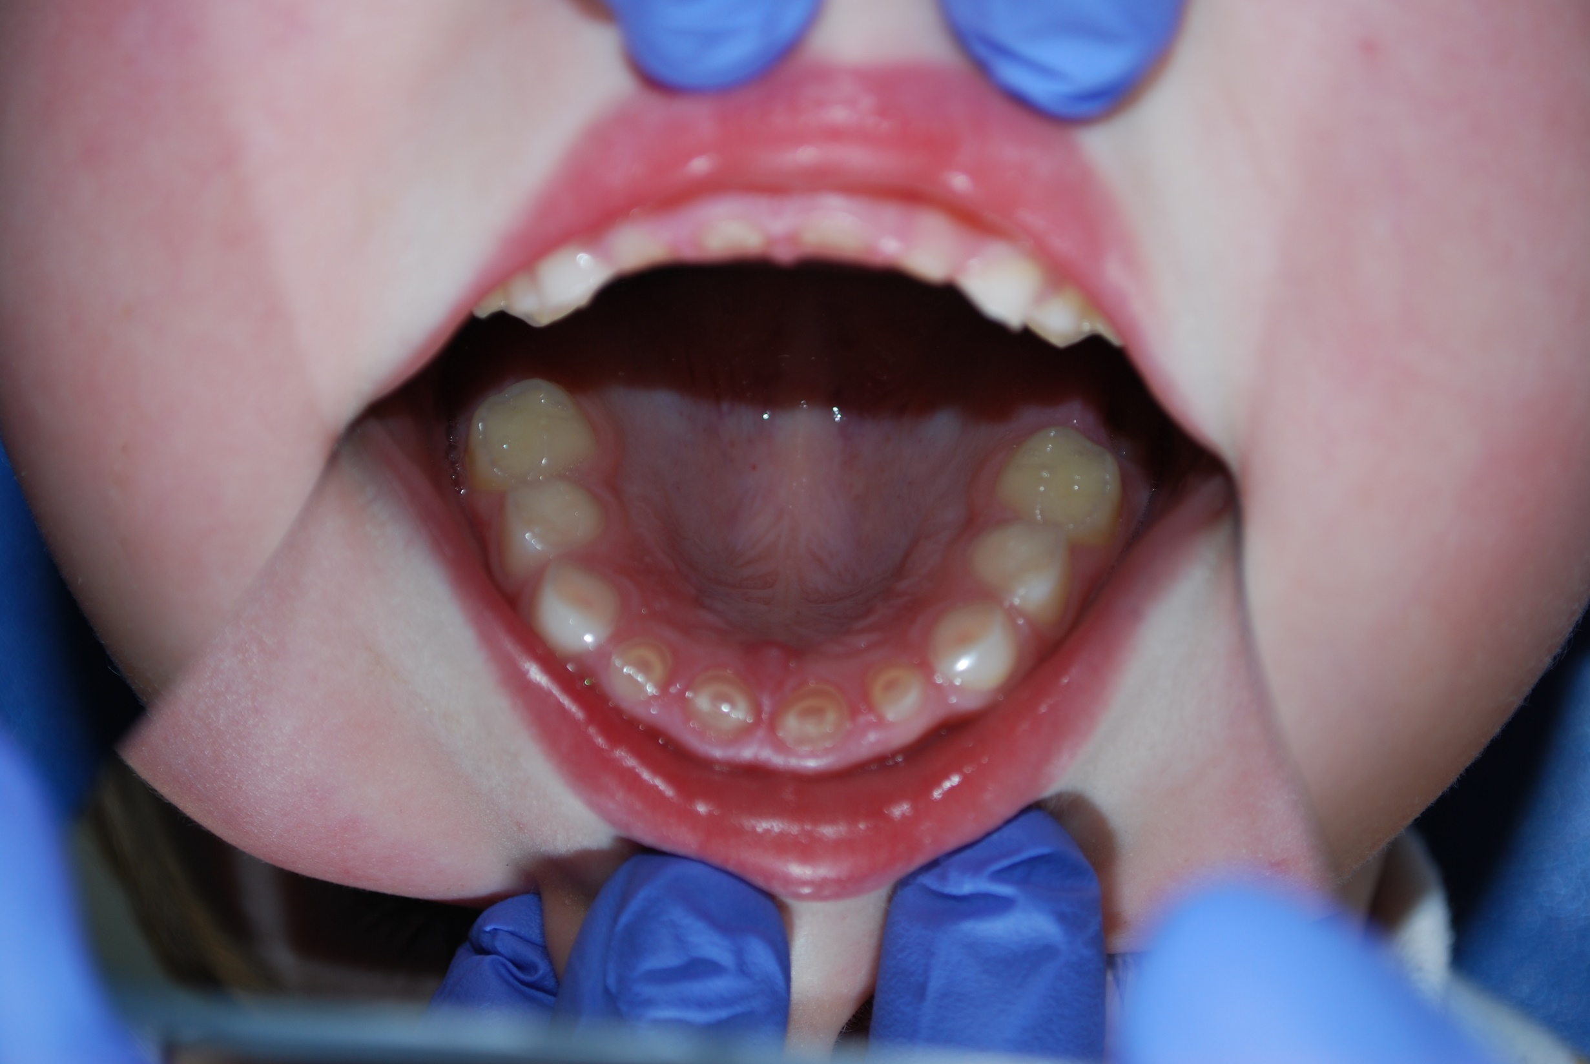
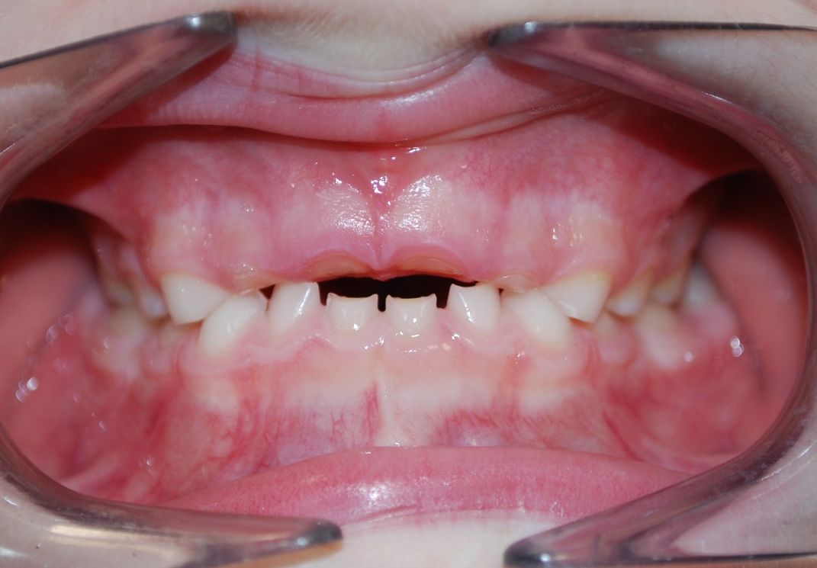
Bruxism
Erosion

Slide 35
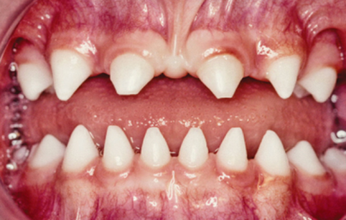
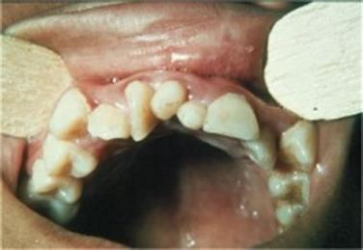
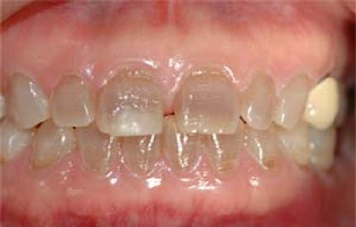
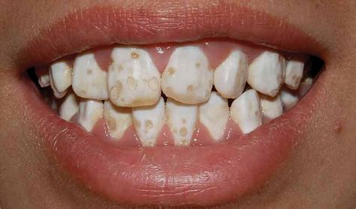
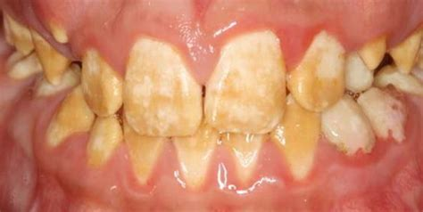
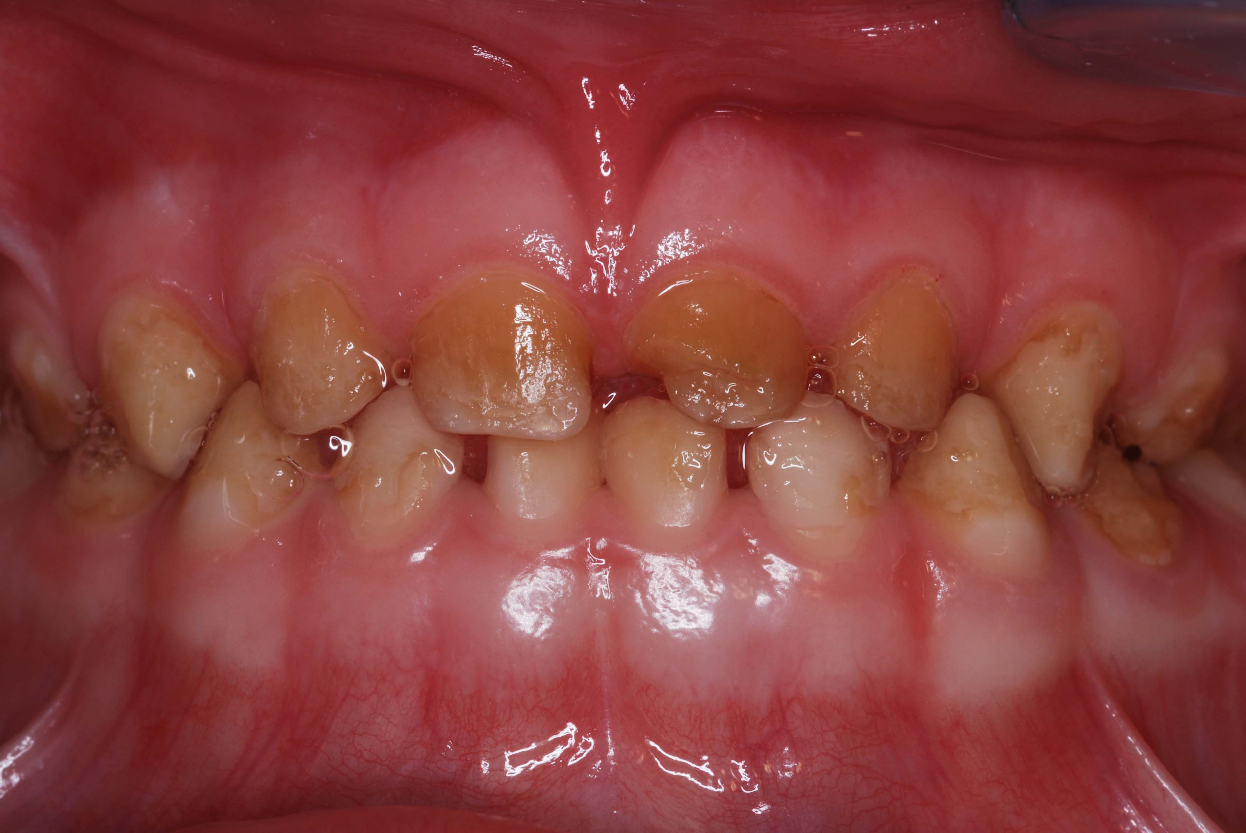

Slide 36

Child with SEN…

Slide 37




Challenges with NDD
Getting into the appointment
Oral aversion/sensitivity
Brushing difficult
Limited diet
Capacity to communicate
Grinding (?sensory seeking)
Xerostomia

Slide 38
“meltdown”
Sensory overload
Smells
Lights
Noise
Touch/Taste
Dental chair
New environment?
Familiar (painful) environment!
Storybook
Pre-appointment info / questions
Timing
Parents/Carers
Clinical holding
Notes:
Smells
Lights
Loud noise
New environment
Familiar environment

Slide 39
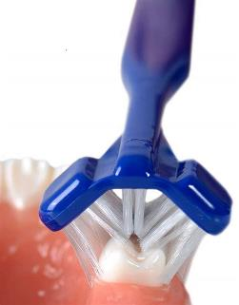

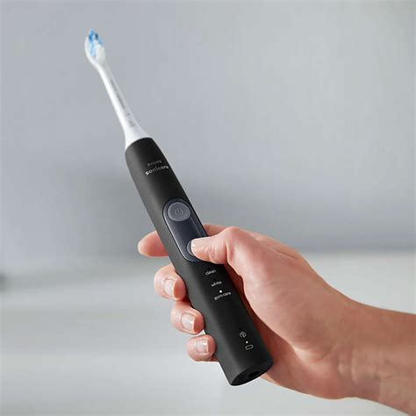
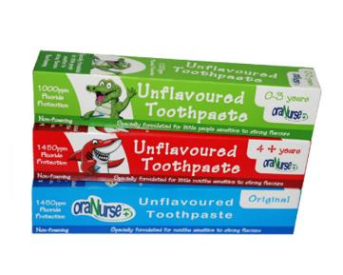

Brushing
Notes:
Twice daily but if not night time
Stand behind
?Pressure to cheeks and jaw working forwards towards mouth
Have them lean against sink – can spit out
Warm water
Brush from when first tooth erupts – build good habits/behaviours
Apps – Brush DJ, Aquafresh. Hey Duggee. Timers
Make a game although careful about describing them as tooth germs
Suction toothbrushes for those with weak swallow/NBM

Slide 40
Diet: sugars cause decay!
Number of sugars intake not necessarily volume
Leave one hour before bedtime
Sugared drinks in bottle = disaster
Free-flowing cup

Slide 41
Non-verbal
May not be able to describe toothache
‘stimming’ = putting objects in mouth, sensory drive
Differentiate with pain
‘mixed dentition’ 6-12 years old

Slide 42
How can you help?

Slide 44
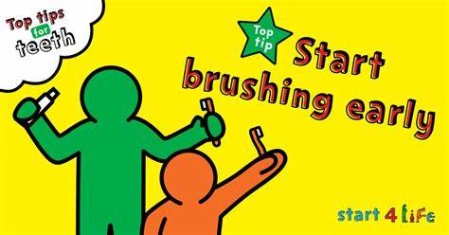


Slide 45
Advocate

Slide 46


Encourage regular dental attendance

Slide 47



Oral Health :: North East and North Cumbria Healthier Together (nenc-healthiertogether.nhs.uk)

Slide 48

Thanks for listening…

Slide 49

Healthier Together Champions
Sharing good practice and learning

Slide 50


Healthier Together Champions using digital technology to reduce health inequalities

Slide 51

Children & Young People are
25% of ED attendances

Slide 52





Parents want to know when to
Visit GP
Stay home with
Contact 111
Go to hospital
minor self-limiting illnesses
possible serious illness
Healthier Together’ provides parents, carers and professionals with consistent information and advice to empower families to make informed decisions around healthcare for their children.

Slide 53
Healthier Together NENC
Community Champions
establish local networks and trusted relationships
Empower people to take control over their health and lives
Work in our most underserved communities
Support a diverse range of individuals and groups at most risk of poor health
Share
HT resources
Encourage
families to use website and app.
Support
wider promotion
Provide
user feedback

Slide 54






HT Champions organisation identified in hotspot areas for high ED attendances
Over 300 HT Champions within VCSE and Education working in to our most underserved communities
potential reach 70,000 families

Slide 55
Sharing some of the HT Champions Work

Slide 56

Case Studies
EVA, in Redcar and Cleveland, work with women who are victims of domestic abuse or sexual violence.
Mum, of two children came for a session with her IDVA (Independent Domestic Violence Advocate)
‘she was concerned about her 8 year old son who had been feeling poorly. She had kept him off school. We encouraged her to download the Healthier Together App, and check the symptoms’
Later, mum told us that she felt relieved and had sent her son back to school. She made a GP appointment (as advised by app) and her son was diagnosed with Hay fever. Her son has not missed any further days off school’
Several staff members also use the app for their own children! and find it a very informative and a useful.

Slide 57



Slide 58
What’s NEW on Healthier Together
Communications
New Comms materials Promotional material for NENC Healthier Together :: North East and North Cumbria Healthier Together (nenc-healthiertogether.nhs.uk)
HT animation Healthier Together animation (youtube.com)
Parent Carer
Tracheostomy :: North East and North Cumbria Healthier Together (nenc-healthiertogether.nhs.uk)
In-toeing or pigeon toe (feet turn in when walking) :: North East and North Cumbria Healthier Together (nenc-healthiertogether.nhs.uk)
Chest pain :: North East and North Cumbria Healthier Together (nenc-healthiertogether.nhs.uk)
Following a head injury :: North East and North Cumbria Healthier Together (nenc-healthiertogether.nhs.uk)
Henoch-Schönlein Purpura (HSP) :: North East and North Cumbria Healthier Together (nenc-healthiertogether.nhs.uk)
Professional Section
Early pubic hair and adrenarche :: North East and North Cumbria Healthier Together (nenc-healthiertogether.nhs.uk)
NHS_Abnormal_head_shapes.pdf (nenc-healthiertogether.nhs.uk)
https://www.nenc-healthiertogether.nhs.uk/professionals/padiatric-pathways/lyme-disease
Beat Asthma Friendly Schools :: North East and North Cumbria Healthier Together (nenc-healthiertogether.nhs.uk)
Beat Asthma Friendly Sports Clubs :: North East and North Cumbria Healthier Together (nenc-healthiertogether.nhs.uk)

Slide 59
Impact
Healthier Together Website has had over 245,000 users since going live
Over 7500 children now signed up on the app
Two-thirds of children end up in selfcare (staying at home)pact
Upskilled VCSE and Education settings to sign post families to access HT resource
Supported schools improved school attendance
Increased parental confidence to selfcare for their children when appropriate
  “The Healthier Together app and website is easy to use, provides good advice and stops me over-worrying about illnesses which could be treated at home instead of attending A&E.”

Slide 60
Reduced Emergency Department Attendance in NENC
in 2023 vs 2022
8% reduction in ED attendance for Pre-school children (0-4 years old)
4% reduction in ED attendance for all children & young people (0-18 years old)

Slide 61

Future Sessions
Themes | Topics
Neurodevelopment | learning disabilities/difficulties-getting a diagnosis Autism and ADHD support
Mental Health and wellbeing | Activities that help with focus and concentration Trauma Disordered Eating Mental Health Advice for new parents Tools to support children in primary school with low level anxiety
Nutrition | Fussy eaters Healthy Eating Eatwell guide and portion size
Long Term Condition | Epilepsy Heart health Asthma and Epipen Tracheostomy Care
General Health and Wellbeing | Common Childhood Illnesses Cost of Living, Public Health, Early childhood Inequalities and access Understanding Data Parent and Carer Support

Slide 62
Healthier Together Champions
Discussion

Slide 63

Stay in touch…
Please follow, share and retweet relevant work so that we can continue to share good practice across the region via the Child Health and Wellbeing Network Twitter @EveryChildNENC
Visit our website: https://northeastnorthcumbria.nhs.uk/our-work/workstreams/optimising-services/child-health-and-wellbeing-network/
Please encourage colleagues from all areas of Child Health and Wellbeing to register via forms.gle/gG11zhr2Z8VLU2db9 so they are included in our communications and feed into the workplan projects that they are interested in.
Please fill in this short form to let us know how you facilitate engagement, participation and 'CYP voice' activity, and connect with us
Complete this short form to register your professional network/group and create more connections
Join our Network
Contact us: nencicb.northernchildnetwork@nhs.net

