Slide 1
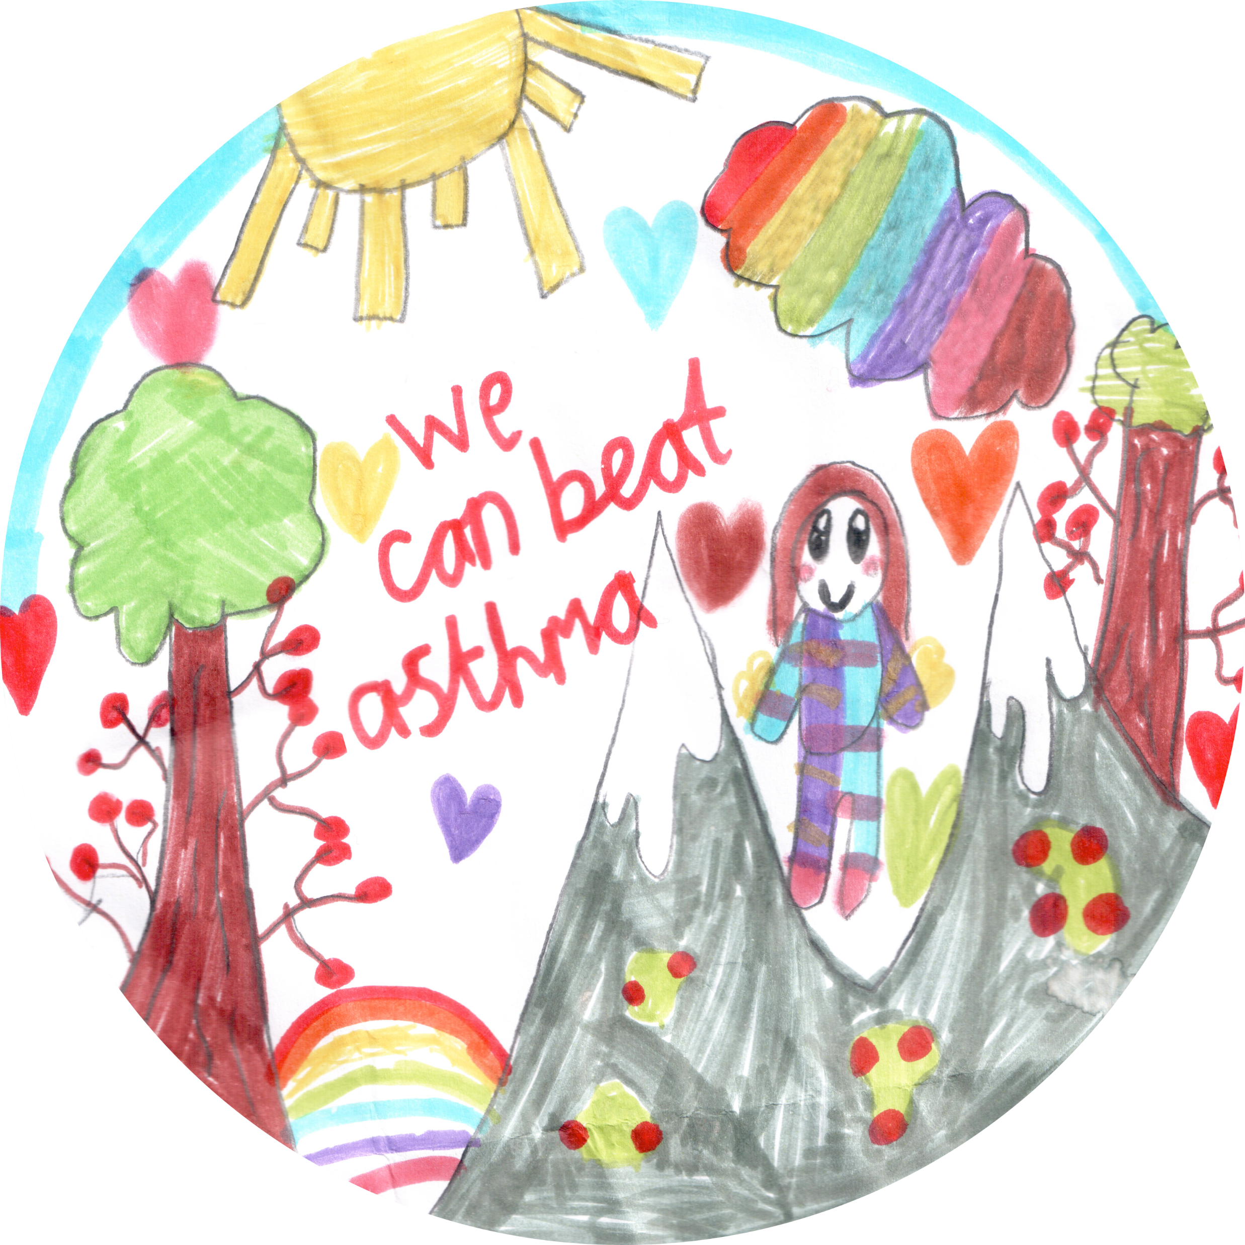
Asthma Assembly
Notes:
Hello and welcome to our assembly on asthma .

Slide 2
Which one of these children has asthma?
Notes:
Looking at the picture of the children, discuss can you tell which child or children might have asthma.
You can ask the children to put their hands up and say who they think in the picture has asthma.
Discuss that you can not tell by looking at a person if they have asthma.

Slide 3
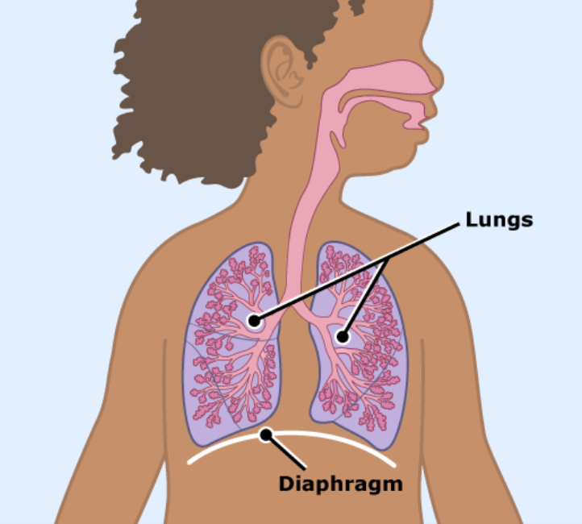
How big are our Lungs?
Notes:
Explain that the lungs are made of 2 big tubes that then go into 2 smaller tubes and then to even smaller tubes. Ask the children to point on their bodies where their lungs are and ask then to take a big breath in and a big breath out and feel their lungs expanding getting bigger.

Slide 4
What do lungs look like close up?
Notes:
This picture show what the lungs look like when they are magnified, the blue arrows show how the air enters the lung and flows through the tubes.

Slide 5
Fascinating facts about breathing
 | If you could spread out the tubes in your lungs they would reach for many hundreds of miles. |  | In adults, the lung tubes would fill a tennis court.
 | We breathe 22,000 times per day. |  | We breathe in oxygen and breathe out less oxygen and carbon dioxide
The lungs get oxygen in, and the heart pumps it around the body.
Notes:
Read the fascinating facts about breathing. Talk about the 22000 breathes and how clever our bodies are and we breath when we are awake and asleep without even thinking.

Slide 6
Notes:
Explain the picture what normal airways looks like of a person who does not have asthma and the picture and the other shows what the airways look like of a person who has asthma. It show how the airways become more narrow and constricted tighter and the lining is swollen making it hard for air to move in and out and the rings of muscle are tighter.

Slide 7
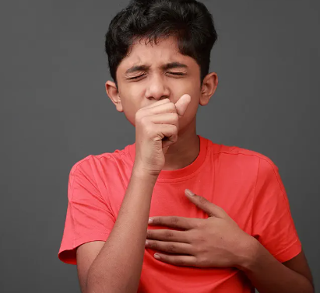
What do children say about asthma?
It makes me cough.
My breathing whistles
It is harder to breathe
I feel like my chest is getting squeezed.
It is hard for me to run
I sometimes miss school and my friends
Notes:
What a child/ young person who has asthma says.
My breath whistles , Do you know what the medical name for whistling sound is ask the children tell them its wheezing if they don’t know.
Talk about the little boy in clinic who once said it felt like a big blue dinosaur was sitting on his chest which made it hard for him to breathe.

Slide 8
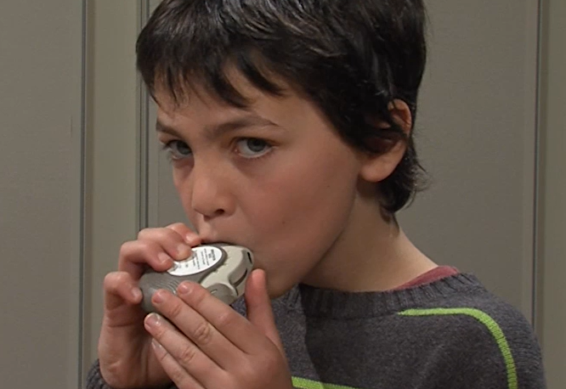
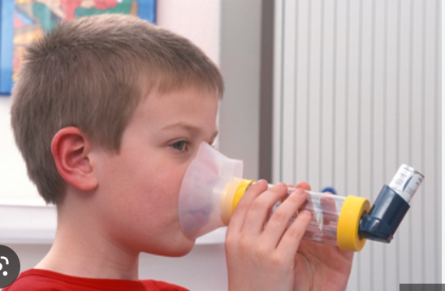
What makes asthma better?
Inhalers and medicine prescribed by a Doctor, or a Nurse can make asthma better and is taken every day.
Blue inhalers help your airways to relax and help you to breathe
Notes:
Discuss the photograph of the two children taking different inhalers, one with a spacer and one via an accuhaler. Explain that there are lots of different coloured inhalers and types of inhalers to help children's asthma. Blue inhalers are usually the rescue inhalers children take if they are having an attack or findi

Slide 9
Notes:
This poster shows all the different inhalers and spacer available to help children and young people with their asthma.

Slide 10
How can you help someone with asthma?
Tell them they will be ok when they are feeling unwell.
1
Get help if you see someone who is finding it hard to breathe
2
Help them get their inhaler if you can it is usually blue .
3
Stay calm and keep talking to them .
4
Encourage them to keep taking their blue inhaler until they feel better.
5
Notes:
Talk through the slide explaining how to help someone with asthma.
Reinforce the importance of staying calm and telling them they will be ok
Encourage them to take their rescue inhaler to help them feel better.

Slide 11
Aliesha's story
Notes:
The video :Alisha talks about her asthma and how it makes her feel , it shows her taking her medication , she talks about her friends, school and activities and how her asthma affects her.

Slide 12
Thank you
Notes:
If you are not already a Beat asthma friendly school and would like to become accredited please feel free to get in touch and discuss. Thank you for your time.

