Slide 1
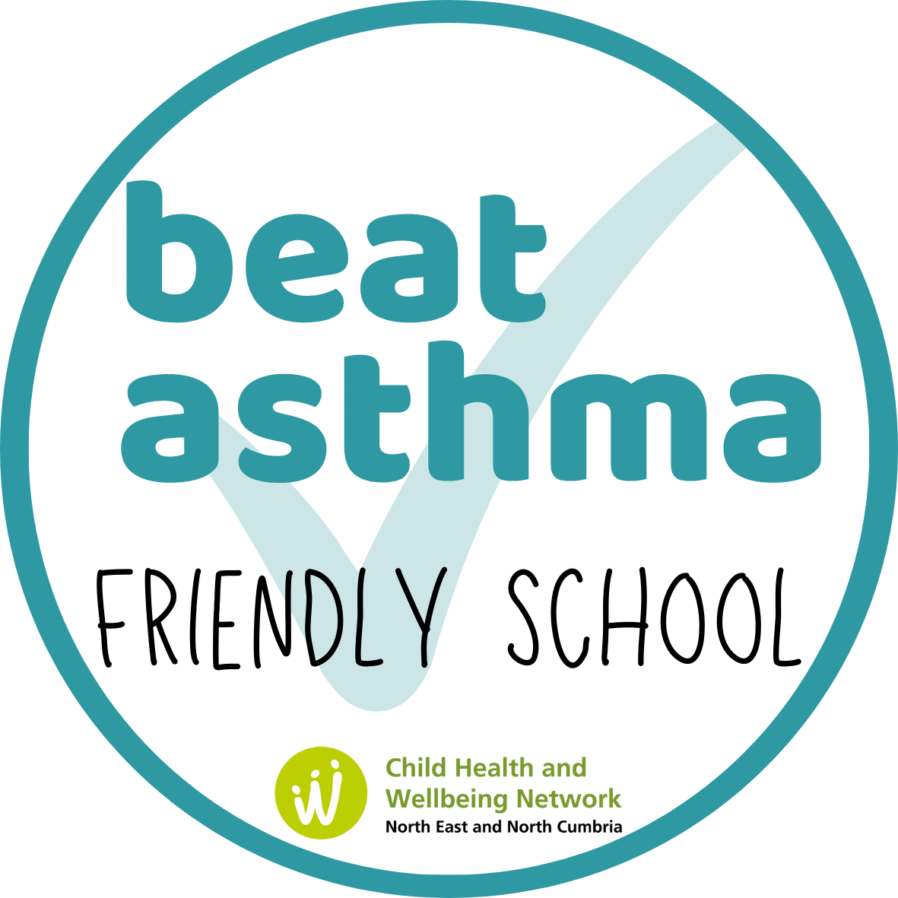
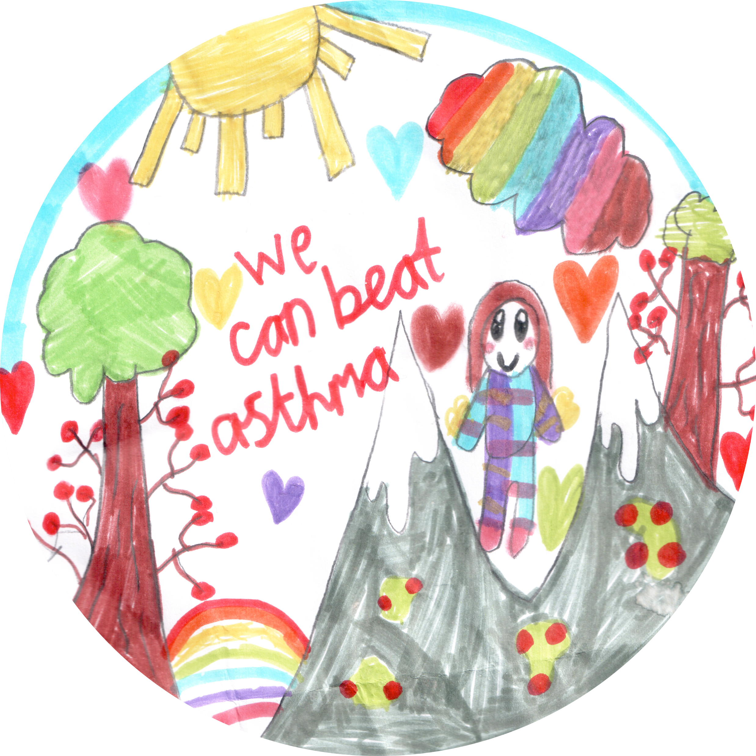
Asthma awareness session- Children and Young people
Notes:
Hello and welcome to our assembly on asthma .

Slide 2
Is asthma obvious?
Notes:
First thing is to ask, do you think it is obvious if someone has asthma?
Do you think you could tell just be looking at them?

Slide 3
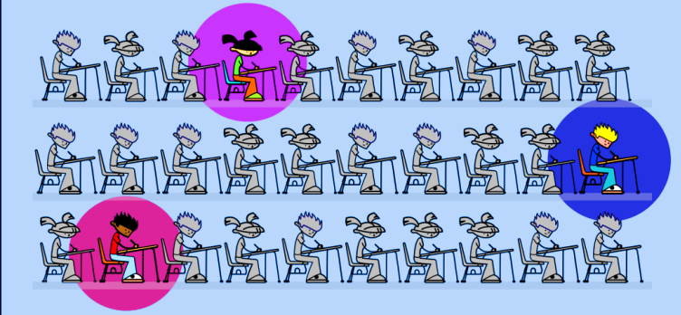
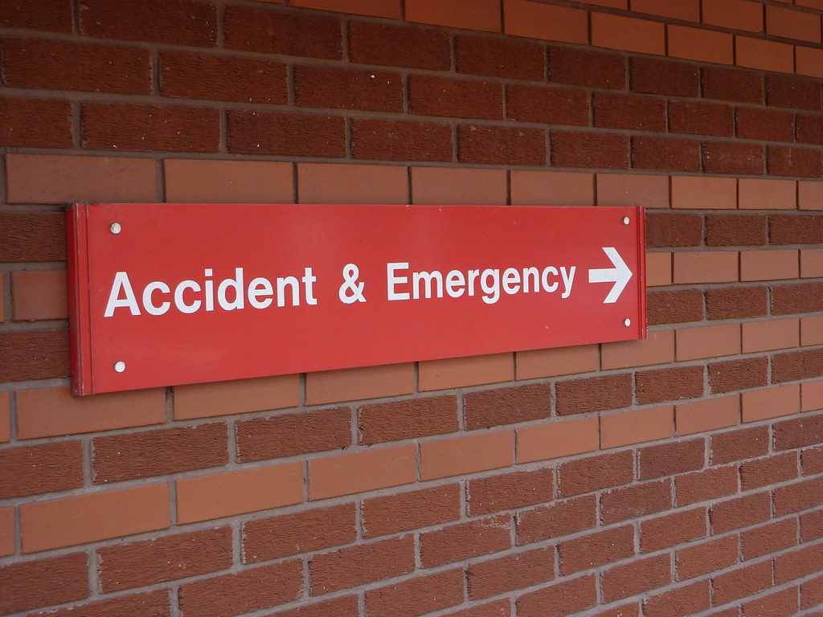
The information we already know about asthma !
One in every eleven children have asthma
Three young people per
average class
Almost 20,000 CYP admitted to
hospital in 2021- 2022
Notes:
What we already know,
1 in every 11 child have asthma. Which would mean children in an average class has asthma.
There was almost 20,000 children and young people admitted to hospital between 2021 and 2022 with asthma.

Slide 4
Asthma Rap
Notes:
Here we have a rap which was written and recorded for the #AskAboutAsthma campaign 2022 (only play a small part)

Slide 5
What is Asthma?
Common lung condition that causes breathing difficulties
Asthma often starts in childhood, but adults can also develop asthma
Some things make asthma more likely e.g. history of allergies
Notes:
So, what is asthma?
Asthma is a common lung disease which causes breathing difficulties
It often starts in childhood, but some adults can develop asthma too
Its known that somethings can make you more likey to have asthma, for instance … if you have any allergies. This is often linked to asthma.
Link – video from moving On Asthma (what is asthma)

Slide 6
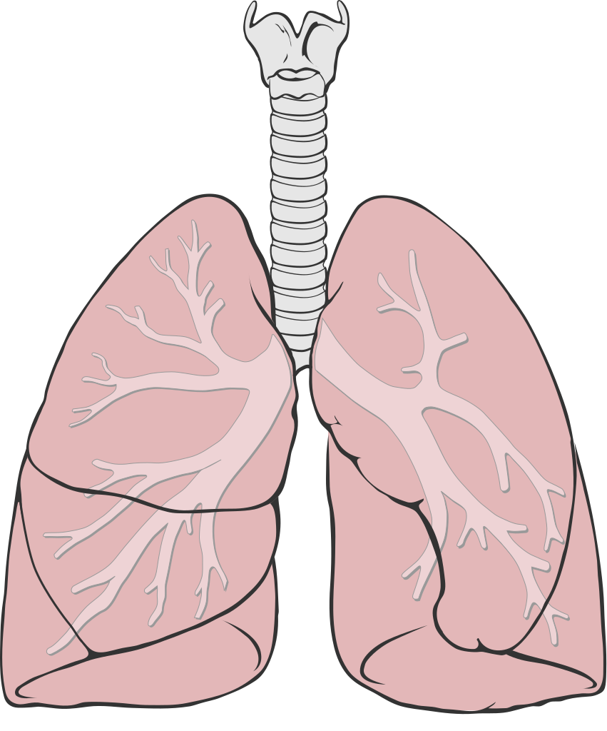
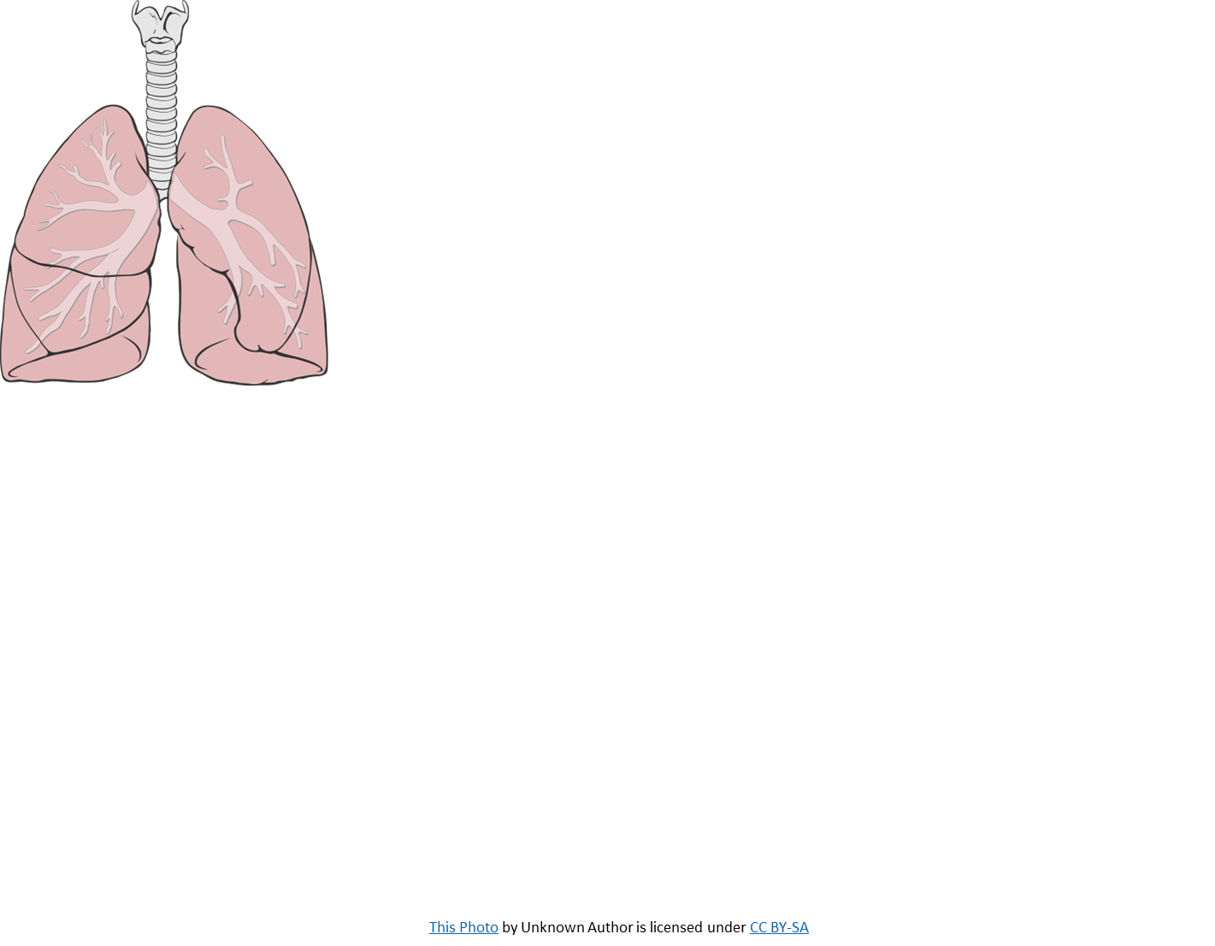
Asthma - How and why?
This Photo by Unknown Author is licensed under CC BY-SA

Slide 7
What are the signs of Asthma?
The main symptoms of asthma are:
Wheezing (a whistling sound when breathing)
Feeling breathless (struggling to speak)
Coughing
Tightness or squeezing of the chest
Asthma can sometimes get worse, for a short time, this is known as an asthma attack. It can happen suddenly, or gradually over a few days
Notes:
What are the signs of asthma?
Here are the main symptoms, Wheezing, Feeling breathless, coughing, and a tight feeling in your chest.
(explain about asthma attack – read the bottom statement)

Slide 8
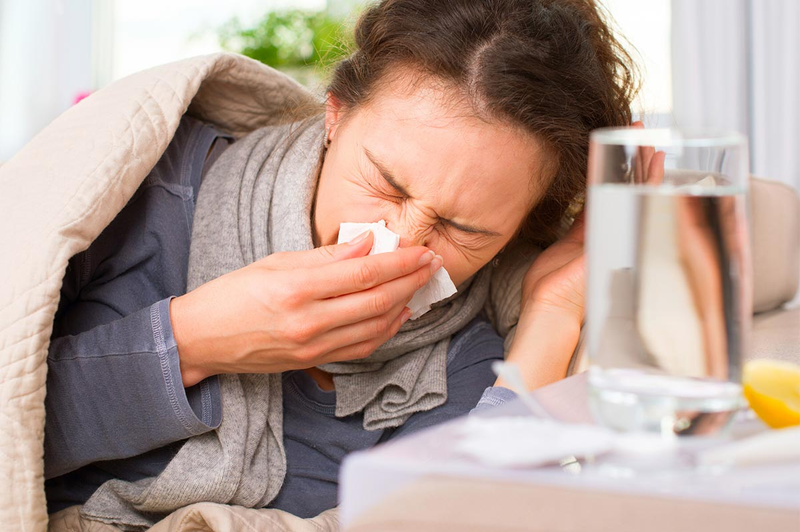
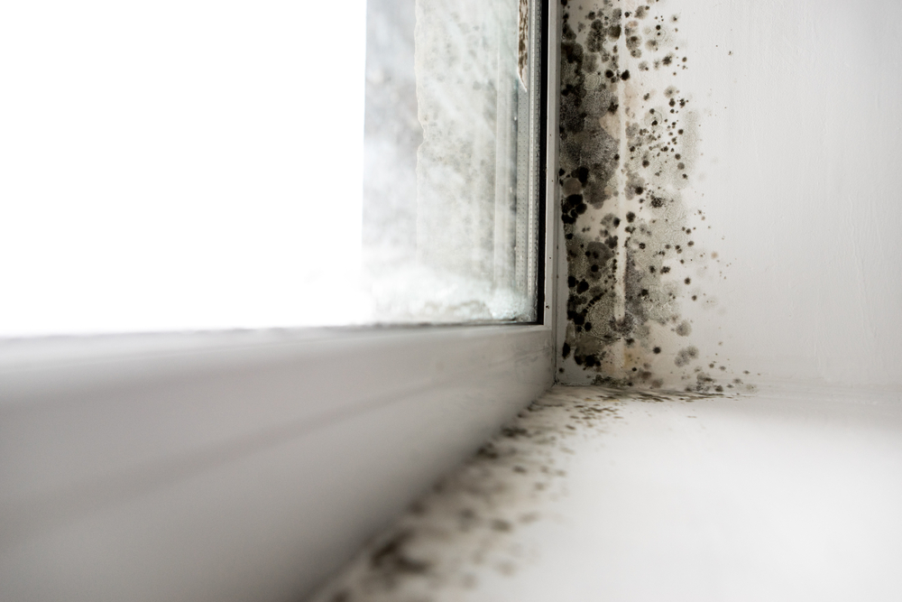
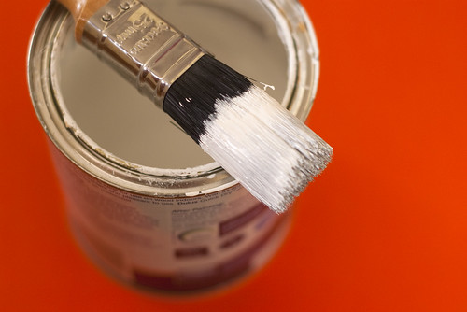
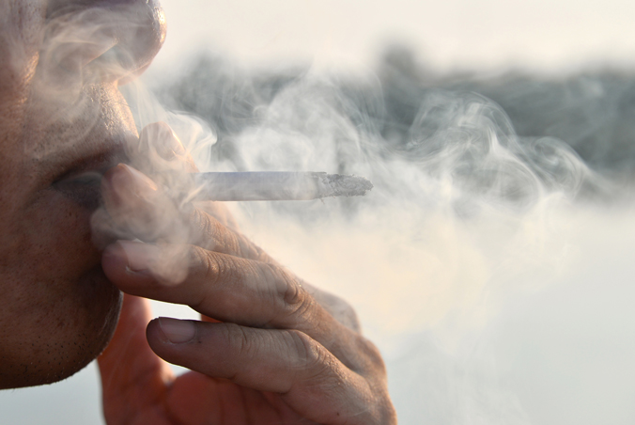
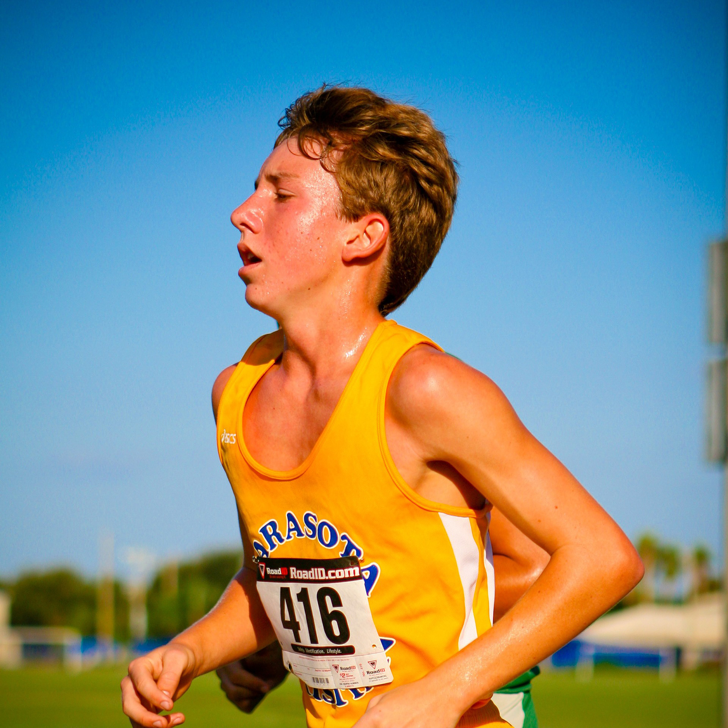
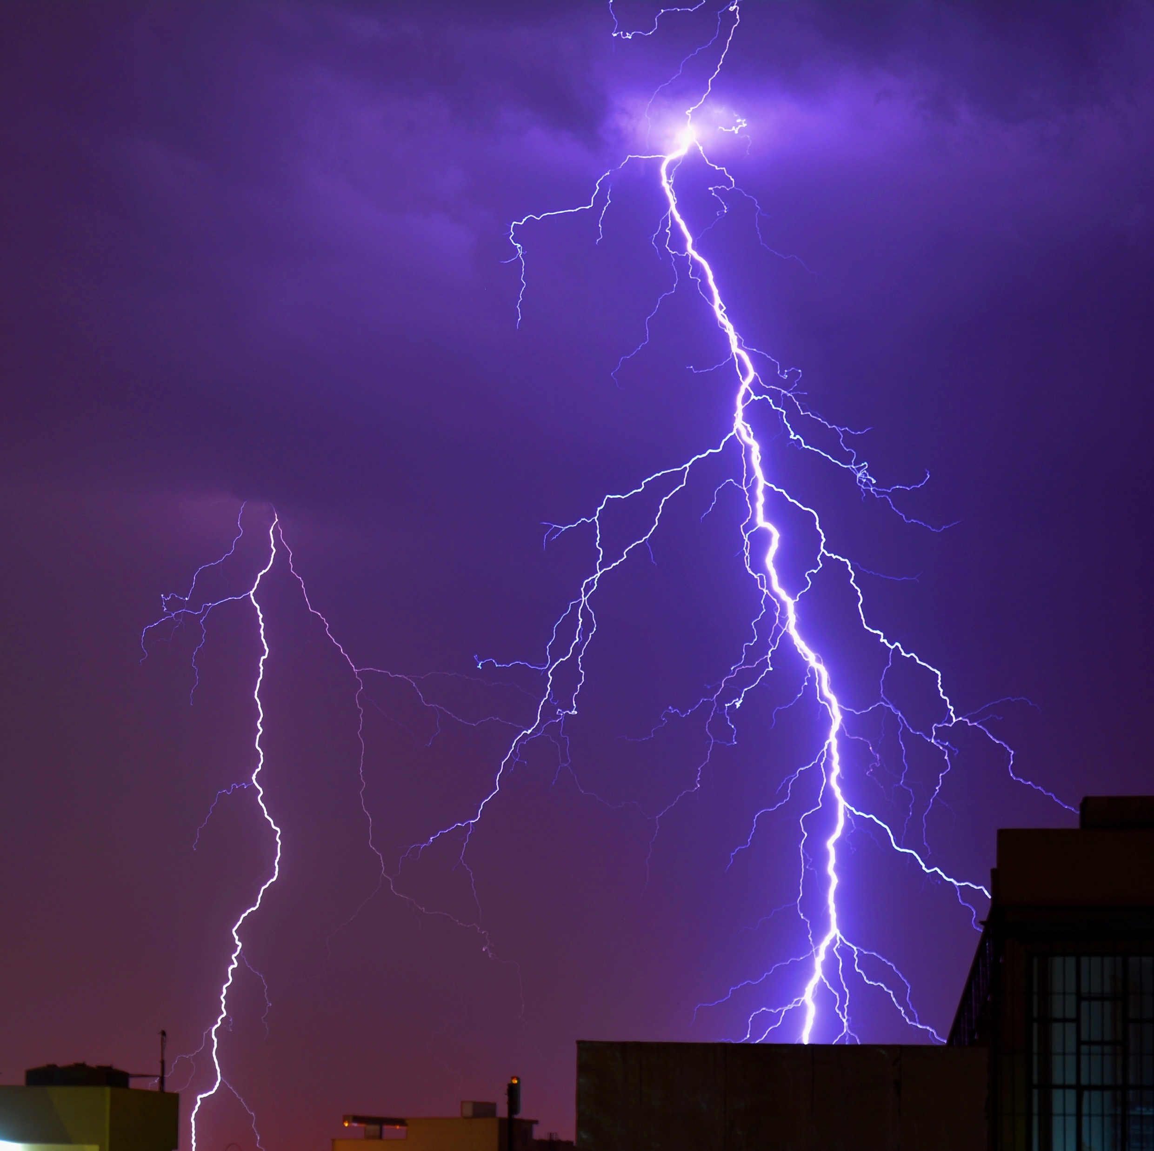
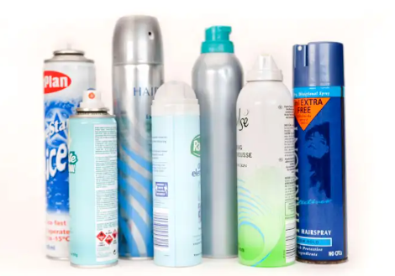
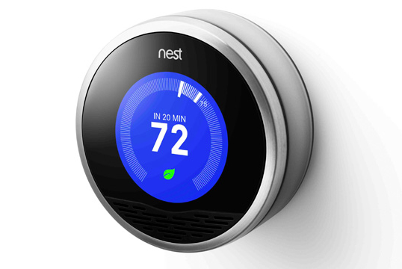
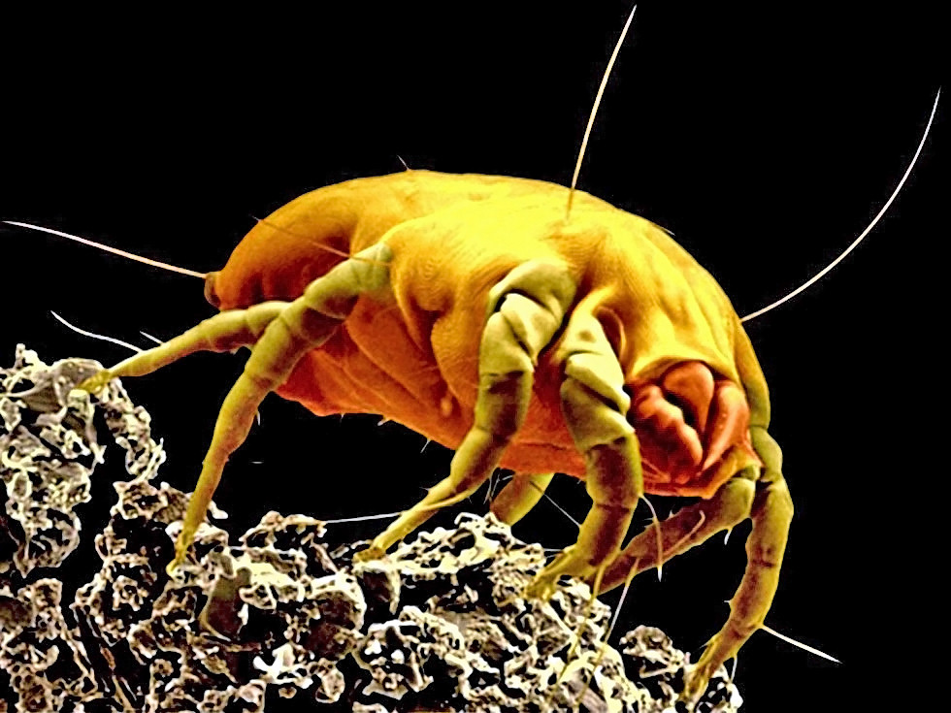
Some examples of Asthma triggers
Cleaning products
Colds/Viruses
Damp and Mould
Paint Fumes
Smoking
Changes in room temperature
Hot/Humid Days
Exercise
Grass
Thunder Storms
Aerosols/sprays
Stress
Animals
Pollution
Dust Mites
Pollen
This Photo by Unknown Author is licensed under CC BY
This Photo by Unknown Author is licensed under CC BY-SA
This Photo by Unknown Author is licensed under CC BY-SA
This Photo by Unknown Author is licensed under CC BY
Notes:
This is just a few examples of what can cause peoples symptoms to become worse.
It is important that is someone with asthma has an allergy, or is triggers by any of these things, that they try to avoid them where possible, as they may lead to them having an asthma attack.

Slide 9
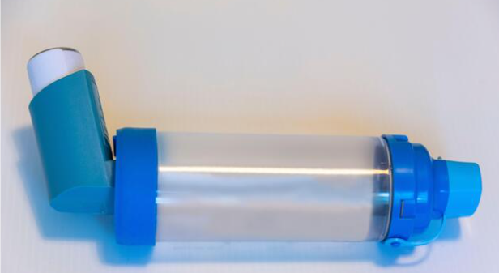
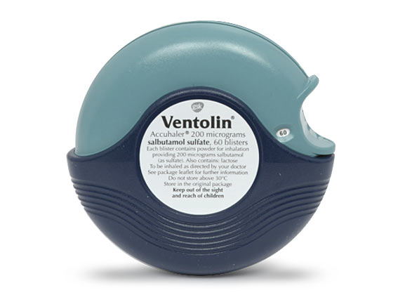
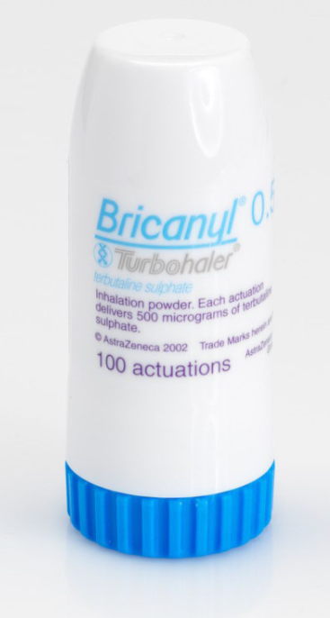
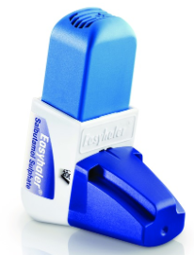
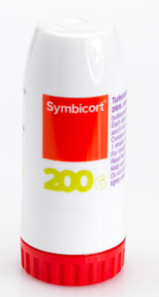
Treatments for asthma
There are many different types of inhalers and medicines which a Doctor or a Nurse can prescribe to help treat asthma
The main types of inhalers:
Reliever inhalers – these are used to quickly relieve asthma symptoms, but only last for a short time. (Rescue)
Preventer inhalers – these are used everyday to prevent asthma symptoms developing.
Some people also need to take tablets and medicines as part of their asthma treatment.
Some inhalers have both reliever and preventor -MART
Notes:
Not everyone has the same treatment, but they all help in preventing and relieving peoples asthma symptoms.
The most common inhaler used it Salbutamol, this is a blue inhaler.

Slide 10
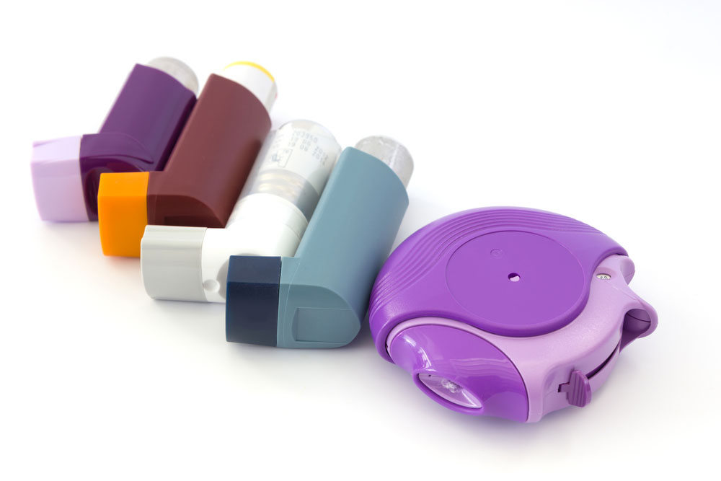
How is asthma controlled ?
Asthma can be controlled with a range of treatments, so it is important the correct medication is used in the right way at the right time
It is also important to try to avoid triggers.
Each individual should have a Personalised Asthma Action Plan (PAAP). The plan should be followed to control asthma.
Regular review with asthma doctor or nurse.
Keeping active.
Notes:
Not only do people with asthma use an inhaler, sometimes people with asthma also take oral medications, such as tablets to help manage their symptoms.

Slide 11
Notes:
This is just some of the many different types of inhalers and spacers used by people with asthma.

Slide 12
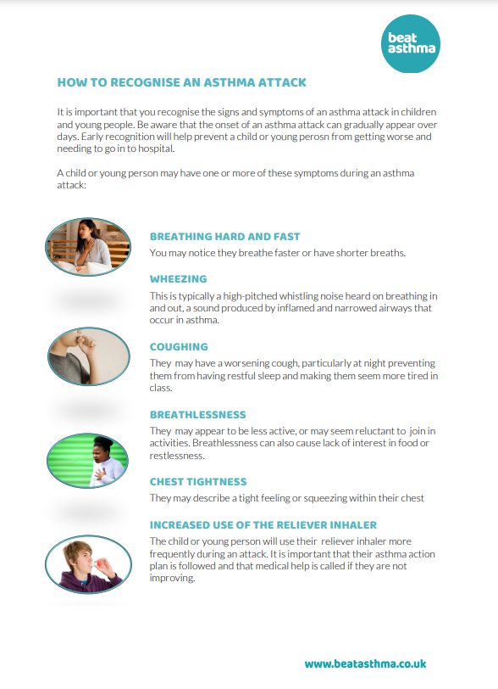
Asthma Attack
It is important that you know what to do if someone you know is having an asthma attack.
Recognising the symptoms of an asthma attack is the first step in helping.
Mild/Moderate Symptoms:
Cough / Wheeze / Shortness of breath / Chest tightness/pain
Severe/life threatening Symptoms:
Faster breathing rate / working hard to breathe / unable to talk in full sentences / Looking pale/looking worried.
Notes:
If someone you know was having an asthma attack, would you know what to do?
It important that you know how to help someone if they have asthma, and are having an asthma attack. And by knowing what the signs of an asthma attack are, this is the 1st step in helping them.
(read through the mild/moderate/severe symptoms)

Slide 13
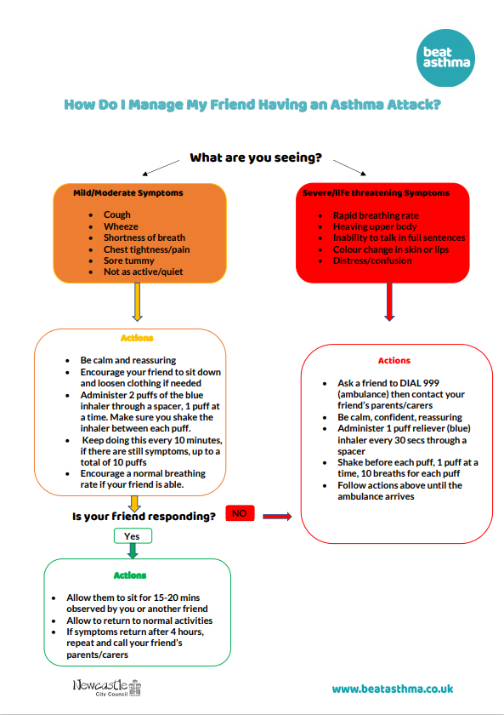
Notes:
This is a diagram to help you if you are with someone who is having an asthma attack.

Slide 14
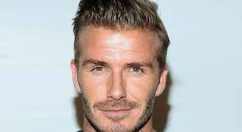
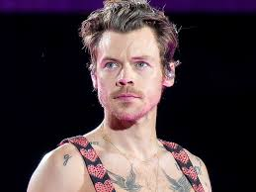
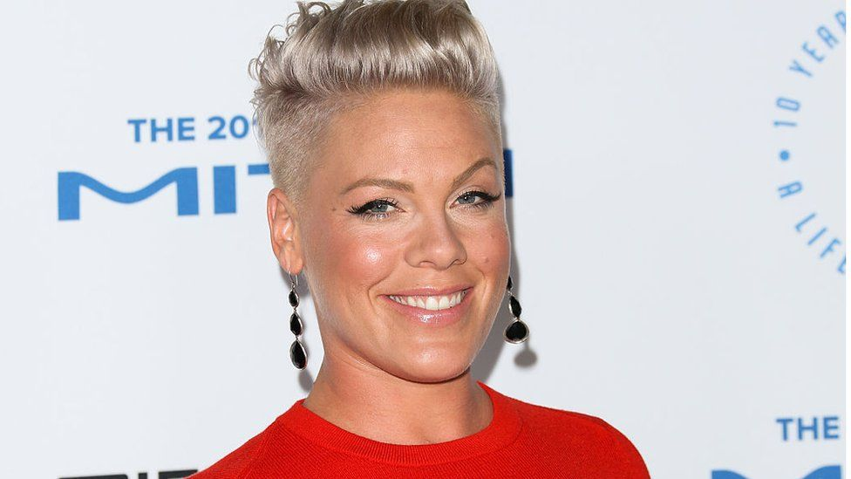
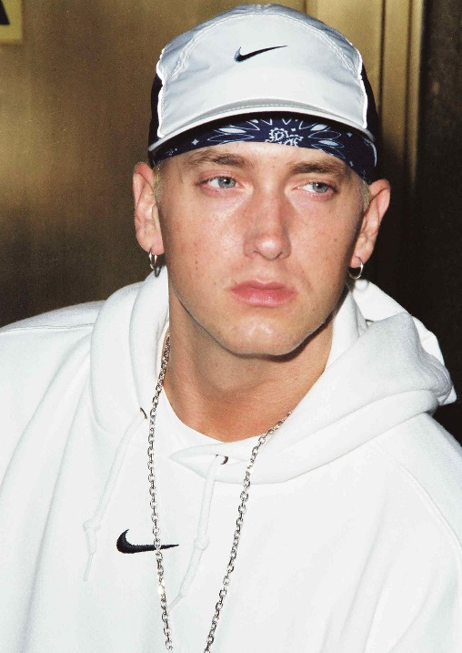
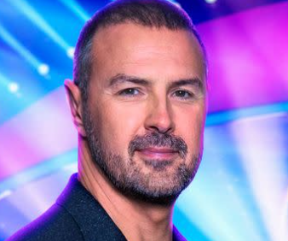
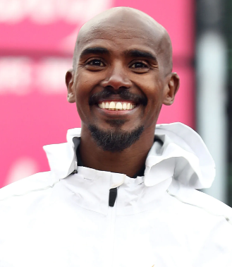
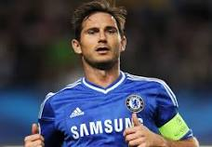
Celebs with Asthma
David Beckham
Harry Styles
Pink
Eminem
Paddy McGuiness
Mo Farah
Frank Lampard
Notes:
Anyone can have asthma. Here are a few celebrities you may know who have asthma.
Many of these are singers and athletes. And them having asthma has not stopped them from doing what they love.

Slide 15
Asthma – becoming independent
Going out is one of the most important parts of growing up and becoming a young adult.
Make sure your friends are aware that you have asthma.
If you have asthma and are planning to go out with friends to a party be aware that some drinks/smoking and some medications/drugs can trigger asthma symptoms.
If you have a Personalised Asthma Action Plan (PAAP) – have a photo of it on your phone, so you always have it ready when it’s needed.
Also carry your rescue inhaler, in case your allergies are triggers.
Take your preventor medication regularly in the right way.
Attend an asthma review at least once per year.
Notes:
As you become older, you start to become more independent, and with this, it is important for you to start to manage your asthma yourself.
Making sure you carry your inhaler with you and a copy of your asthma management plan when you go out with friends, this helps you to be prepared incase your asthma is triggered.

Slide 16
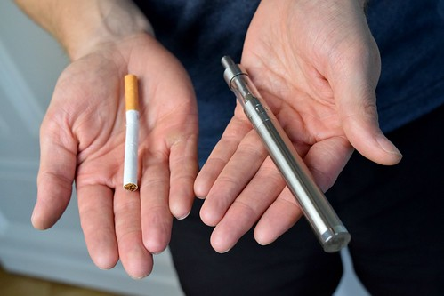
Smoking and Vaping
Did you know:
It is illegal to buy cigarettes in the UK if you are under 18 years old, and if you are under 16 years old, the police have the right to remove them.
Smoking puts your lungs at risk – smokers are 5 times more likely to catch flu and twice as likely to get pneumonia
Vaping is much more harmful in young people than adults
Increase the risk of a severe asthma attack.
Notes:
We know that smoking is bad for our health, and often smoke from other people, or actually smoking yourself is bad for you. Cigarette smoke is often a trigger someones asthma.

Slide 17
What to remember…
You will probably know someone who has asthma.
The main symptoms of someone having an Asthma attack are:
Wheezing
feeling/sounding short of breath
Coughing
not being able to speak in full sentences.
If you think someone is having an asthma attack, alert someone who can get help, and help them use their rescue inhaler.
Remember to carry your rescue inhaler for asthma.
Arrange a check-up/review
Know your Asthma management plan.
Take your treatment as prescribed.
Notes:
Important things to take away with you from this today is:
1 in 11 children have asthma, so It is very likely you know someone who has it.
The main symptoms of someone having an asthma attack are: wheezing, feeling breathless, or sounding short of breath, coughing and not being able to speak in a full sentence.
And if you think someone is having an asthma attack, tell someone who can get help and make sure they have access to their inhaler as this can help manage their symptoms.

