Slide 1
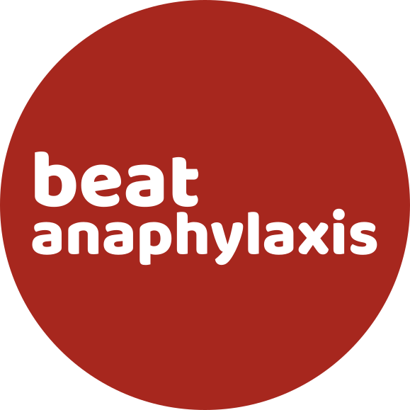
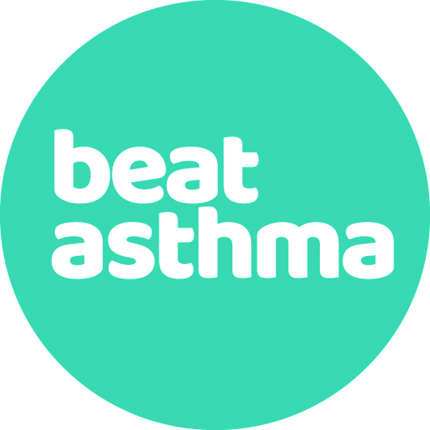
NECPAAC
6th June 2023
Ask the Expert
Workshop 5

Slide 2
Question 1:
How to make a diagnosis in the younger child with clear history but unable to understand/complete Feno/Spirometry?

Slide 3
Question 2:
How best to educate parents/children under practice nurse for paed techniques and would you recommend beat asthma plan if not already in place?

Slide 4
Question 3:
The best way to work out diurnal variation when peak flow diary completed.

Slide 5
Question 4:
When would you start montelukast before ICS if over age 5?

Slide 6
Question 5:
What is the recommended number of adrenaline autoinjectors to be prescribed to a patient with risk of anaphylaxis? (the numbers seem to differ in different guidelines)

Slide 7
Question 6:
What is the evidence of replacing oral prednisolone for dexamethasone in acute exacerbation of asthma? And if dex preferred, what is the recommended dose and dosing regimen? (not clearly stated in BTS guidelines)
Qureshi F, Zaritsky A, Poirier MP. Comparative efficacy of oral dexamethasone versus oral
prednisone in acute pediatric asthma. J Pediatr. 2001;139(1):20–6.

Slide 8
Question 7:
What are your tips on working out if anxiety is playing a role in SABA overuse in the complex asthma patient and best strategies for managing this?

Slide 9
Question 8:
At what point is it appropriate to refer to secondary care, should we wait till all options exhausted in primary care?

Slide 10
Question 9:
At what age would you upgrade to standard peak flow meter from a low range?

Slide 11
Question 10:
When commencing patients on AIR/MART regimes for asthma management, should a SABA be routinely prescribed for use in an emergency?

Slide 12
Question 11:
SABA weaning plans and phasing out of weaning plans, thoughts from experts on how best to change practice and any tips/advice for implementing this change?

Slide 13
Question 12:
What are your thoughts and/or experience of using artificial intelligence for interpreting spirometry e.g. Artiq. Likely to be coming to GP practices soon (there are pilots being set up).

Slide 14
Question 13:
Have you had any patients who have completed a trial of omalizumab?
Why have male patients had better outcomes with this?

Slide 15
Any Further Questions / Discussion

