Slide 1
NECPAAC
6th June 2023

Slide 2
Workshop Session
Inhaler workshop
Scenarios

Slide 3
Scenario 1. Inhaler workshop.
Miya is 5 years old . She has a history of multiple admissions to hospital with a diagnosis of Viral induced wheeze prior to moving to the UK only 6 months ago. This admission was diagnosed as probable asthma following a detailed history .
Her medication before admission was Montelukast 4mg at night and Salbutamol 100mcg 2-6 puffs prn .
How would you differentiate between VIW and asthma ?
What are the treatment options including type of inhaler?
What are any other considerations here ?
What would be the plan ?

Slide 4
Difference between VIW and asthma

Slide 5
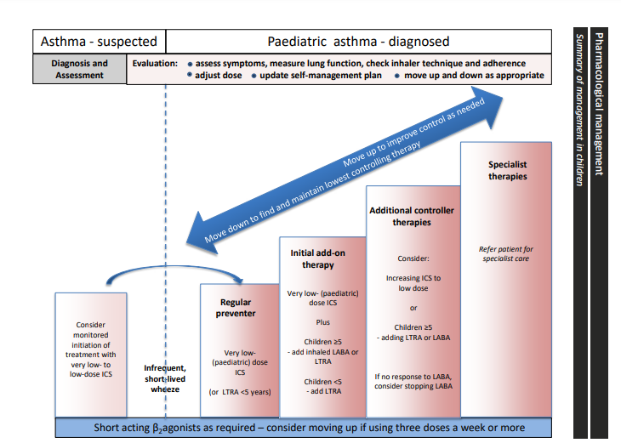
Treatment /inhaler/ options
Step appropriate to history
low dose ICS
Beclomethasone
Large volume spacer
Small spacer aerochamber plus flow-Vu
Consider antihistamine if seasonal triggers identified

Slide 6
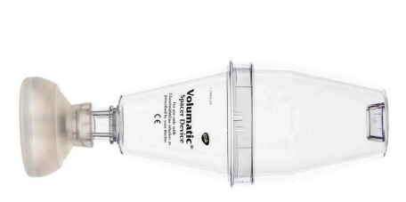
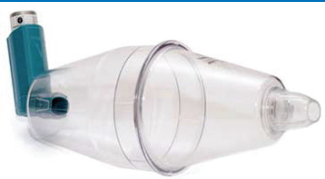

Slide 7
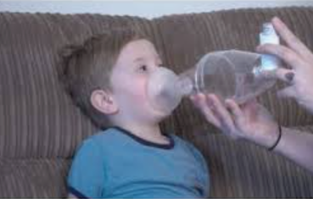
Using a spacer device with mask
Shake the inhaler
Insert into the end of the spacer
Ensure the mask is over the nose and mouth
Slightly tip the spacer
Hold over the nose and mouth for 20 seconds per dose
Wait 30 seconds
Repeat
https://www.beatasthma.co.uk/resources/families-children/

Slide 8
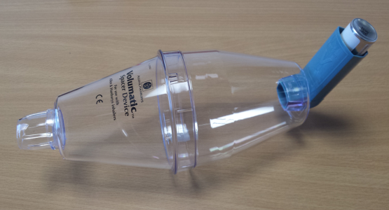
Using a spacer device
Shake the inhaler
Insert into the end of the spacer
Start breathing, insert one “puff”
Take 4 to 5 breaths – normal rate tidal breathing
Listen for the click each breath
Wait 30 seconds
Repeat

Slide 9
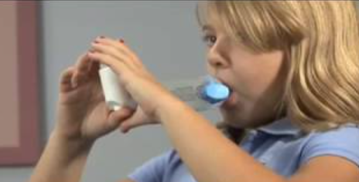
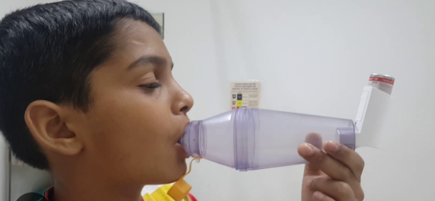
Inhaler choices in the over 5’s
Consider on an individual basis if a child can use a spacer without mask .
Assess ability with guidance and allow the parent and child to demonstrate their understanding –reinforce with resources for technique .
Include children in decision making or involve them in as many ways as possible .
Consider portability and practicality of using a spacer particularly in school and for sport .
Notes:
Consider age /ability/understanding
Demonstrate inhaler technique and guide the use of resources – beat asthma and asthma lung uk
Including children in inhaler and spacer choices

Slide 10
Considerations
Considerations
Inhaler technique
Education and advice previously given
Parental understanding- recent arrival in the country
Triggers /allergies
Concordance –strategies

Slide 11
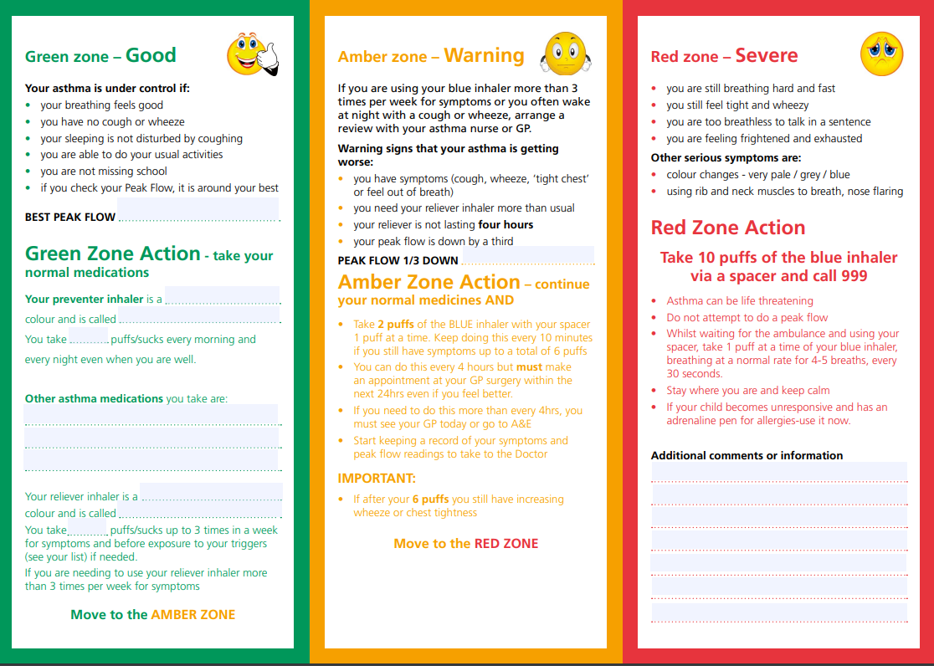
Plan
Start treatment
Parental advice on asthma /inhalers/technique/triggers
Arrange follow up
Resources-translation
PAAP –to be taken to school

Slide 12
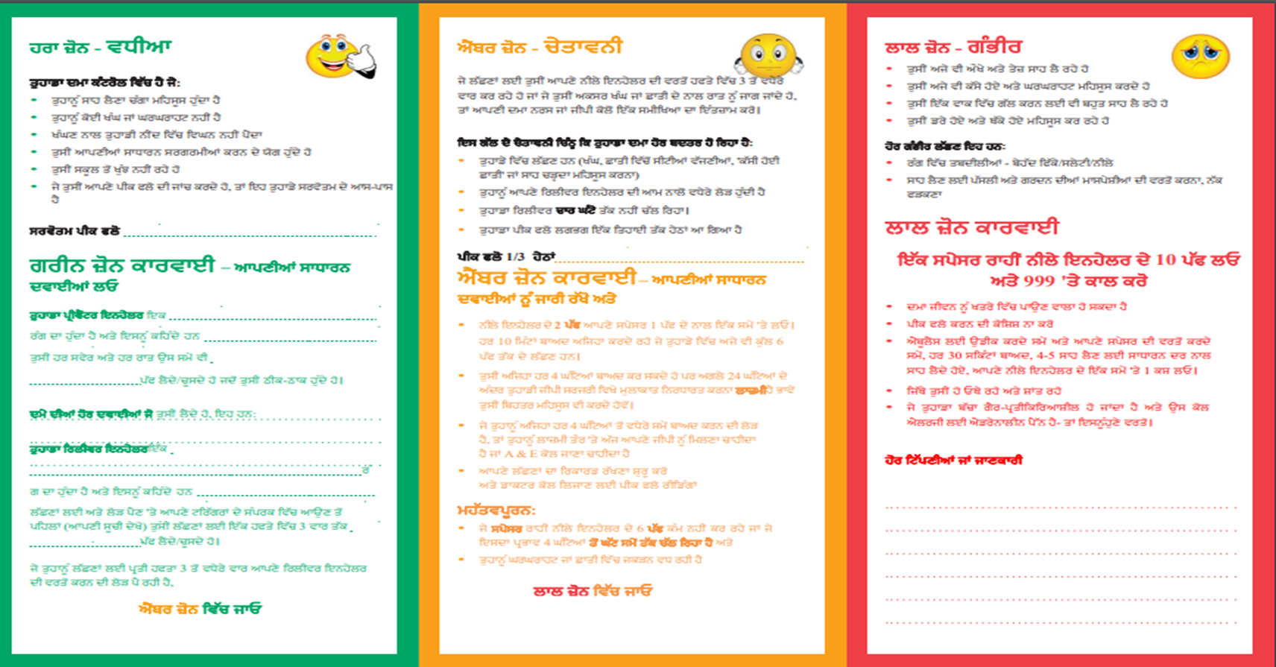
https://www.beatasthma.co.uk/wp-content/uploads/2022/09/x239573_NUTH_AsthmaManagement_p1_at_PU.pdf

Slide 13
Scenario 2 Inhaler workshop .
Max is 15 years old with an established diagnosis of asthma and in general he says he has been reasonably good control .
On his medical record his treatment is
Seretide 125mcg x 2 puffs BD MDI in a large volume spacer
Salbutamol 100mcg 2-6 puffs BD MDI in a large volume spacer
Montelukast 5mg at night –chewable tablet
His school attendance is considerably reduced . He comes to clinic with dad who thinks he doesn’t take his treatment.
1.What information would be helpful here?
2.Are there any specific challenges in this age group ?
3. What are the treatment /inhaler choices here ?
4. Explain your plan for Max ?

Slide 14
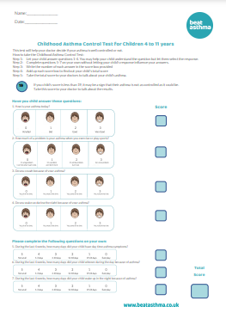
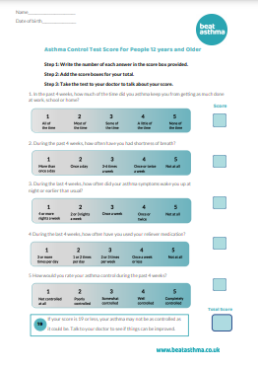
History and investigations
Frequency of Saba
Frequency of symptoms
Night disturbance
Exercise tolerance
Triggers/allergy
ACT score
Spirometry /PEFR
FENO
Reason for poor school
attendance

Slide 15
Challenges
Age
Risk taking behaviour
Denial
Poor perception
Hormones and emotions
Peer pressure
Concordance
Level of understanding
Knowledge of asthma

Slide 16
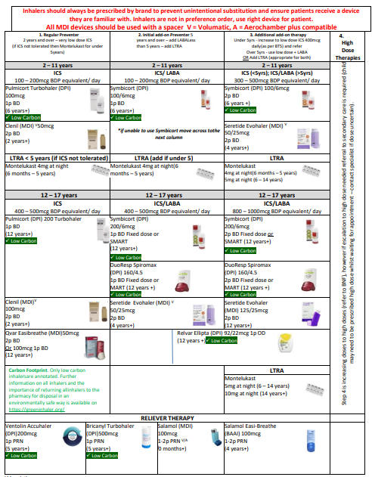
https://medicines.necsu.nhs.uk/guidelines/tees-guidelines/

Slide 17
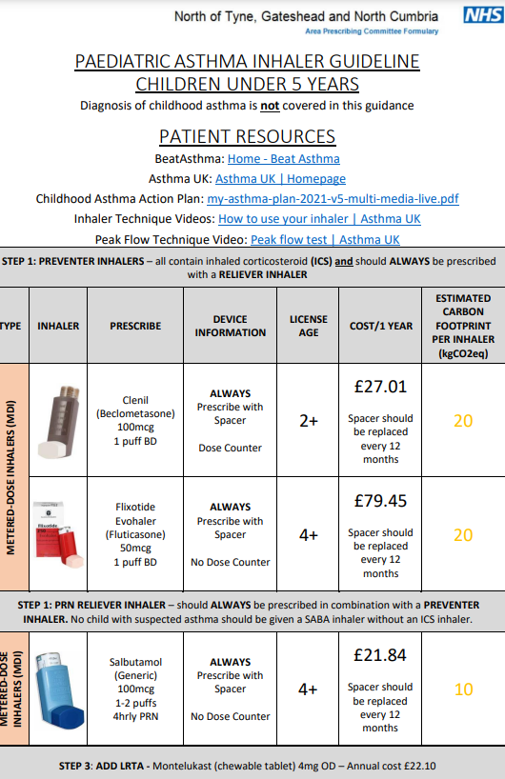

Slide 18
https://www.beatasthma.co.uk/resources/families-children/

Slide 19
Plan
Advice and education on asthma and risk .
Ready steady go transition tool
Seeing Max on his own next clinic
PAAP
Resources
Support contact details
Monitor with PEFR/FEV1 monitor
Liaise with education /support
Follow up

Slide 20
Thank you
NECPAAC
6th June 2023

