Slide 1
NECPAAC
6th June 2023

Slide 2
Asthma management in the community/ schools

Slide 3
Scenario 1 Management in community settings/education
William age 6 is in year 1 in Primary School . He has a Salbutamol inhaler in school . School attendance is considerably reduced 80% compared to his class. Noted on his attendance record is that mum reports that William is off school due to tiredness from coughing during the night .
What are your first thoughts /considerations for William in this situation ?
What further information would be useful to know?
What could be the plan of action for William ?
What is current best practice for CYP within school who have asthma .

Slide 4
First thoughts/concerns?
Education impact –has he had an assessment ?
Emotional well being
Lack of sleep
Friendships
No diagnosis
Salbutamol only

Slide 5
Information to assist diagnosis
History
Birth history
Vaccinations
Family history
Allergy/triggers/smoking
Symptoms-
Frequency of salbutamol
Technique –using a spacer ?
Comorbidity – rhinitis (seasonal) or perennial
History of medications trialled or actions taken and effect

Slide 6
Plan
Plan
School
Speak to parent/carer first-ask about symptoms and if seen by GP
Change in environment or home circumstances
Gp/Nurse practitioner Advise to make anappointment .
Advise to feedback to school following appointment.
Letter to parents regarding concern –Healthier together
Medical care
Detailed review –change in medication following BTS guidelines
PAAP –copy to school
Advice and education on probable/possible asthma if indicated
Advice on triggers and avoidance (pollution/smoking )
Inhaler technique
Review in 6-8 weeks

Slide 7
School support and best practice
PAAP in school /IHCP
Entered on asthma register
Inhaler is accessible
Good communication with parents
Record of use of salbutamol
Communication within school to share information
Emotional support
Emergency inhaler in school
School policy
Asthma friendly schools pilot and roll out

Slide 8
Scenario 2 Management in community settings /Primary care
Samantha is 13 years old .She swims for her local club and is in trials for selection to Regional squad. Mum brings Samantha to your practice as Samantha is becoming wheezy during each training session and mum reports that her Personal best times (PB ) are significantly slowing down . She has a diagnosis of seasonal asthma and takes Beclomethasone 200mcg BD . She also has a Salbutamol inhaler.
What would you like to know ?
What are the specific challenges here?
What other tests /investigations might be useful .
What would be the plan ?

Slide 9
Information needed
Asthma history
Concordance
Inhaler technique spacer ?
Change of circumstances
Parental pressure
Body changes /hormonal influence
Allergies/Triggers
Stress and friendships

Slide 10
Age
Sport
Hormones
Growth
Peer pressure
Concordance
Inhalers and choices

Slide 11
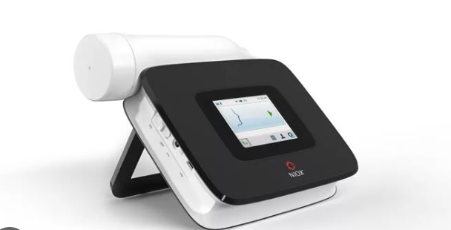
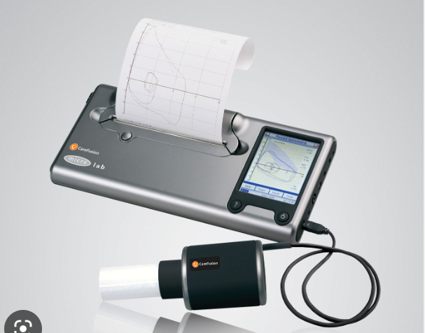
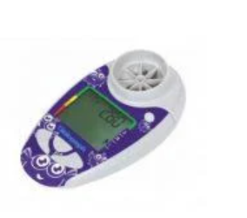
Tests and investigations
Serial peak flows at best and post exercise
Spirometry
FeNO
Specific allergy testing IgE

Slide 12
Plan
Discussion around sport/exercise
Pressure and stress management
Consider treatment and increase according to BTS guidelines
Consider change in inhaler type /greener agenda
Advice on triggers
Advise on inhaler technique
PAAP –copy to school
Follow up

Slide 13
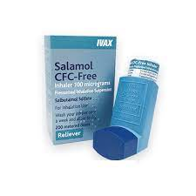
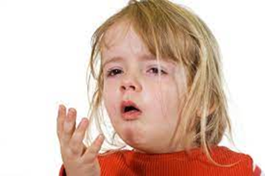
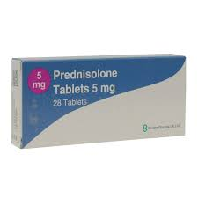
Recognising uncontrolled asthma
Frequent hospital/GP visits
Requiring more than 2 courses of oral steroids in 12 months
Using reliever (Short acting beta agonists) inhaler more than 3 times a week / Overuse of reliever inhalers 6 or more in 12 months
Poor Asthma Control Test score
Regular asthma symptoms
Notes:
Number of A&E visits / Record of number of attacks over the last year.
– indicates control.
Number of courses of steroids – 2 or more courses of steroids per year can indicate a need for secondary care referral
Are they using more than 3 times a week? Using more that 3 show that it isn’t as controlled as it should be – is it inhaler tech? are they taking medication?
Frequency of Salbutamol use – 6 or more salbutamol inhalers a year indicator of poor control.
Calculate number of preventers since last review. Does this show they are collecting their inhalers in a timely manner to ensure they are using daily as prescribed?
Number of relievers? NRAD 2014 highlighted prescribing errors in nearly half of asthma deaths (47%) such as salbutamol being prescribed in excess with no monitoring of preventer use.
New analysis from Asthma UK, based on data from over 500,000 UK GP Practices indicates almost 100,000 people with asthma have been prescribed too many SABA (more than 12 in a year) without national clinical guidelines being followed leaving them at risk from life threatening attacks.
Are they using more than 3 times a week? Using more that 3 show that it isn’t as controlled as it should be – is it inhaler tech? are they taking medication?
Does the above indicate good adherence? Are they collecting more relievers than preventers?
What is the patient’s understanding of asthma and their understanding of which inhaler does what with regards to bronchoconstriction and inflammation?
Asthma Control Test – this could be Childrens Asthma Control Test if under 12yrs and ACT if over 12. – 5 and 7 questions score of <19 indicates poor control.
Royal College of Physicians 3 Q’s simple to use but not validated in children. (Have you had difficulty sleeping because of your asthma / have you had your usual asthma symptoms during the day / has your asthma interfered with your usual activities
GINA 4 Q’s – past 4 weeks - daytime asthma symptoms more than twice a week / any night time wakening? / SABA reliever more than twice week / any activity limitation?
Please note however that if they have had an exacerbation recently the ACT can be misleading – if medication has been changed since this episode then ACT will need repeated in the next few weeks to assess efficacy. Quality and Outcomes Framework for rewarding good practice in primary care score points for Recording an ACT score along with an asthma review/ recording number of asthma attacks/ PAAP)
Patient’s perceptions of control differ to HCP’s. HCP professionals can also have poor perceptions of control. (Menzies-Gow & Chiu 2017 Perceptions of asthma control in the uk – a study comparing patient and professionals perceptions of asthma control with validated ACT scores) 84% of patients and 74% of doctors thought asthma was well controlled but act result indicated only 55% were.
The Recognise asthma and link to symptoms and experience (RALISE) survey 2014 was conducted in 11 European countries, including the UK. It found that despite experiencing symptoms and exacerbations, many patients regarded their asthma to be controlled. Therefore very valuable tool.
Symptoms – cough/ wheeze/ disturbed sleep/ chest tightness/ breathless/ missing school

Slide 14
Thank you
NECPAAC
6th June 2023

