Slide 1
NECPAAC
6th June 2023

Slide 2
Workshop 1 – Asthma Diagnosis
-Dr Neelmanee Ramphul
Consultant Paediatrician, Gateshead Health NHS Foundation Trust
-Dr Arshid Murad
Consultant Paediatrician, South Tees Hospitals NHS Foundation Trust
-Dr Elizabeth Mclellan
Consultant Paediatrician, Great North Children’s Hospital, Newcastle
ext

Slide 3
Aims and Objectives
How to diagnose asthma
Role of Spirometry and Exhaled Nitric Oxide (FeNO)
Peak Flow and home devices

Slide 4
Asthma
5.4 million people who suffer from Asthma in the UK
1.1 million children
Common chronic disease in children
Outcomes for children in the UK amongst the worst in the West
Outcomes even worse in the North East

Slide 5
WHO definition
Asthma is a long-term condition affecting children and adults. The air passages in the lungs become narrow due to inflammation and tightening of the muscles around the small airways. This causes asthma symptoms such as cough, wheeze, shortness of breath and chest tightness

Slide 6
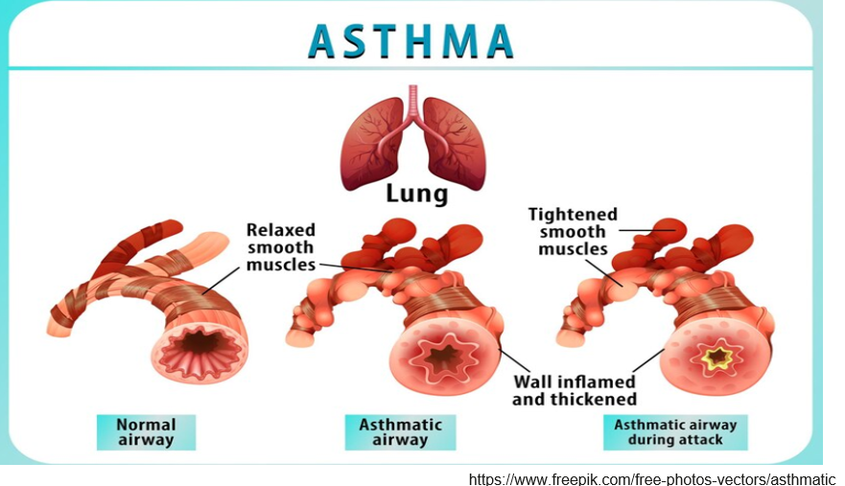

Slide 7
Most children who wheeze, cough or have exercise induced symptoms intermittently have asthma.
True
False

Slide 8
When to suspect a diagnosis of asthma?
Wheeze and Cough are common symptoms in children
Wheeze : continuous high pitched musical sound coming from the chest
Only a quarter of children who cough or wheeze or have exercise induced symptoms have asthma
Two thirds of children with a cluster of symptoms ( cough, wheeze, SOB, chest tightness, exercise induced symptoms) have asthma
Wheeze heard by a healthcare professional on auscultation increases the probability of asthma

Slide 9
Diagnosis

Slide 10
History
No substitute for a good history
Explore symptoms: Cough, wheeze, chest tightness, SOB
When are symptoms worse ( diurnal variation)
Triggers ( allergic and non allergic)
Frequency and severity of asthma attacks
Unscheduled attendances ( primary care/ urgent care/ hospital)
Which medication helps
How often medication is missed
Spacer use
Impact on quality of life and education
Co-morbidities (Eczema, Allergies, Allergic Rhinitis, obesity)

Slide 11
Allergic Triggers

Slide 12
Food Allergies and risk of anaphylaxis
Asthma Plus Nut allergy especially: high risk of anaphylaxis
If other IgE Mediated allergies consider a referral to allergy clinic for further risk assessment

Slide 13
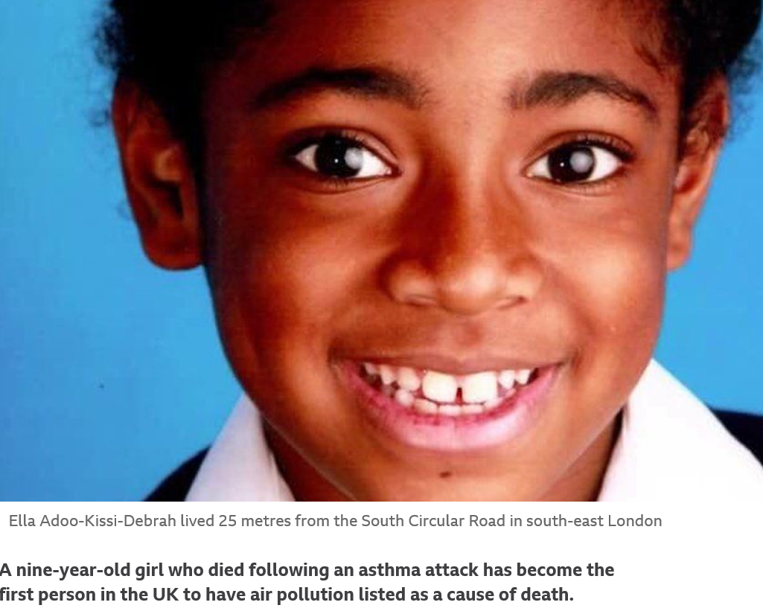
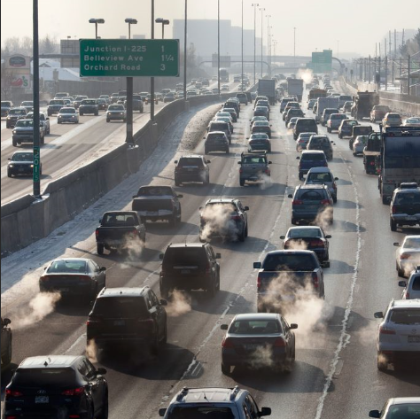
Environmental Triggers

Slide 14
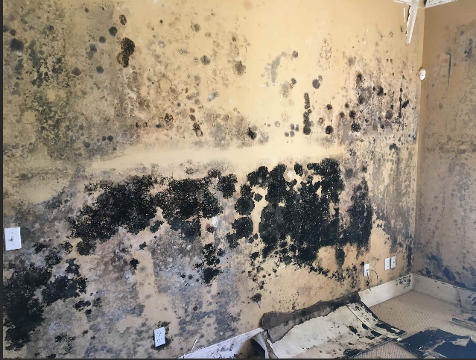
Environmental triggers

Slide 15
Environmental Triggers

Slide 16
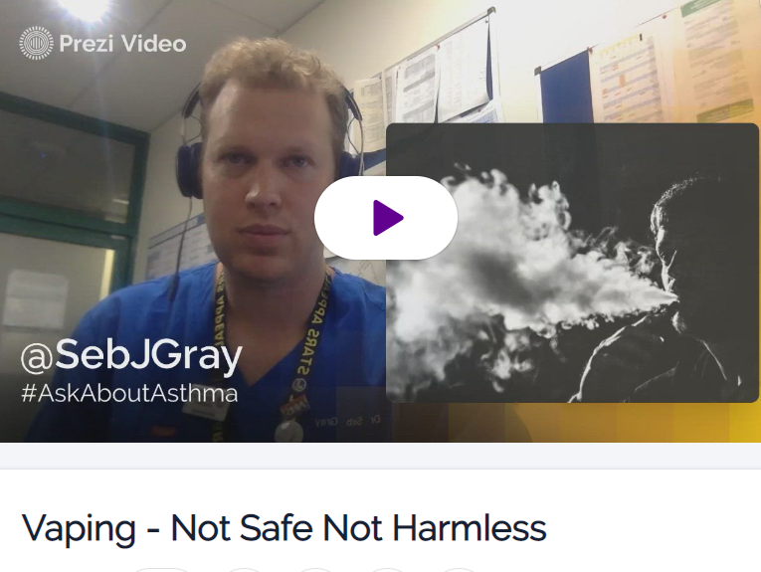
Smoking and….vaping
Vaping - Not Safe Not Harmless by Seb Gray on Prezi Video
Intended for people who want to give up smoking but increasingly used now in school aged children
Often viewed as trendy and “safe”

Slide 17
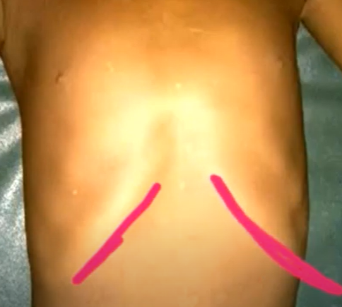
Examination
Most of the time examination is normal in non acute phase
Occasionally hyper-expanded ( barrel shaped)chest
Less commonly seen now, Harrison’s sulcus
What is Harrison’s Sulcus: https://www.youtube.com/watch?v=7dsDrHHVMN8

Slide 18
Normal spirometry excludes asthma
True
False

Slide 19
Diagnosis
Peak flow variability of 20% suggestive of asthma
Spirometry ideally, not always possible in young children
An improvement of at least 12% in FEV1 to either beta 2 agonist or corticosteroid treatment considered positive
Normal spirometry when asymptomatic does not exclude asthma
FEV1/FVC ratio of 70% or less considered positive
FEV1/FVC ratio changes with age; can be as high as 90% in young children
FeNO > 35 ppb considered positive

Slide 20
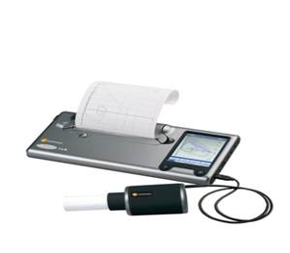
Objective testing

Slide 21
Exhaled Nitric Oxide ( FeNO)
https://www.youtube.com/watch?v=JircOusFsVU
5 minutes ( Asthma and lung UK)

Slide 22
Spirometry ( 3 minutes video)
https://www.youtube.com/watch?v=OKquzgr8F6w

Slide 23
Peak Flow and Home Devices
Diagnosis
Monitoring

Slide 24
Objective tests for asthma in children and young people aged 5 to 16 Positive test thresholds: Spirometry:obstructive pattern FEV1/FVC) ratio less than 70% BDR: Improvement in FEV1 of 12% or more Peak flow variability: >20%

Slide 25
Peak Expiratory Flow (PEF, peak flow or peak flow rate)
Maximum flow achieved during maximal expiratory effort after a full inspiration
fullness of the preceding inspiration
calibre of the large airways
expiratory muscle strength
voluntary effort
predominantly assesses large airway calibre

Slide 26
Peak Expiratory Flow - Limitations
Effort/technique dependence
reduced PEF in the absence of airflow limitation –restrictive processes
Chest wall disease
Obesity
Muscle wall disease
Lack of graphic display
large variability of PEF
between individuals (±30 percent)
given individual (±15 percent)
In severe asthma
underestimate the degree of airflow limitation
As air trapping increases, it causes the PEF to give misleading reassurance of normal pulmonary function.
Can peak expiratory flow predict airflow obstruction in children with asthma?N Eid et al.Pediatrics. 2000 Feb;105(2):354-8. doi: 10.1542/peds.105.2.354.

Slide 27
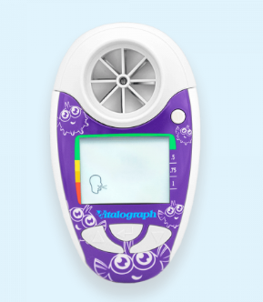
Home Spirometer
Measure both PEF and FEV1
Mainly used for FEV1
Uses:
Monitoring at home - especially in poor symptom perceivers
Help for health professionals during acute exacerbations in hospital

Slide 28
Home Spirometer

Slide 29
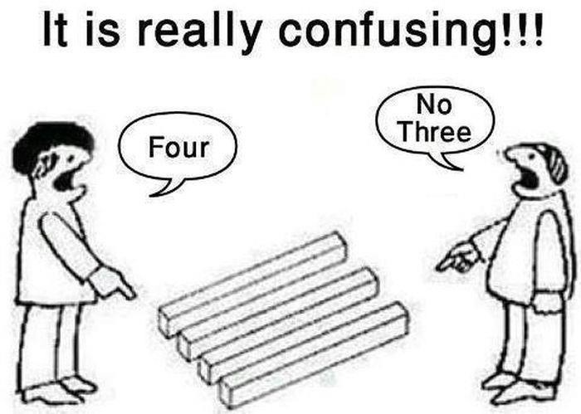
Preschool Wheeze

Slide 30
Preschool wheeze
Very common
Consumes high amounts of healthcare resources
Major impact on children and their families due to significant morbidity associated with acute episodes.
Lack of evidence regarding
pathophysiology
treatment
Notes:
One in three children has at least one episode of wheezing prior to their third birthday.
around 50% of all children wheeze in some way or other before they reach school age

Slide 31
18 months old child – acutely unwell, cough wheeze, respiratory distress
Case 1
Born term
Bronchiolitis 4 months
8 episodes of cough, wheeze, fast breathing
Always unwell
Weight 25-50th centile
No eczema
4 older siblings
No family history
Mum smokes
Case2
Born term
Bronchiolitis 4 months
8 episodes of wheeze, cough and fast breathing
Always unwell
Weight 25-50th centile
No eczema
4 older siblings
Dad and two brothers has asthma
Dad smokes

Slide 32
Give any treatment
Treat with oral steroids
Maintenance treatment
What maintenance treatment

Slide 33
Preschool wheeze
Episodic viral wheeze Vs multitrigger wheeze - better therapeutic decisions.
Intrapatient variation
Overlap in phenotype over time
Phenotype can change in up to 55% of the children
European respiratory society, Classification and pharmacological treatment of preschool wheezing: changes since 2008
Notes:
These classifications help understanding the mechanisms and natural history of preschool wheeze, but do not help the clinician when faced with a child in the clinic

Slide 34
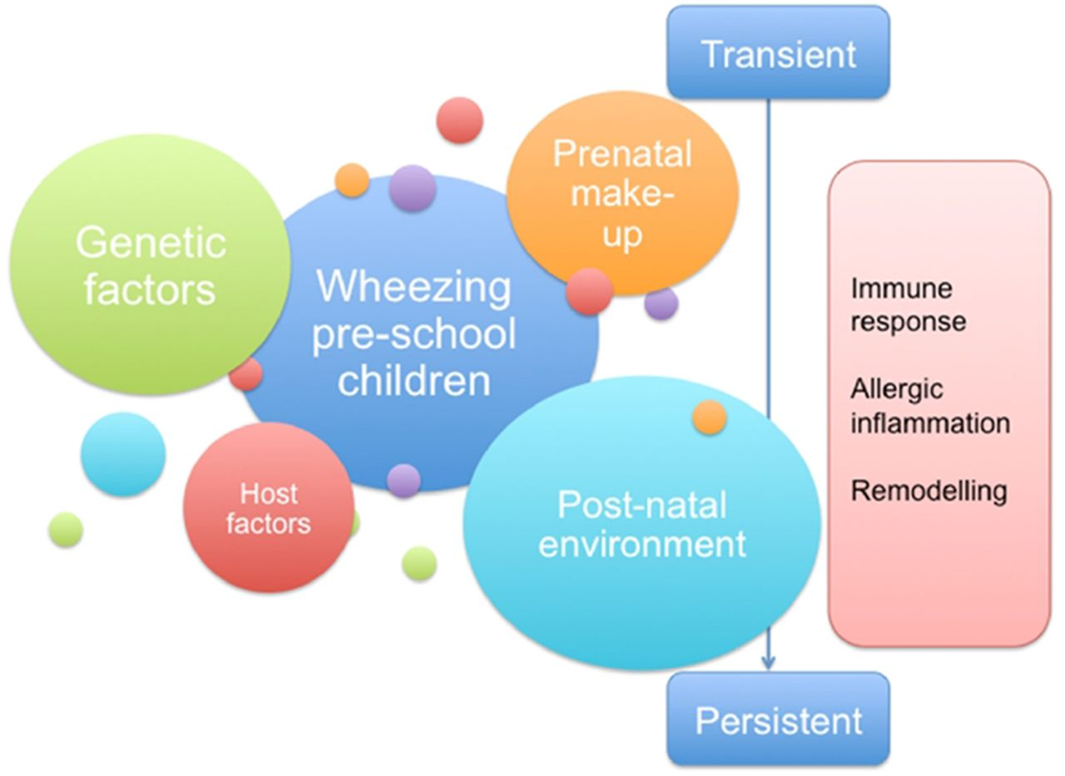
Risk factors for preschool wheeze.
Renu Khetan et al. Arch Dis Child Educ Pract Ed 2018;103:7-14
Copyright © BMJ Publishing Group Ltd & Royal College of Paediatrics and Child Health. All rights reserved.
Notes:
Risk factors for preschool wheeze.

Slide 35
WHEEZING PHENOTYPES 12 Longitudinal birth cohorts Original Tucson Group (Taussig L et al 1985)
Transient Vs persistent wheeze
34% of children wheezed during the first 3 yrs
60% - resolve by the age of 6 yrs – transient wheezers
reduced lung function prior to the first respiratory illness
exposed to maternal smoking
No personal history of eczema
No family history of asthma
40% -continue to wheeze beyond 6 year – persistent wheezers
with normal lung function during the first year of life, but
reduced lung function from the preschool age period and through adulthood (in most but not all cohort studies),
with atopy and
a family history of asthma
Persistent
Atopic
Non Atopic
Transient

Slide 36
Progression –based on severity of wheeze
Severe early wheeze, hospitalised with acute wheeze before the age of 2 yrs
50% symptom-free by the age of 5 yrs
70% by 10 yrs,
only 57% by 17–20 yrs - the tendency for relapse during adolescence.
Symptoms continuing into early adulthood,
Female sex,
passive smoking during infancy
early sensitisation to allergens
Asthma symptoms in early childhood – what happens then? Goksör E Acta Paediatr 2006;95:471–478.

Slide 37
Maintenance treatment
Is there a need?
Intermittent Vs Continuous?
Failure to initiate regular treatment will not prejudice future respiratory health of the child. Indeed, neither early use of continuous nor intermittent with viral colds ICS can prevent the progression of any phenotype of preschool wheeze to asthma in childhood.
Infantile wheeze: rethinking dogma , Fernando Maria de Benedictis et all; ADC

Slide 38
Maintenance treatment of episodic (viral) wheeze
Inhaled bronchodilators
There is no clear evidence for benefit of regular daily inhaled corticosteroids or montelukast in recurrent episodic viral wheeze.
(Leukotriene receptor antagonists as maintenance and intermittent therapy for episodic viral wheeze in children. Brodlie et al; The Cochrane database of systematic reviews, vol. 10, p. CD008202. (2015))
Episodic Use of an Inhaled Corticosteroid or Leukotriene Receptor Antagonist in Preschool Children with Moderate-to-Severe Intermittent Wheezing; J Allergy Clin Immunol. 2008 Dec; 122(6): 1127–1135.e8.
Daily therapy may be considered with either ICS or montelukast if:
the attacks are severe (requiring hospital admission or systemic corticosteroids); or
the attacks are frequent; or
the clinician suspects that interval symptoms are being under reported

Slide 39
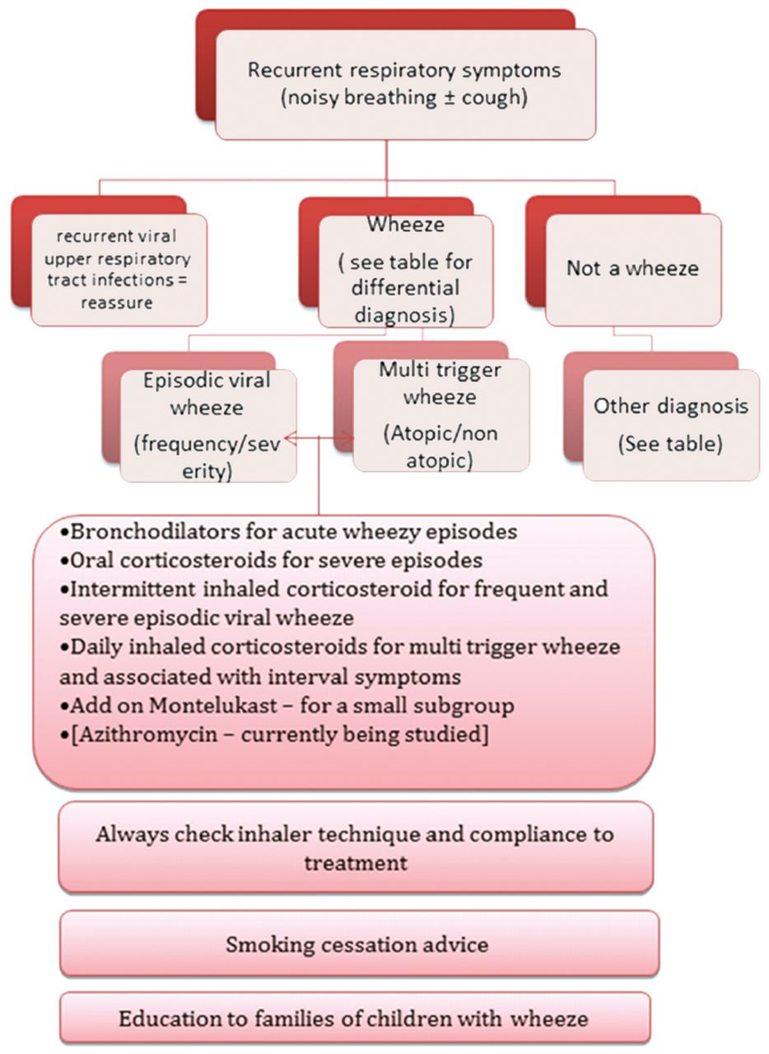
Approach to preschool wheeze.
Renu Khetan et al. Arch Dis Child Educ Pract Ed 2018;103:7-14
Copyright © BMJ Publishing Group Ltd & Royal College of Paediatrics and Child Health. All rights reserved.
Notes:
Approach to preschool wheeze.

Slide 40
Tiers 1 to 5 Training
Access the training: Asthma (Children and young people) - elearning for healthcare (e-lfh.org.uk)

Slide 41
Any Questions

