Slide 1
Children and Young People’s Mental Health Data pack
Produced by - Local Knowledge and Intelligence Service – North East and Yorkshire
Date: INSERT DATE

Slide 2
Summary
There are known things that protect our children and young people's emotional wellbeing, such as school readiness- which is increasing.
There are known things that are risks to our children and young people's mental health, such as poverty- which is increasing.
These protective and risk factors are also linked to other health outcomes and health inequalities for children and young people.
The need for mental health support is increasing, shown by the increasing number of referrals to hospital for mental health conditions
Girls and boys are experiencing different mental health conditions at different ages.

Slide 3
About this data pack
This data pack sets the scene about mental health in children and young peoples in NENC. It provides useful information about some of the positive and negative factors that can impact on children and young people’s mental health and data, these are considered as part of the whole picture about levels of mental health illness, outcomes, use of services, assets in the community etc. helping to identify areas that can be targeted to that might prevent mental health issues developing.
The pack provides a summary of the key data and links to where you can find out more. Most of the data comes from the Office of Health Improvement and disparities (OHID) Fingertips tool. Fingertips is a large public health data collection, organised into themed profiles, including profiles with children and young people’s mental health data. The data can be broken down by different geographies, organisations, age, sex, and levels of deprivation and includes trends. A Picture of health a health intelligence pack for health improvement North East and Yorkshire ICS edition 2023 offers further information.
Inequalities – When looking at the data it’s important to reflect that there may be inequalities in health that affect some groups more than others, there are some examples in this pack showing inequalities such as between areas with different deprivation levels and sex.
NENC/ NE region data availability – the data in this pack is currently not always published at NENC level and so maybe only available for the NE region. Data will be available in the future at this level on fingertips. Fingertips still provides data by county and district local authorities and previous CCGs. This can be found using the links available on the slides. Please contact LKISNorthEastandYorkshire@dhsc.gov.uk for further information about this.
Health inequalities
“avoidable, unfair and systematic differences in health between different groups of people”.
The Kings Fund
Data note: Please be aware that depending on the indicator, trend data may change once the Office for National Statistics (ONS) has re-based (using the 2021 Census results) the population estimates back to 2011 (expected later in year). For further information please contact the email address above.

Slide 4
Wider determinants - risk and protective factors for children and young people’s mental health
Child poverty
Vulnerable groups
Educational factors
Behaviour factors

Slide 5
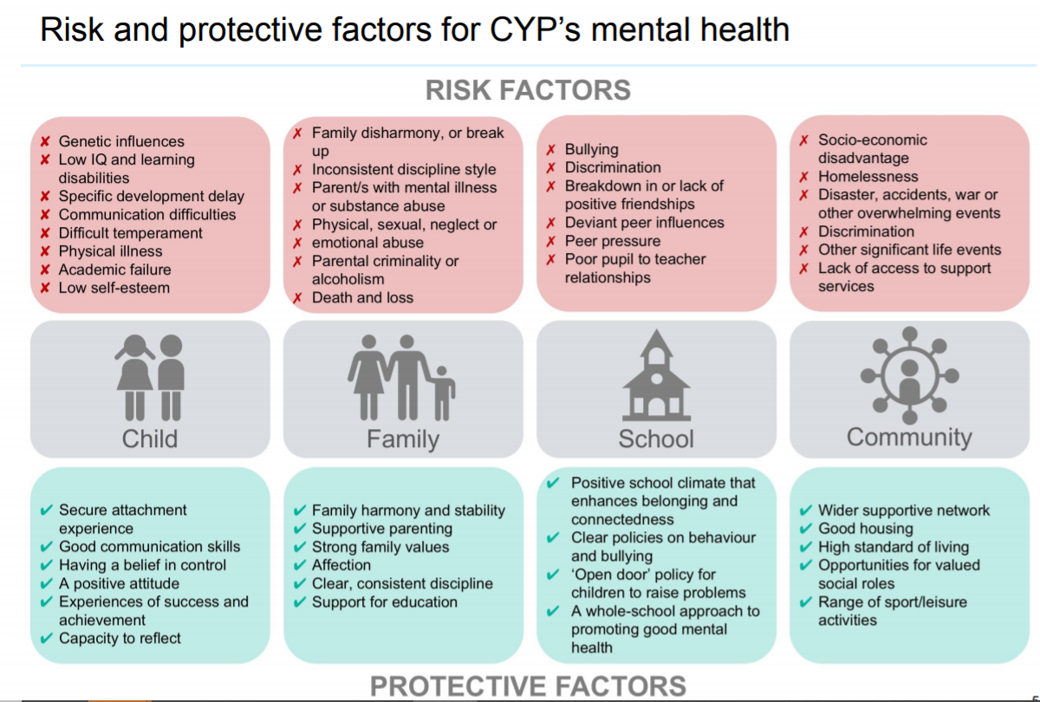
There are four categories of risk and protective factors for children and young people’s mental health (the individual child, the child’s family, the child’s school and the community the child lives in) These can be broken down into risk factors (more likely to have a negative effect on a child’s mental health) and protective factors (more likely to have a positive impact)

Slide 6
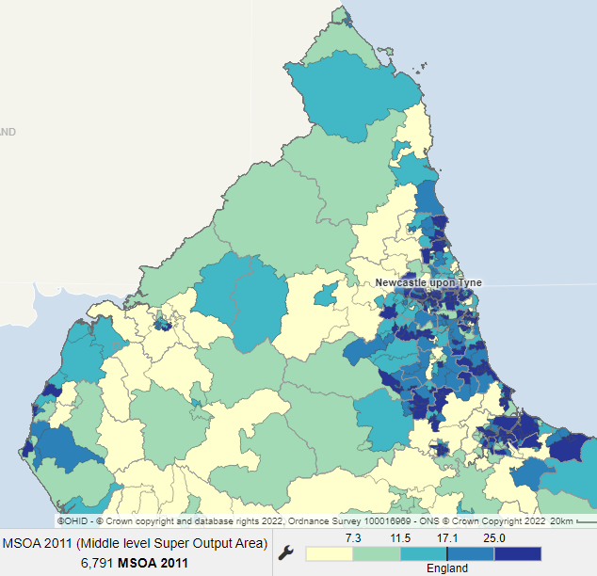
NENC – Population and child poverty
Percentage of the total population who are 0 to 15 years of age 2020 (%)
17.7% (531,200)of the total population are children age 0 to 15.
10.7% (320,900) of the total population are young people aged 16 -24
22% of children are living in poverty compared with 17% in England as a whole (IDACI 2019)
There are higher percentages of children and child poverty in more urban areas
Child Poverty, Income Deprivation Affecting Children index (IDACI) ,
2019 (%)
Maps available from Local Health More data available on fingertips

Slide 7
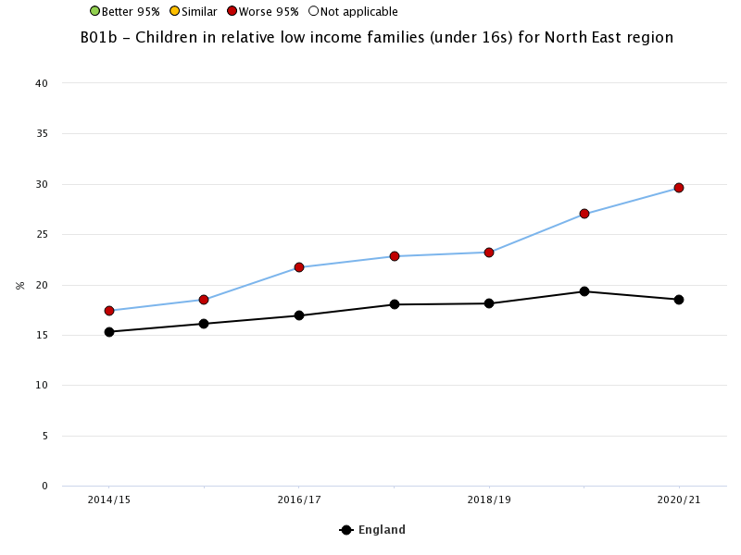
Wider determinants – risk factors - child poverty
There are strong links between poverty and mental health and the North East is one of the most deprived regions in England. Whilst children in low-income families continues to be such a key issue for the region, mental health in children and young people is likely to remain a priority
Trend Children in relative low income families (under 16s)
There are strong links between poverty and mental health and the North East is one of the most deprived regions in England.
Whilst children in low-income families continues to be such a key issue for the region, mental health in children and young people is likely to remain a priority
NENC
NE 28%
- NE region only
Eng 19%
Sources:
Picture of health
Fingertips (including local authority level data)
Other child poverty indicators:
Children in absolute low income families (under 16)
England
North East region

Slide 8
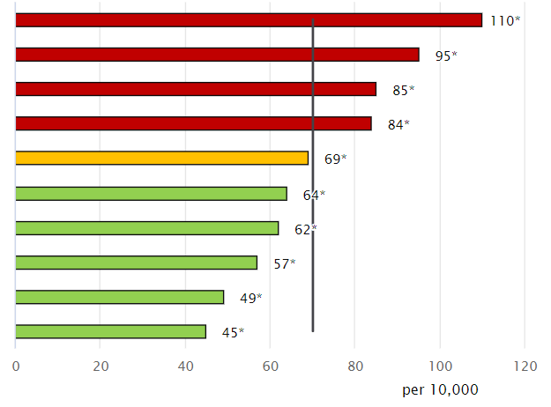
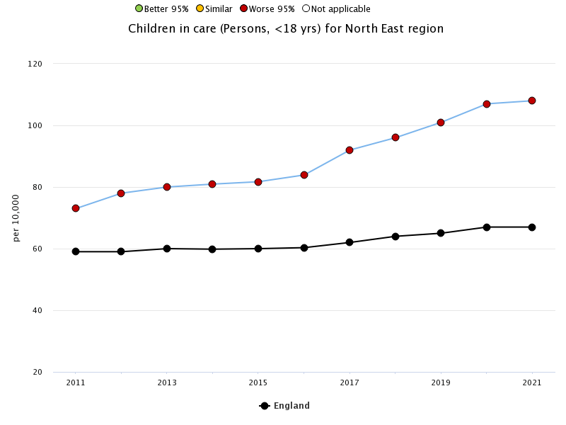
Wider determinants– Vulnerable groups – Children in care
Many children in care are likely to have had experiences or been brought up in circumstances which make them more vulnerable and at risk of poorer outcomes than other children (No child left behind: understanding and quantifying vulnerability). Studies have found that children in care are more likely to have lower educational attainment across all age groups as well as poorer mental and physical health (Rahilly et al, 2014).
Currently half of all children in care meet the criteria for a possible mental health disorder, compared to one in ten children outside the care system (Improved mental health support for children in care
The North East has a significantly worse rate, compared to England, of children in care and children subject to a protection plan with an initial category of neglect or abuse. The region also has a significantly higher rate of children on protection plans and children leaving care, compared to the national average. The percentage of children who became subject of a child protection plan for a second or subsequent time is statistically similar to the England value.
Inequalities (England) – deprivation (deciles) Children in care per 10,000 (2022)
Most deprived
(110)
Trend Children in care per 10,000
- NE region only
Least deprived (45)
Other indicators:
Children on child protection plans
Looked after children emotional wellbeing
Pupils with social, emotional and MH needs
Homelessness households with dependent children
Children with learning difficulties known to school
England
North East region
Sources:
Fingertips (including local authority level data)

Slide 9
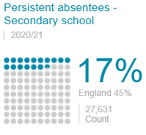
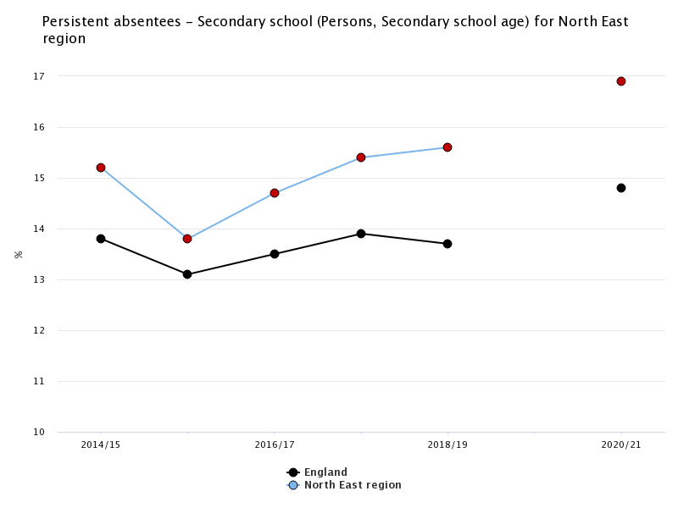
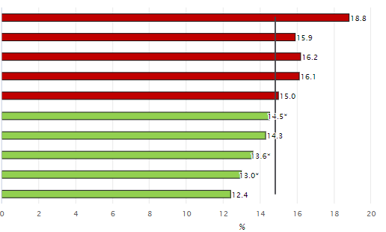
Wider determinants – Educational risk factors - Pupil absentees
Disillusion or exclusion from school are risk factors for children’s mental wellbeing (National Collaborating Centre For Mental Health)
Trend Persistent absentees – secondary schools
The proportion of children missing school through pupil absenteeism at secondary school, is higher in the region compared to the national average.
This is also the case for children in primary school
NE 17%
- NE region only
NENC
Eng 15%
Inequalities (England) by deprivation decile (2020/21)
Persistent absentees – secondary school
Most deprived (19%)
England
North East region
Sources:
Picture of health
Fingertips (including local authority level data)
Other educational risk factors indicators
Children with SEN
Absentees – primary
NEETs
Least
deprived
(12%)

Slide 10
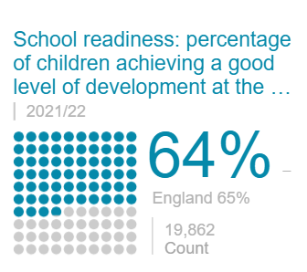
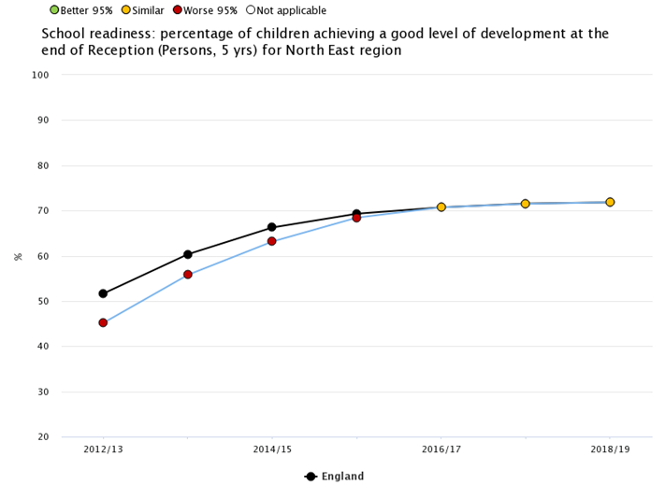
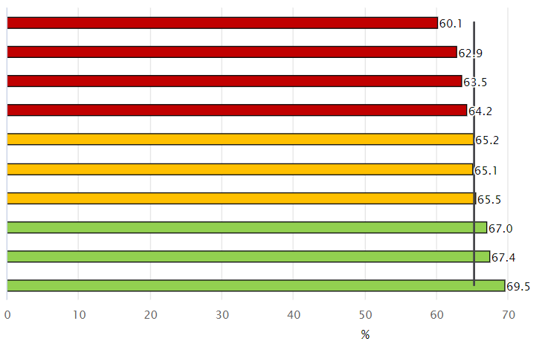
Wider determinants – Educational protective factors – School Readiness
This is a key measure of early years development across a wide range of developmental areas. Children from poorer backgrounds are more at risk of poorer development and the evidence shows that differences by social background emerge early in life (Fingertips). Academic achievement can act as a protective factor giving a child a sense of worth, as well as opportunities
Trends in school readiness have increased significantly over the last few years. Rates for the North East region were significantly worse and are now similar to England
There are inequalities in school readiness found between deprivation, ethnicity first language status, SEN status, month born and sex.
Trend School readiness (%)
NENC
- NE region only
Inequalities (England) by deprivation (decile)
school readiness (%) (2021/22)
Most deprived (60.1%)
England
North East region
Other educational protective factors indicators:
Childhood development at 2-2½ years
Attainment 8 score
Attainment 8 score of children in care
Least
deprived
(69.5%)
Sources:
Picture of health
Fingertips (including local authority level data)

Slide 11
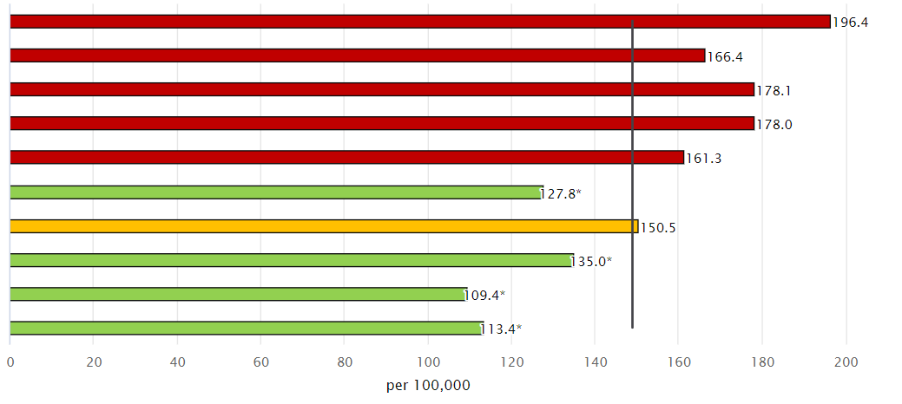
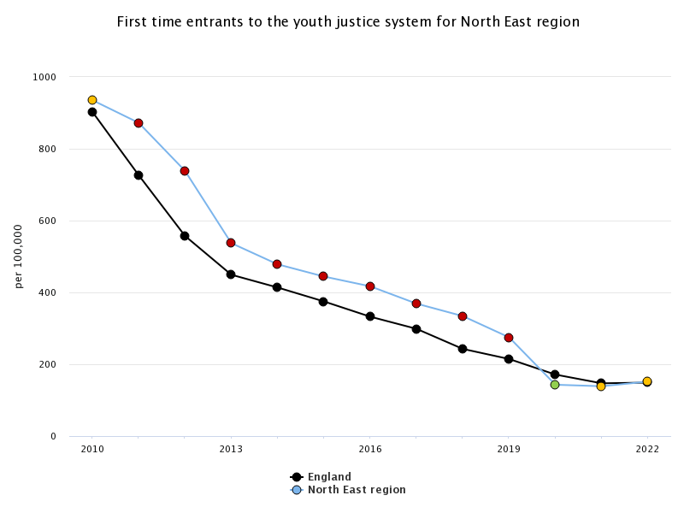
Wider determinants – Behavioural risk/ protective factors – First time entrants to youth justice system
Children and young people at risk of offending or within the youth justice system are at risk of higher than usual rates of mental health problems (No child left behind: understanding and quantifying vulnerability). The original risk factors that led to their offending also predict mental health problems, various aspects of offending itself may cause mental health problems and interactions with the criminal justice system are stressful and may on their own lead to anxiety and depression, particularly those associated with custody (The Mental Health Needs of Young Offenders).
Trends in the North East region have fallen faster than England rates over the last few years and are now statistically similar rate to the national average.
.
There are inequalities between most and least deprived areas of deprivation.
Inequalities (England) by deprivation (decile)
First time entrants to youth justice system rate per 100,000 (2022)
Most deprived (196)
Trend First time entrants to youth justice system rate per 100,000
- NE region only
Least deprived (113)
England
NE (152)
Other behavioural risk/ protective indicators:
Teenage conception rates
Obesity and overweight rates
Physical activity rates
North East region
Eng (149)
Sources:
Fingertips (including local authority level data)

Slide 12
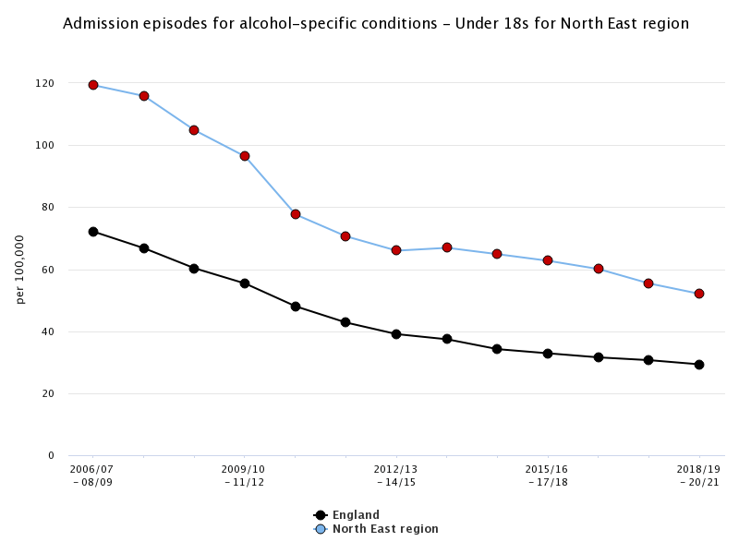
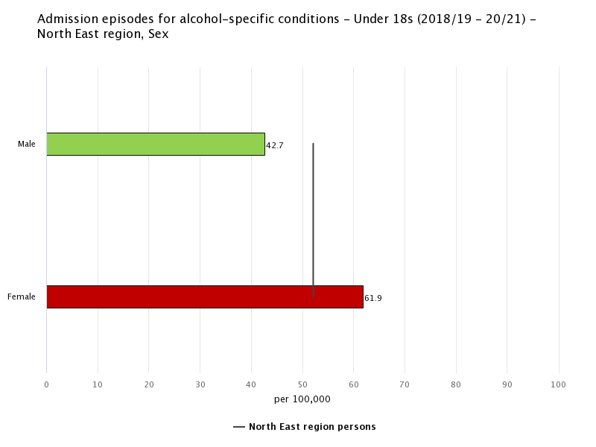
Wider determinants – Behavioural risk/ protective factors – Alcohol admissions
Adolescence is a developmental period often associated with high-risk behaviours. While some risk-taking behaviour is considered normative in adolescents, research has indicated an association between risky behaviours and mental ill-health. Anxiety and depression are found to positively and significantly predict the occurrence of risky behaviours (Soleimani et al, 2017). Therefore hospital admissions for alcohol use in under 18s are measures of extreme risky behaviour in adolescents.
Trend Admissions for alcohol-specific conditions <18s (rate per 100,000)
Inequalities by sex – NE region
Admissions for alcohol-specific conditions <18s
(rate per 100,000) (2018/19 – 20/21)
Trends in the North East region have fallen over the last few years but remain statistically worse than the national average.
There are inequalities between males and females.
- NE region only
Males (43)
NE (52)
Females (62)
Eng (29)
England
North East region
Sources:
Fingertips (including local authority level data)
Other behavioural risk/ protective indicators:
Substance misuse admissions

Slide 13
Identifying need - children and young people’s mental health
Prevalence estimates
Self-harm
Service use

Slide 14
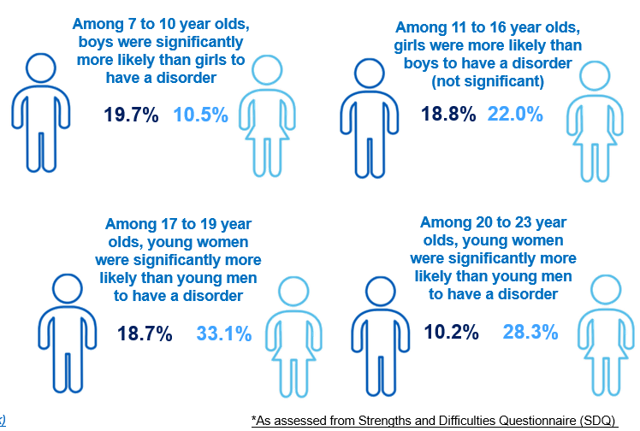
Identifying need: How many children and young people in NENC have mental health issues?
We can estimate the number of children and young people with a mental health problem in NENC using national survey data
Results from a national survey show boys are more likely to have probable disorders in the younger age groups. Rates of mental health problems for girls/ young women rise steeply in mid to late-adolescence.
Although boys are more likely to have a disorder among 7 to 10 year olds, by the time they reach secondary school age (11-16 year olds) there is a slight fall in the number of boys having a probable mental health disorder and a big increase for girls.
In 17 to 19 year olds rates of probable disorders in young men remains similar and increases in young women so that a third of young women aged 17 to 19 have a probable disorder. This declines to 28.3% for young women and 10.2% for young men aged 20 to 23.
Source
Mental Health of Children and Young People in England 2022 - wave 3 follow up to the 2017 survey - NDRS (digital.nhs.uk)

Slide 15
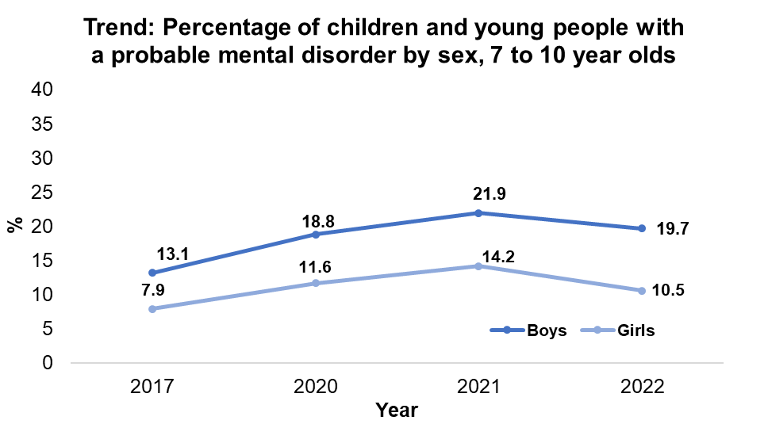
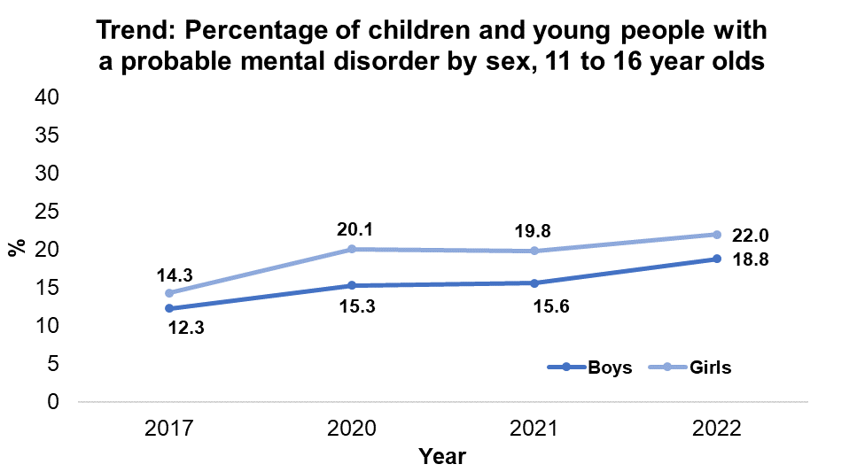
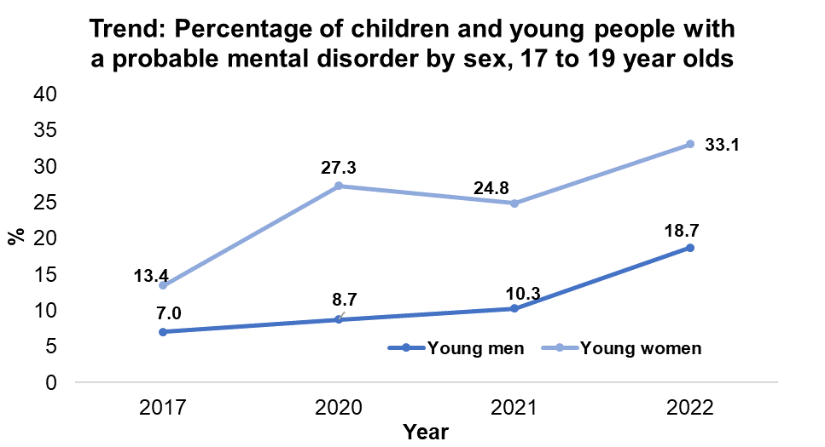
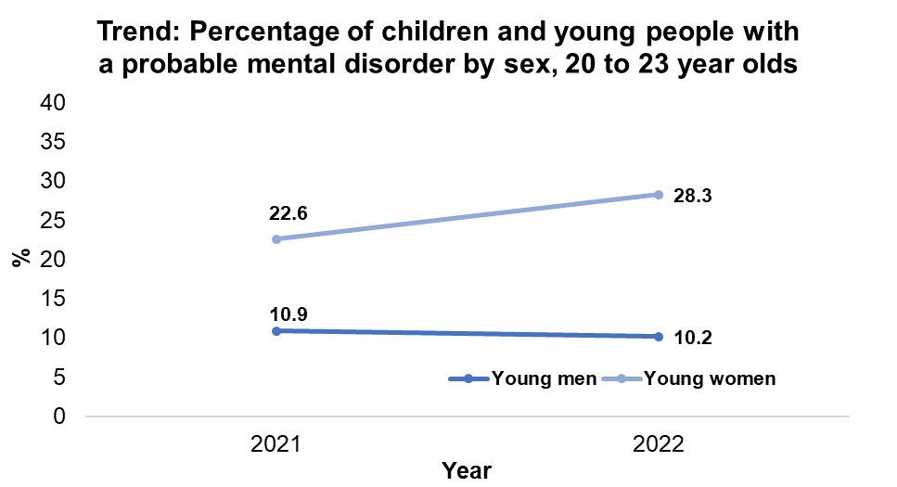
Identifying need: Trends - Are mental disorders increasing?
There was an increase in the rate of probable mental health disorders aged 7 to 10 between 2017 and 2021, before falling in 2022. The percentage for boys remained higher than girls.
For 11 to 16 year olds rates increased between 2017 and 2022 and remined higher for girls than boys
For the 17 to 19 age group, the biggest increase was for girls between 2021 and 2022.
Data for 20 to 23 year olds was only collected in 2021 and 2022. There was an increase in the rates of probable mental health disorders for young women (aged 20 to 23) between 2021 and 2022 and a slight decline for young men
Source: Mental Health of Children and Young People in England 2022 - wave 3 follow up to the 2017 survey - NDRS (digital.nhs.uk)

Slide 16
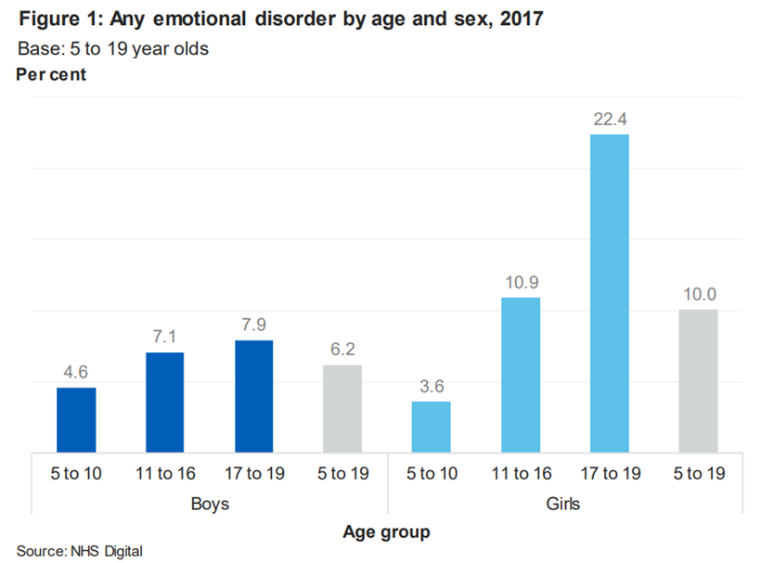
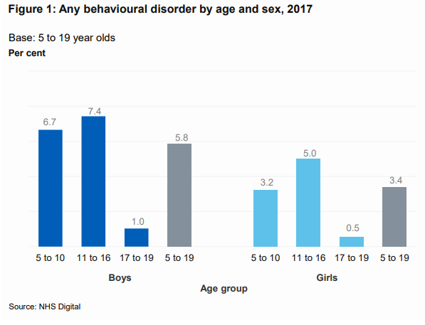
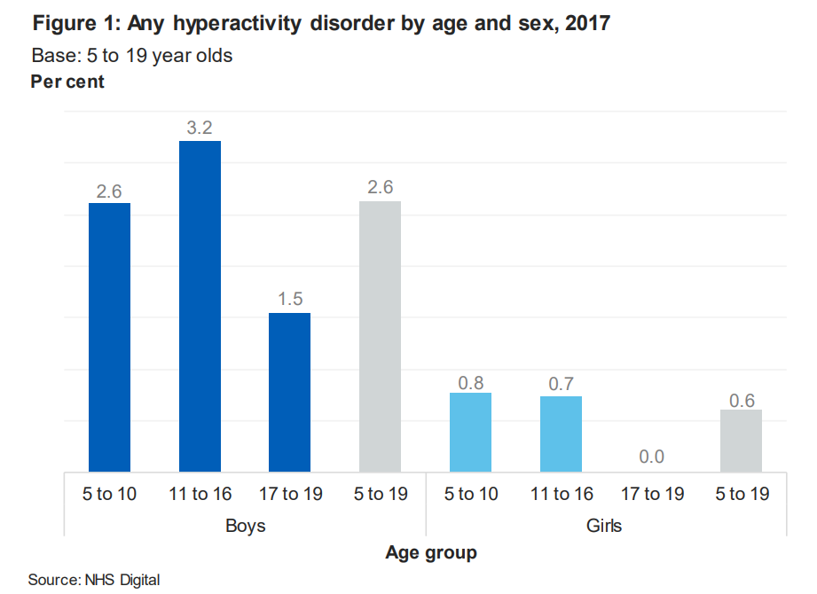
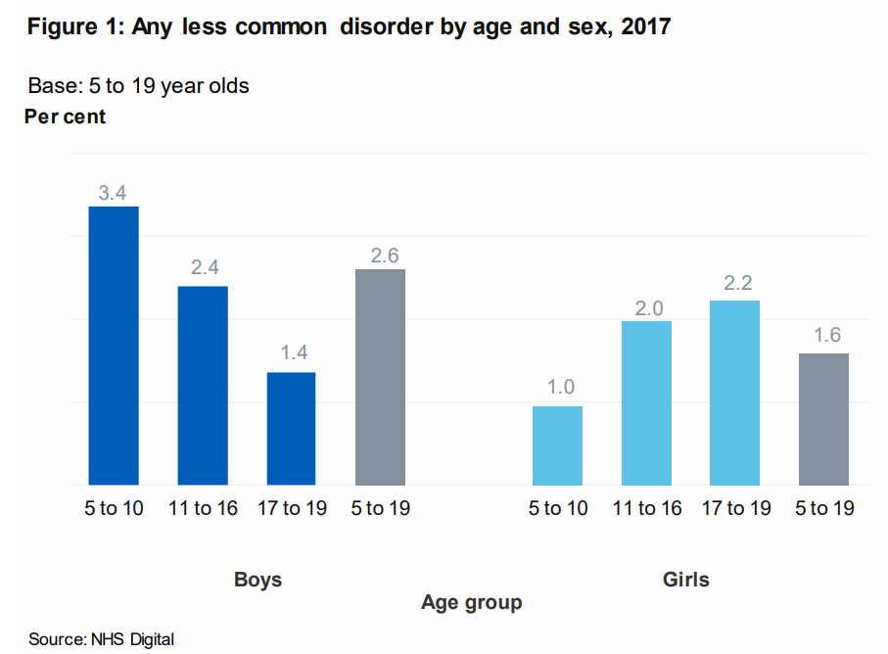
Identifying need: What are the types of mental health disorders children and young people have?
Boys aged 5 to 16 have high rates of behavioural disorders.
Young women have been identified as a high risk group in relation to emotional disorders
Emotional Disorders
Behavioural Disorders
Boys aged 5 to 16 have higher rates of hyperactivity disorders
Less common disorders include autism spectrum disorder (ASD), eating disorders and tics. These are more prevalent in boys (2.6%) than girls (1.6%)
Hyperactivity Disorders
Other less common disorders
Source:
Mental Health of Children and Young People in England, 2017

Slide 17
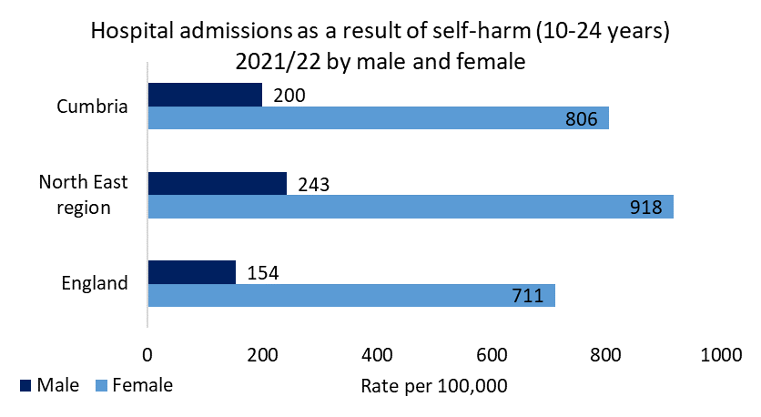
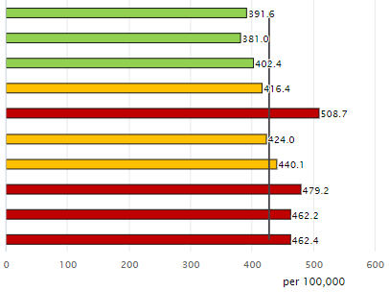
Identifying need – Hospital admissions for Self-Harm (10-24)
With poor quality data available on self-harm for A&E attendances, community and GP data it is hard to measure the full picture of self-harm in children and young people. Hospital admissions can be seen as the tip of the iceberg for the numbers who are actually self-harming but it can be used as a proxy indicator gauging increasing and decreasing rates of self-harm. With links to other mental health conditions such as depression, the emotional causes of self-harm may require psychological assessment and treatment.
Inequalities (England) by sex
Inequalities (England) by deprivation
(deciles)
Hospital admissions for self-harm ages 10-24 per 100,000 (2021/22)
Most deprived (392)
Trend Hospital admissions for self-harm ages 10-24 per 100,000
Least deprived
(462)
- NE region only
Sources:
Fingertips (including local authority level data)
Other indicators:
Self-harm by age 10-14, 15-19, 20-24
Compared to England, the North East region has a significantly worse rate of hospital admissions due to self-harm for those aged 10-24 years. When broken down into smaller age groups, the rate is still significantly worse for those aged 15-19 years and 20-24 years, but statistically similar to the national average for those aged 10-14 years.
Females aged 10 to 24 are 3 to 4 times more likely to be admitted to hospital for self-harm than males.
Rates are higher for those living in the least deprived areas
England
North East region

Slide 18
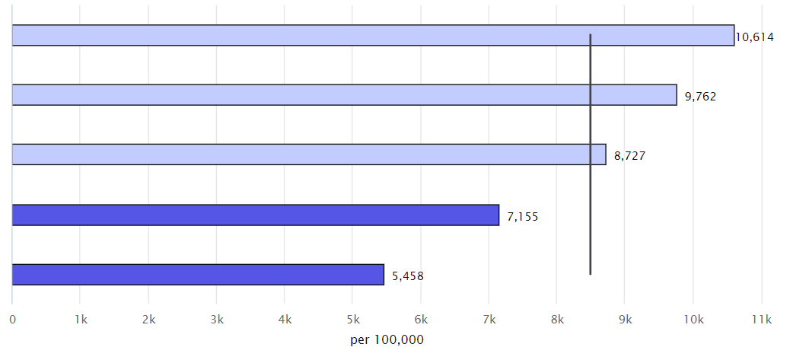
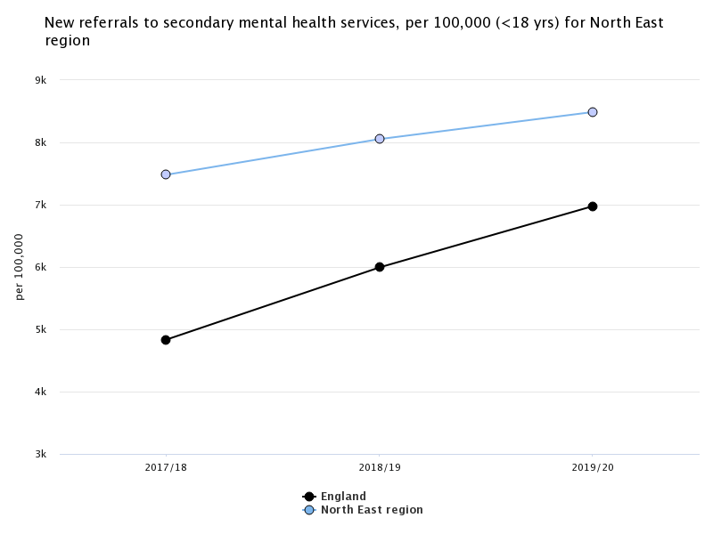
Identifying need – Demand for services – new referrals to secondary MH services
The rate of new referrals will help to assess how the demand reflects the mental health needs of the local population and if the demand can be met by current service provisions. It is a measure of the number of referrals made to mental health services in the time period which will reflect factors such as the prevalence of mental ill health in the community, the capacity of primary care services to manage this need, local secondary mental health services and the expectation that the secondary services are able to accept referrals.
The North East has a significantly higher rate of new referrals to secondary mental health services compared to England and also a higher proportion of attended contacts with community and outpatient mental health services for children and young people <18 years.
Children from the most deprived areas are nearly twice as likely to be referred to secondary mental health services the least deprived
Inequalities (North East) – deprivation (quintiles)
New referrals to secondary MH services per 100,000, (2019/20)
Most deprived(10,614)
Trend New referrals to secondary MH services per 100,000, (2019/20)
- NE region only
NE (8,488)
Least deprived (5,458)
Eng (6,977)
Sources
Fingertips (including Local authority level data)
Other indicators
Contacts with MHS
Hospital admissions for MH conditions
Link to the NHS Mental Health Dashboard for further indicators on CYP MH services

Slide 19
Useful links
Sources used in this pack
Public health profiles - OHID (phe.org.uk)
Local Health - Office for Health Improvement and Disparities
Mental Health of Children and Young People Surveys - NHS Digital
NHS England » NHS mental health dashboard
For further information please contact:
LKISNorthEastandYorkshire@dhsc.gov.uk

