Slide 1


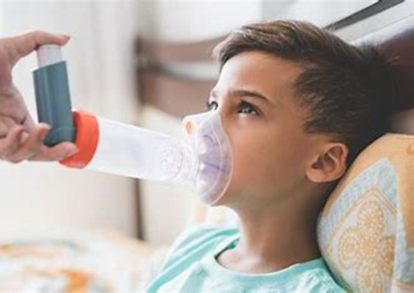
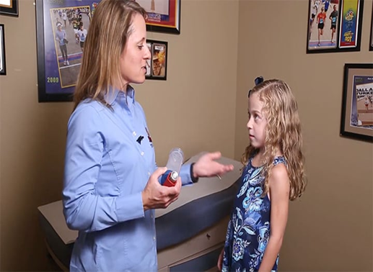
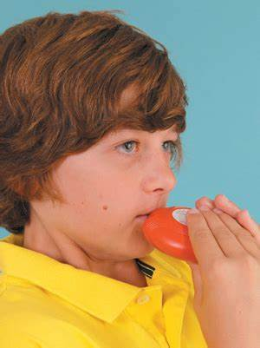


Beat Asthma Friendly School Accreditation Guide
Each slide has supporting audio, please use the speaker icon to play the recording on each slide

Slide 2
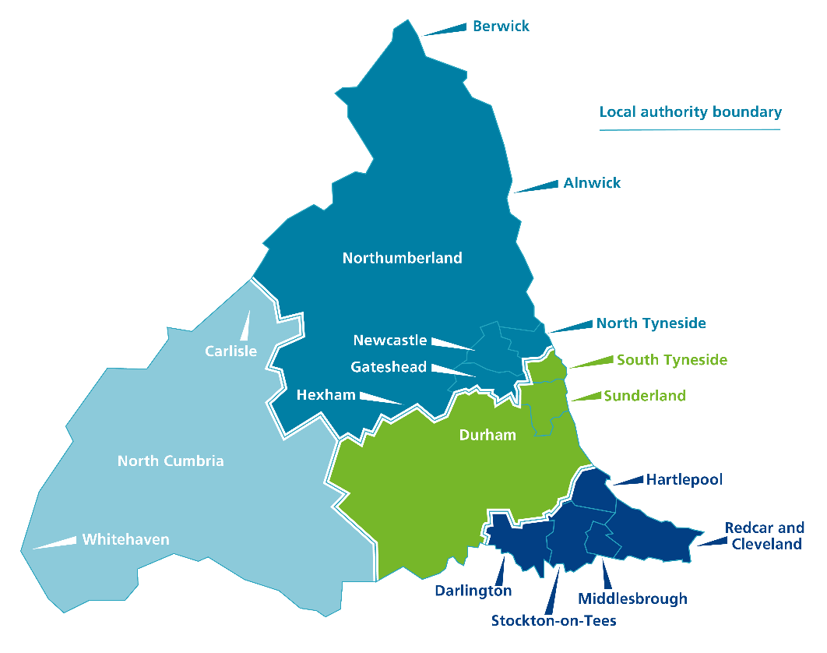
North East & North Cumbria ICS Area

Slide 3
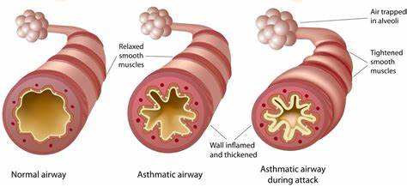
What is Asthma
Asthma is a chronic lung disease affecting people of all ages. It is caused by inflammation and muscle tightening around the airways, which makes it harder to breathe.
Symptoms can include coughing, wheezing, shortness of breath and chest tightness. These symptoms can be mild or severe and can come and go over time.
Although asthma can be a serious condition, it can be managed with the right treatment. People with symptoms of asthma should speak to a health professional.
Asthma (who.int)

Slide 4
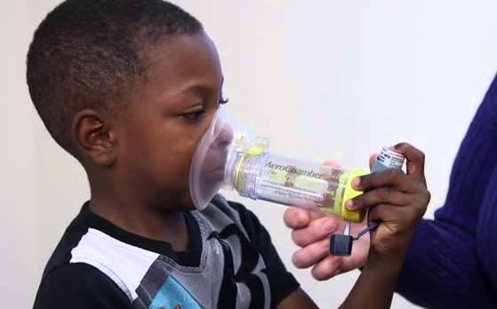
Asthma
Asthma is the most common long term medical condition in children and young people
Around 1 in 11 children live with Asthma
Outcomes for children and young people living in deprived areas are worse.
The UK has one of the highest emergency admission rates for Asthma in Europe
There are over 25,000 emergency hospital admissions for Asthma amongst children a year in the UK
Asthma is a main contributor to school days lost
(National bundle of care for children and young people with Asthma – September 2021)

Slide 5
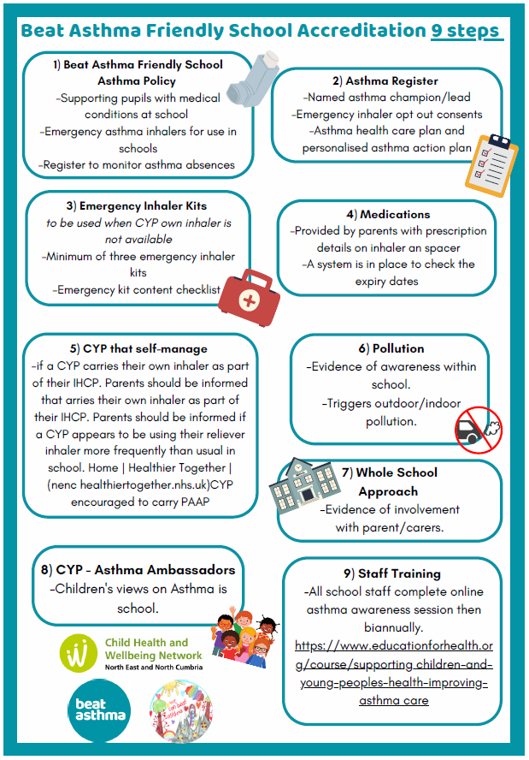
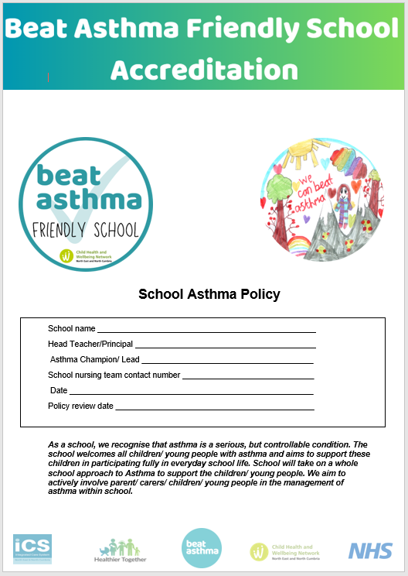
Accreditation Steps

Slide 6
Policy
Link to accreditation pack

Slide 7

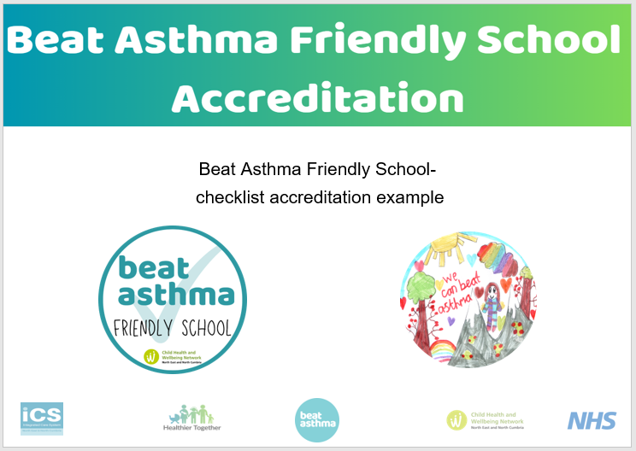
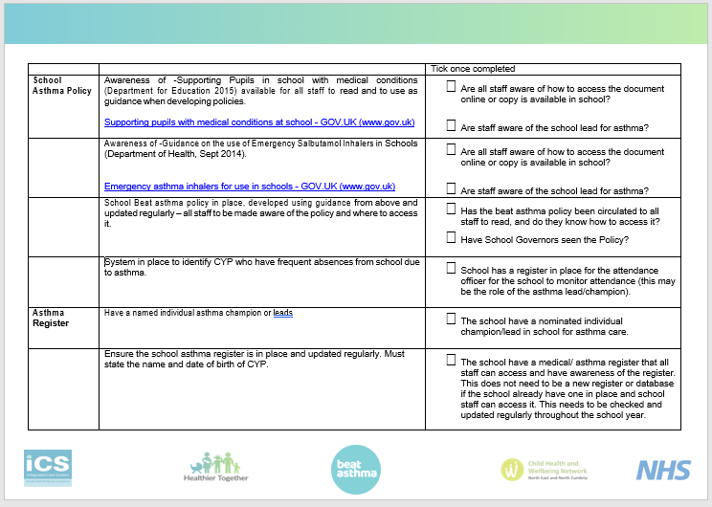
Step 1
Click here to view the completed checklist example

Slide 8
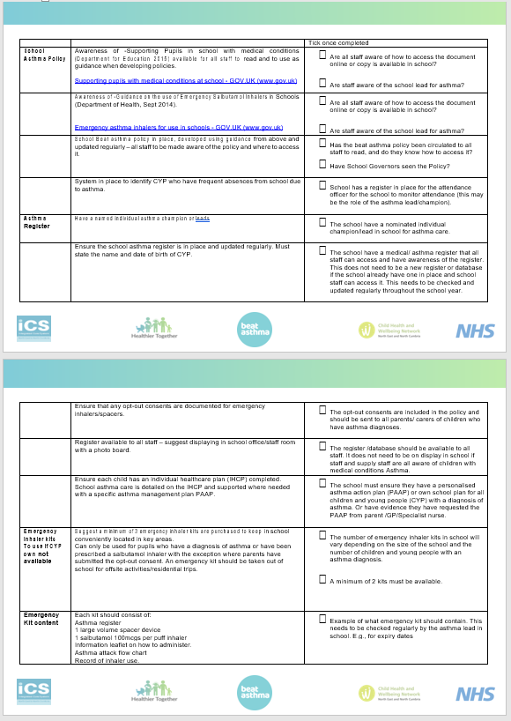
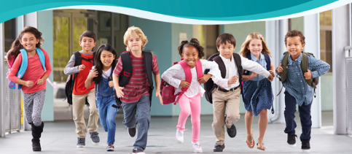
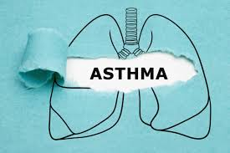
Step 2
Click here to view the completed checklist example

Slide 9
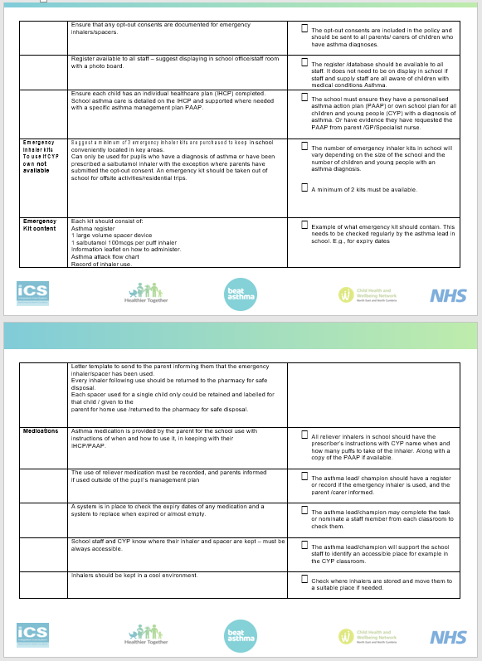
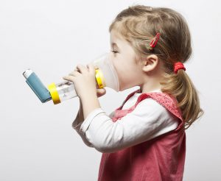
Step 3
Click here to view the completed checklist example

Slide 10
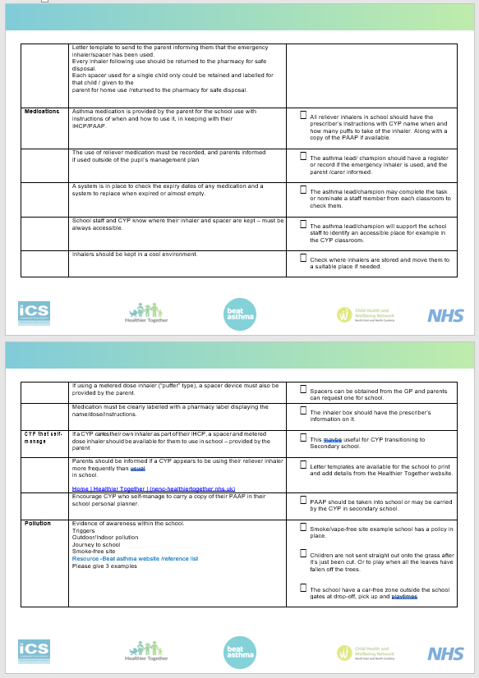
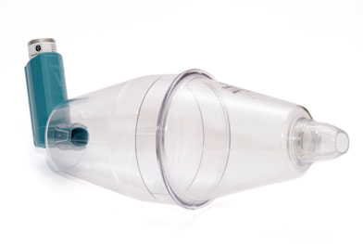
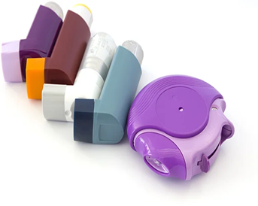
Step 4
Click here to view the completed checklist example

Slide 11
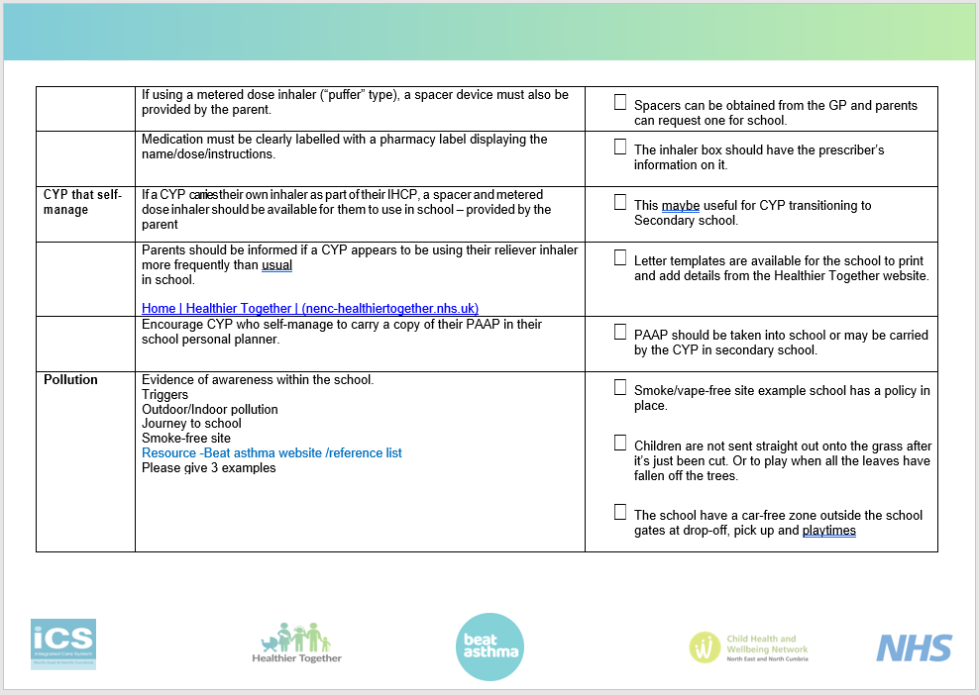

Step 5
Click here to view the completed checklist example

Slide 12
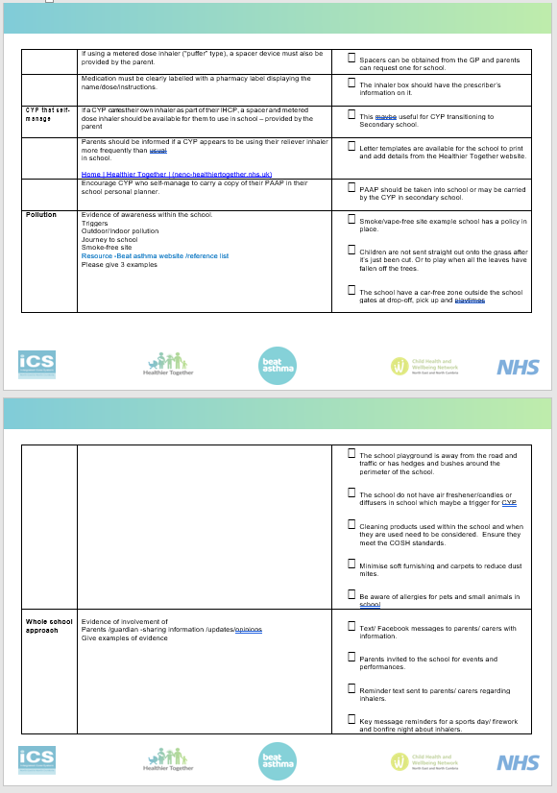

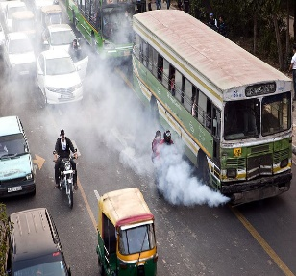
Step 6
Click here to view the completed checklist example
This Photo by Unknown Author is licensed under CC BY-SA

Slide 13
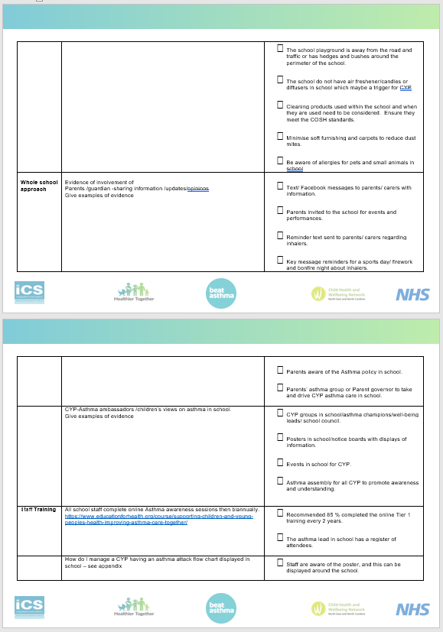
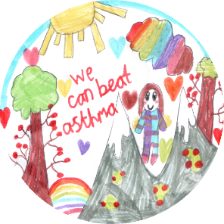


Step 7 & 8
Click here to view the completed checklist example

Slide 14
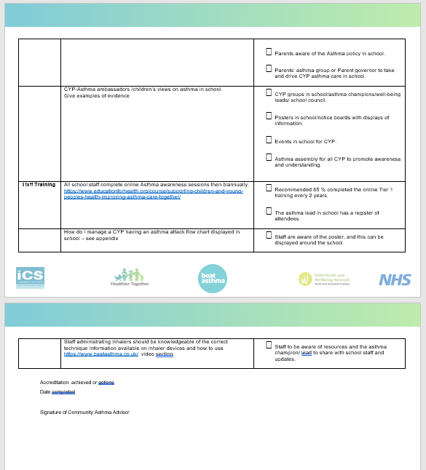

Step 9
Click here to view the completed checklist example

Slide 15
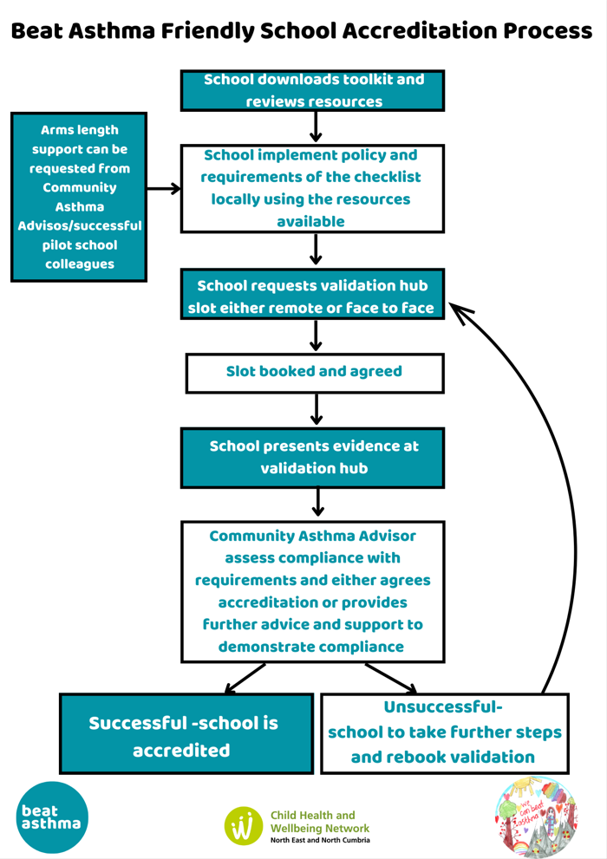
How to become a Beat Asthma Friendly School: Validation Process
More information available online:
https://www.nenc-healthiertogether.nhs.uk/resources/child-health-and-wellbeing-network-chwn-shared-resources/beat-asthma-friendly-schools-chwn
Contact details for Community Asthma Advisors:
Carol Barwick c.barwick@nhs.net
Clare Caygill clare.caygill@nhs.net

Slide 16
Resources & References
NHSE
https://www.england.nhs.uk/publication/national-bundle-of-care-for...
National bundle of care for children and young people with asthma
National bundle of care for children and young people with asthma: resource pack
Beat Asthma
https://www.beatasthma.co.uk/
NICE guidance (2017)
https://wwwAsthma + Lung UK (blf.org.uk).evidence.nhs.uk/search?q=ASTHma+guidelines+in+children
BTS Sign (2019)
https://www.brit-thoracic.org.uk/document-library/guidelines/asthma/...
National-Capabilities-Framework.pdf (e-lfh.org.uk)
Healthier Together
Home :: Healthier Together (what0-18.nhs.uk)
Asthma and Lung UK
Asthma + Lung UK (blf.org.uk)
NICE
https://www.nice.org.uk/guidance/ng149/resources/visual-summary-pdf-7022755693

Slide 17

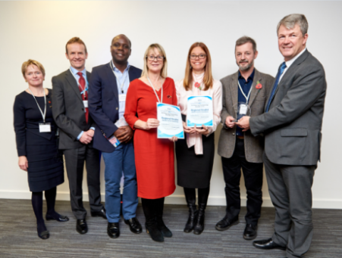

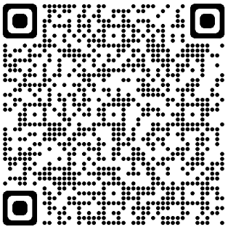
Thank You
Please follow, share and retweet relevant work so that we can continue to share good practice across the region at the Child Health and Wellbeing Network handle @EveryChildNENC
Visit our website - nhsjoinourjourney.org.uk/what-we-are-doing/priorities/optimising-health-services/child-health-and-wellbeing-network/
Please encourage colleagues from all areas of Child Health and Wellbeing to register click the link forms.gle/gG11zhr2Z8VLU2db9 or scan our QR code
Contact us: england.northernchildnetwork@nhs.net

